Slide 1
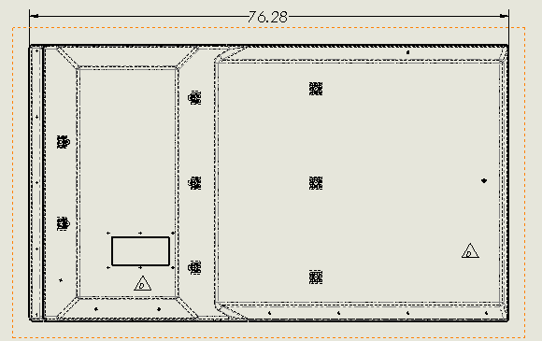
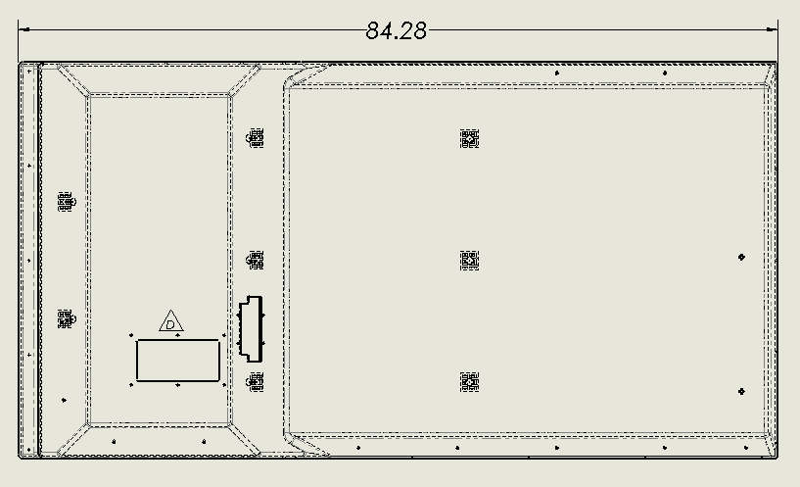
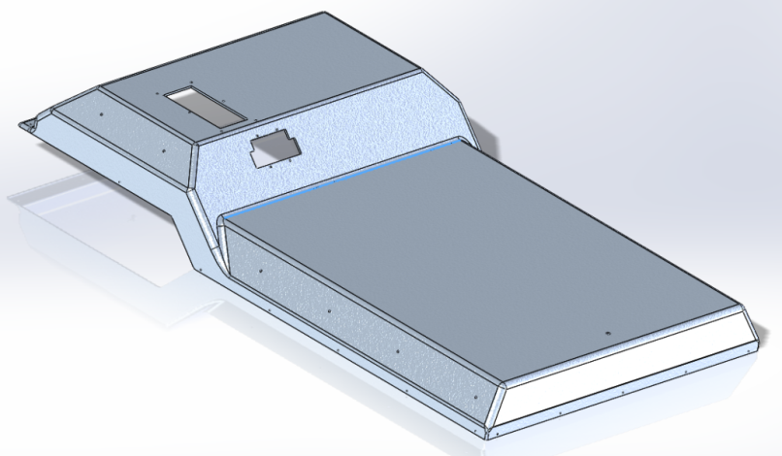
SUTPHEN CORPORATION
SALES TECHNICAL BULLETIN
ENGINE HOOD LENGTH’S
OVERVIEW
Trucks with ISX engines can only have the full length hood.
Trucks with ISL engines have the option of a full length hood or a shorter hood (8” shorter in length).
Full Length Hood
Advantage: Additional space on the engine hood are between the driver and officer (where center consoles/tool boards are installed. approximately 8” of additional space, front to rear.
Disadvantage: Less leg room for the occupant in the forward facing seats on the crew seat riser.
Short Length Hood
Advantage: Additional leg room for the forward facing crew seats on the crew seat riser.
Disadvantage: less space on the engine hood are between the driver and officer.
Any questions please contact your SAE.
STB-0030 – ENGINE HOOD LENGTH’S

