Slide 1
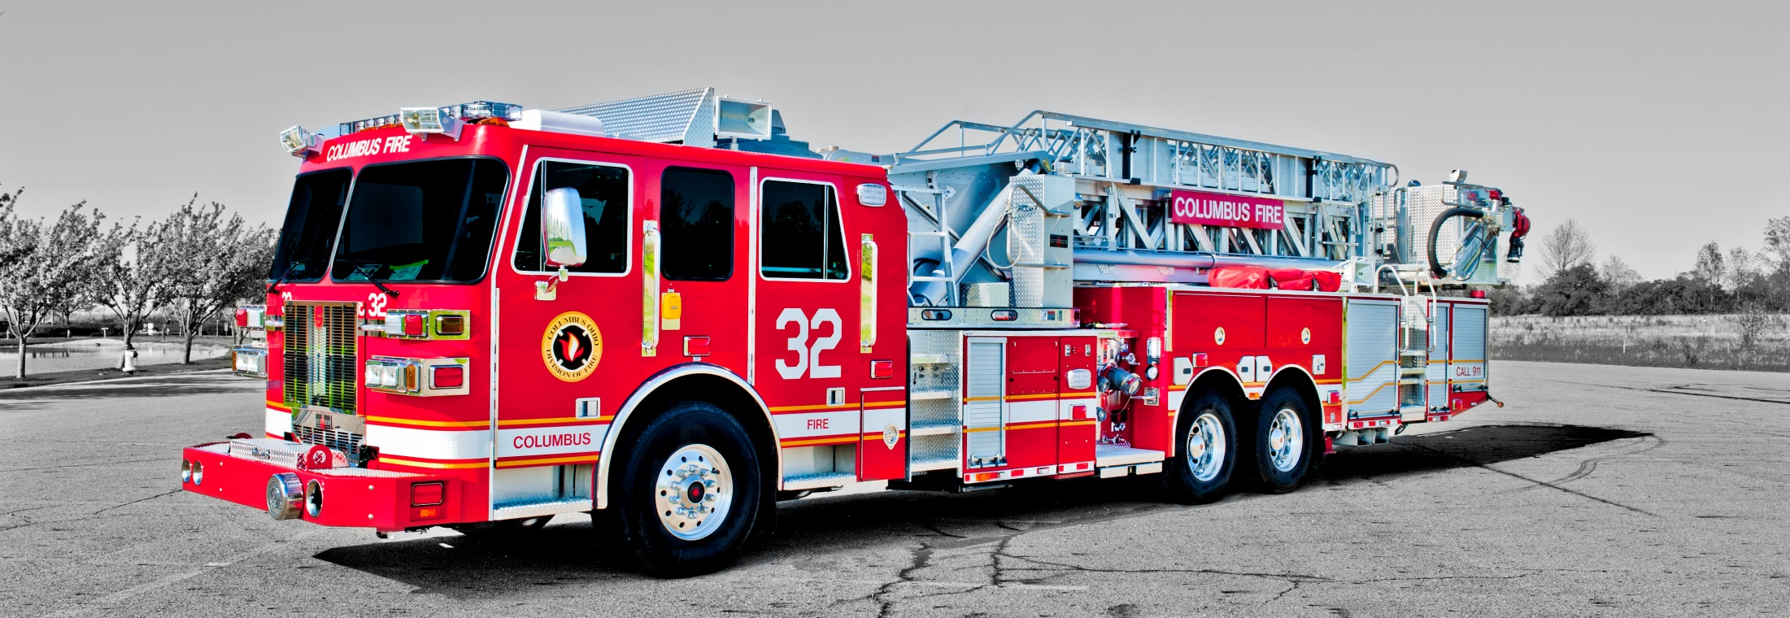
Sutphen Corporation
A Family Owned Business Since 1890

Slide 2
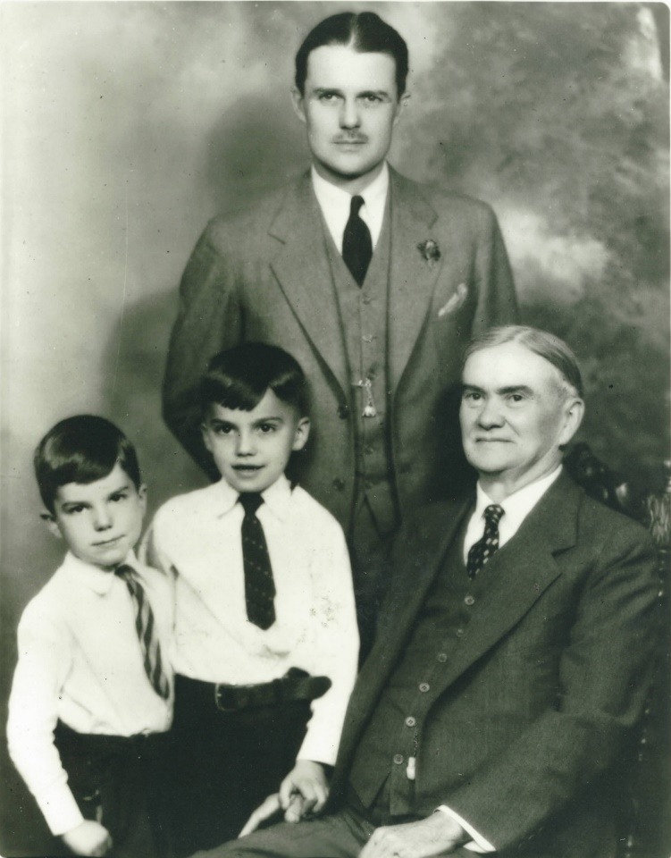
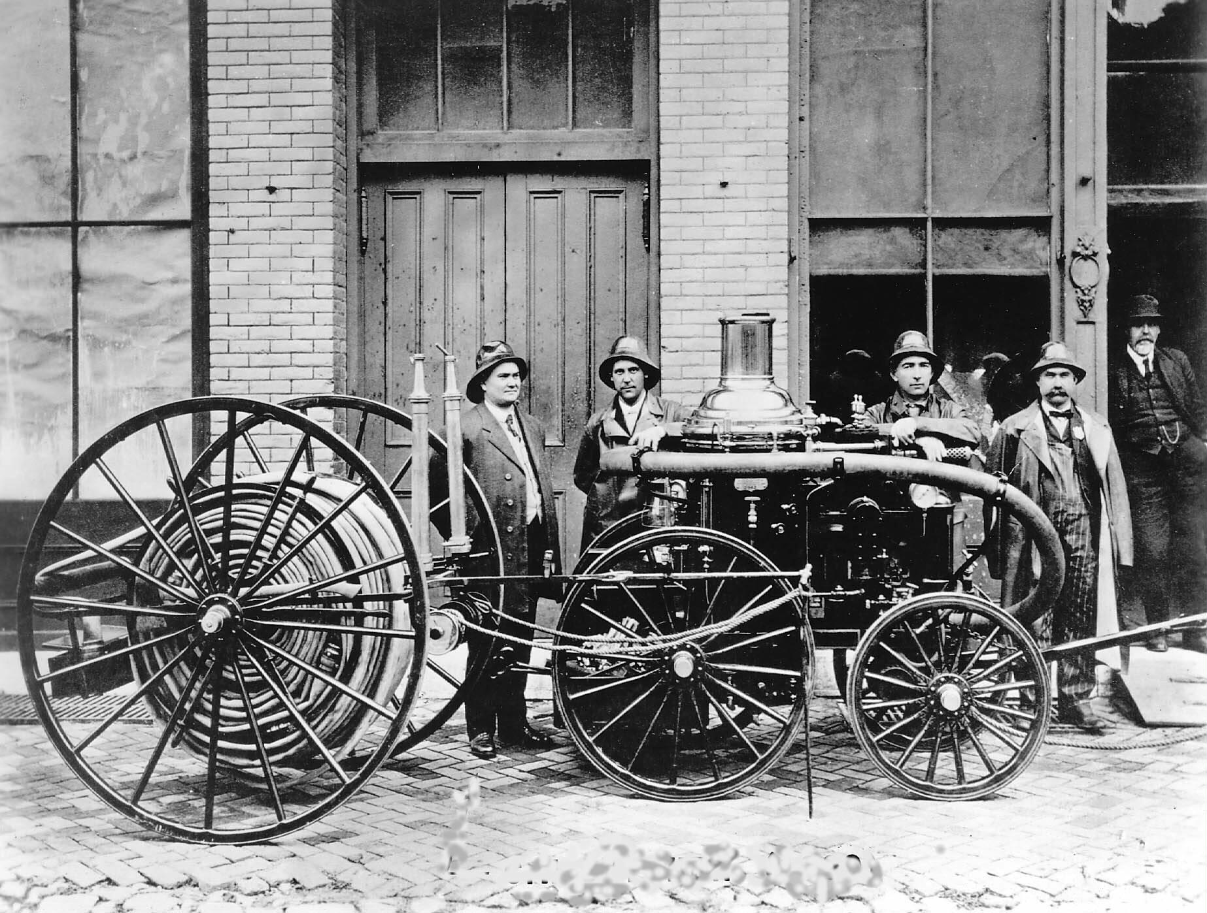
Our Company History
1890 - C.H Sutphen founded Sutphen Corporation
From Left to Right:
Thomas Sutphen
Robert Sutphen
Harry Sutphen
C.H. Sutphen
1923
C.H. Sutphen and steam powered fire truck
First Generation – C.H Sutphen founded Sutphen Corporation in 1890.
Second Generation – C.H Sutphen’s son，Harry Sutphen, managed the Company from 1931 to 1960.
Third Generation – C.H’s grandsons, Tom and bob Sutphen jointly managed the company from 1940s to 1970s.
Fourth Generation –Tom’s daughter, Julie Sutphen Phelps, and Bob’s son, Drew Sutphen, who are currently leading the company since the 1970s.
Notes:
I am going to start off with just a brief history of the Sutphen Corporation.
The man on the far left of this photograph, Clarence Sutphen. He delivered this steamer to Urbana, OH in 1890. In the early 1930’s, Clarence’s had one son Harry Sutphen who took over the business and continued to expand it. Harry has two sons, Bob and Tom who followed along after their service in WWII, and grew Sutphen to a Nation and world player in the aerial platform market. Sutphen Corp is presently under the guidance of Drew Sutphen (Bob’s) son and is part of the forth generation at the helm of the company. The fifth generation has recently began taken various positions with the company.
Sutphen currently builds about 30% of all of the aerial platforms in the US and about 85% of the mid-mount units.

Slide 3
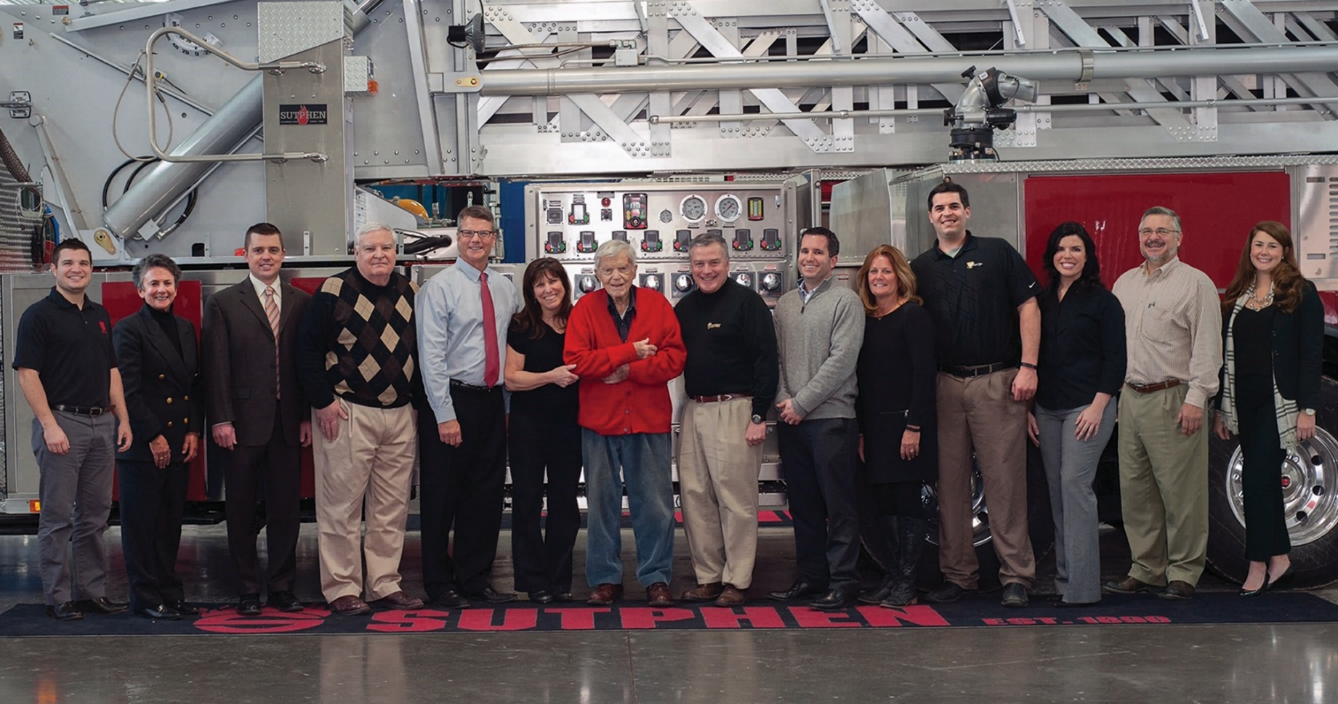
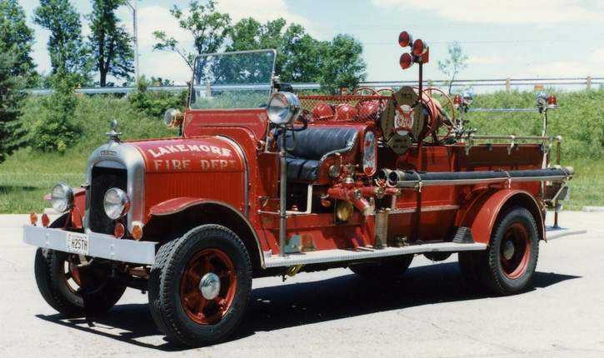
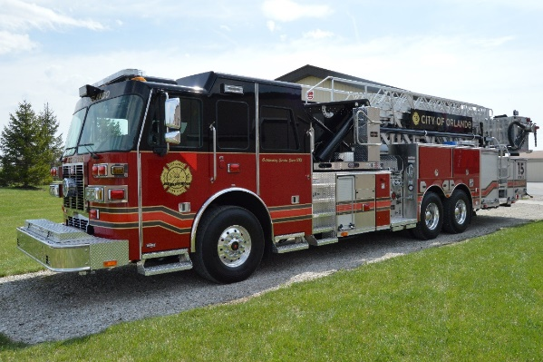
Our Mission
To build the safest, most reliable, fire apparatus in the world through innovation and customer focus.
Sutphen Family Picture taken in 2015

Slide 4
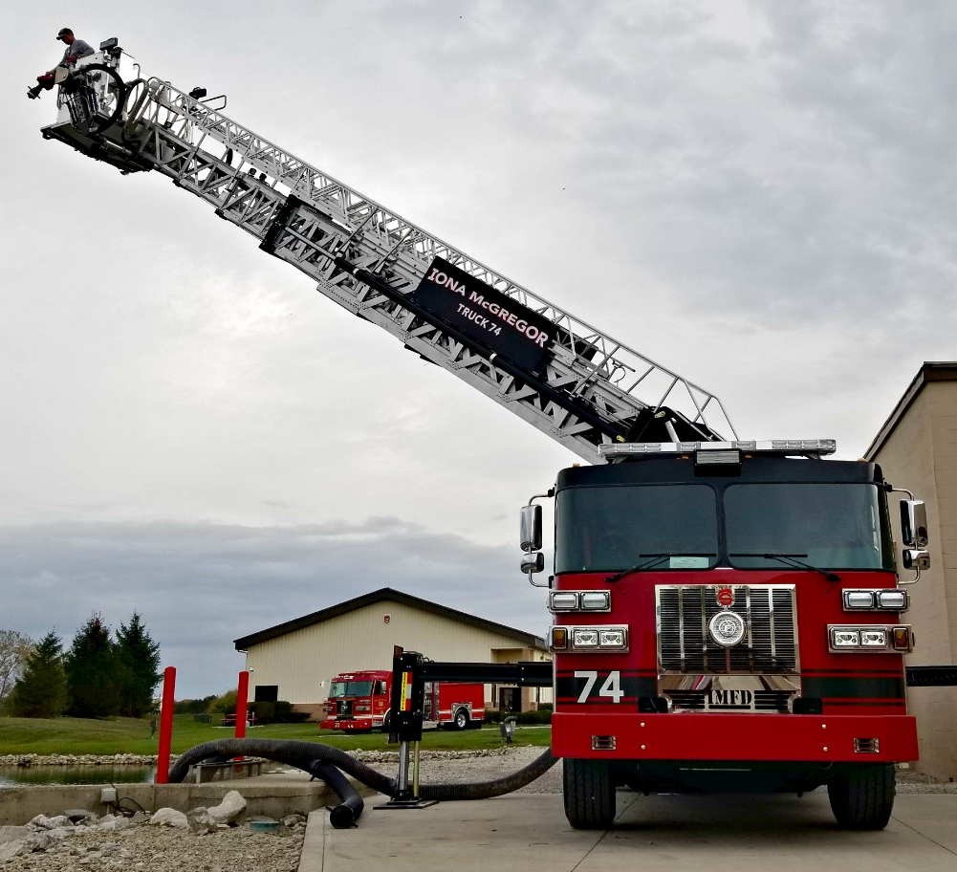
Sutphen SPH Key Components
SPH Standard Profile
Sole Source Manufacture
Mid-Mount Aerial Device Design
Benefits of Box Boom Structure
Huck Bolt Fastening Technology
Aerial Flow
Stabilizer/Outrigger System
Water Tank configurations
Generator Placement
Platform Benefits
Wrap Up

Slide 5
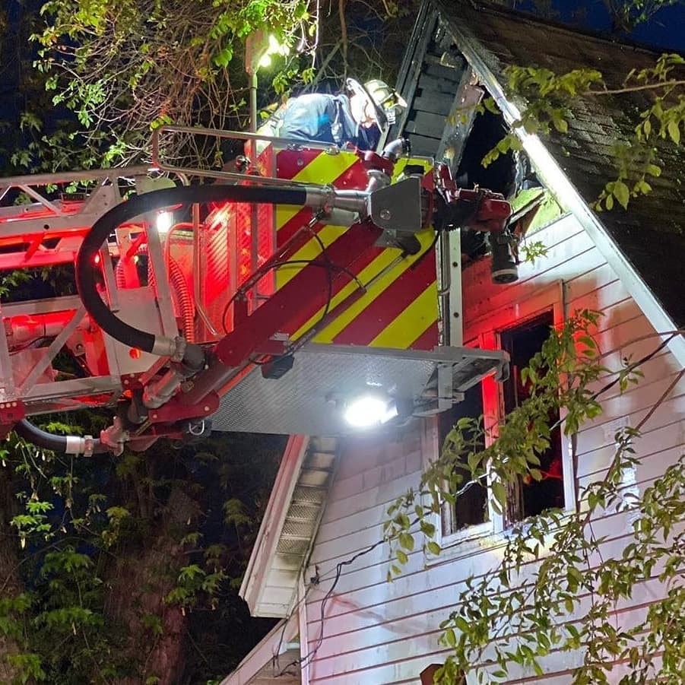
Standard Profile
Standard Length – 46’
Standard Height – 11’ 6”
Low Profile option – 10’ 0”
Min Wheelbase – 230” (56” cab)
Max Wheelbase – 247” (73” cab)
Standard Weight – 68,000 lbs
Vertical Reach – 100’
Horizontal Reach – 89’ 4”
Tip Load – 1000 lbs dry
500 lbs wet
(1) set of stabilizers/outriggers – out and down
(2) sets of jacks – straight down

Slide 6
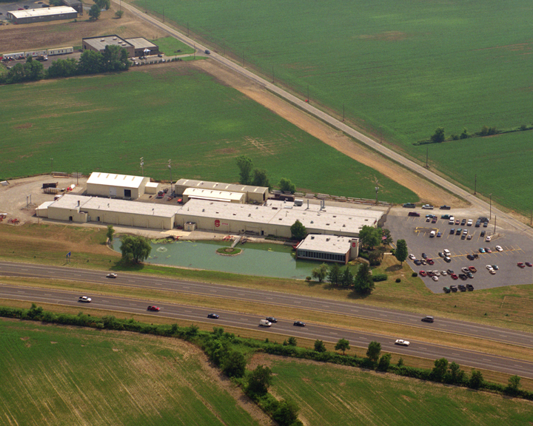
Located in
Dublin, Ohio
Sutphen Corporation Headquarters

Slide 7
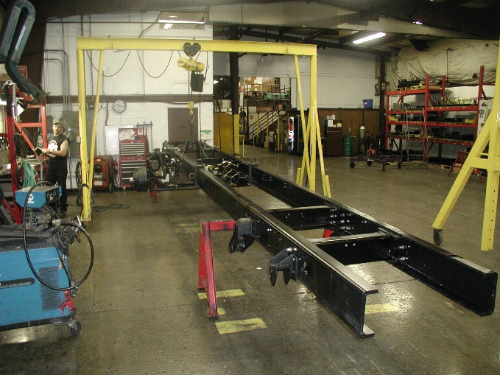
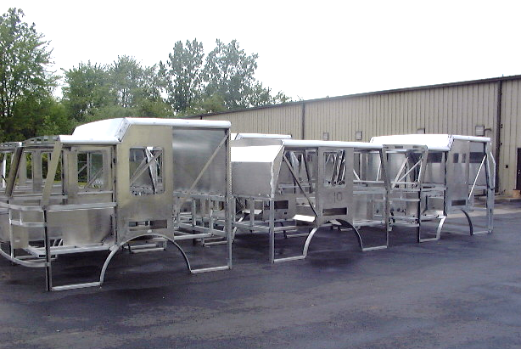
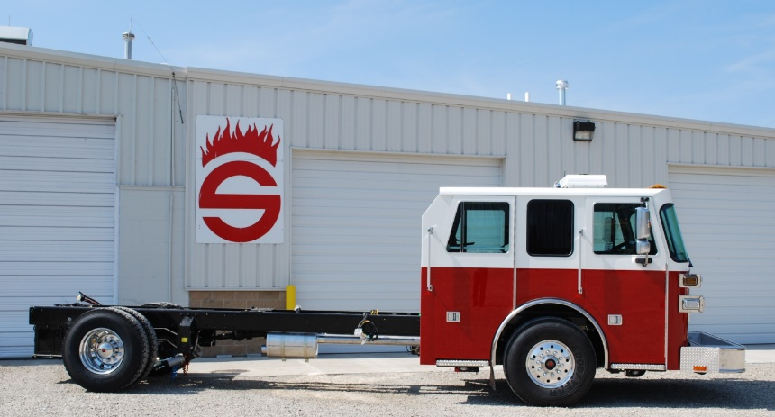
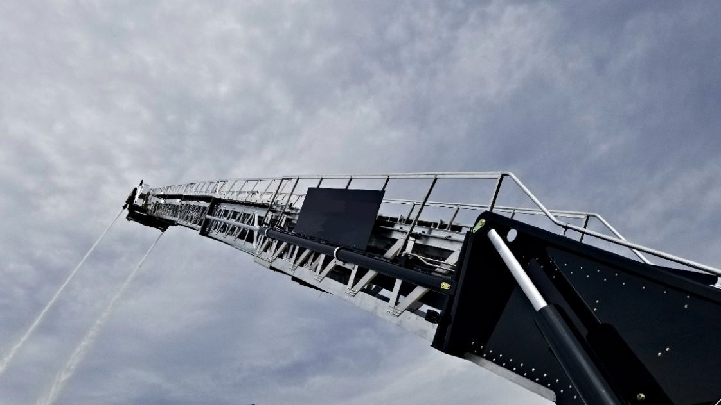
Single Source Manufacturer
Sutphen manufactures:
Cab
Chassis
Body
Aerial Ladder and Platform
Eliminating customer’s need to seek after-sales service from multiple manufacturers.

Slide 8
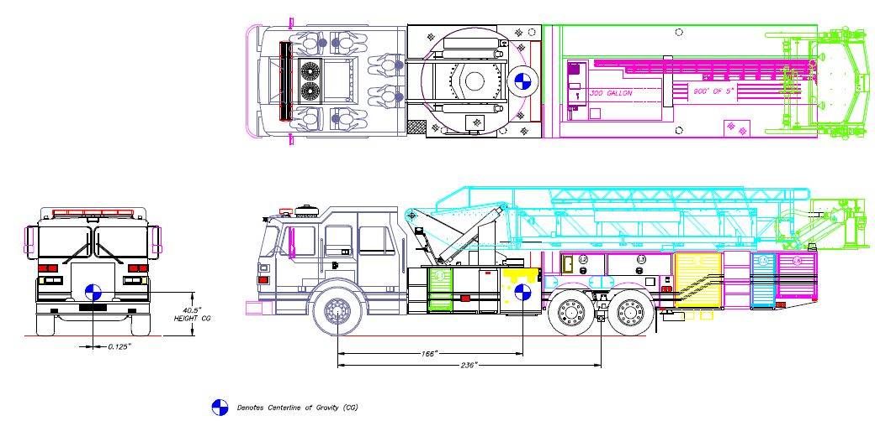
Aerial Device Mid-Mount Design
Truck feature: Base of aerial device is in the center of the truck
Benefit and Value: Lower center of gravity – better weight distribution: providing excellent drivability with outstanding stability and maneuverability
SUTPHEN MODEL | NFPA CG REQUIREMENTS | SUTPHEN CG
SPH 100 Arial Platform | 58.6” | 40.5”
SL 100 Arial Ladder | 58.6” | 49.1”
SP 95 Aerial Platform | 58.6” | 34.7”
SP 70 Aerial Platform | 58.6” | 51.5”
Custom Pumper | 58.6” | 52.4”

Slide 9
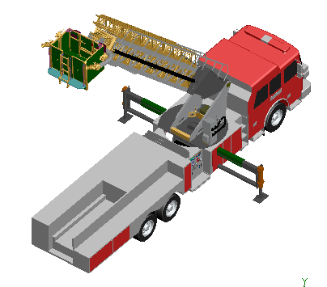
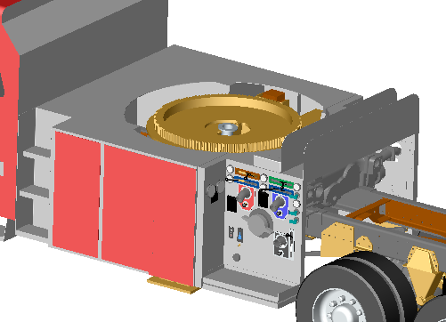
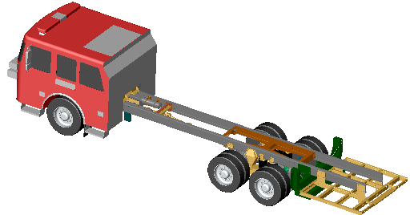
Aerial Device Mid-Mount Design
Every Sutphen fire truck is built with advanced 3D engineering modeling to ensure safety, performance and fit.

Slide 10
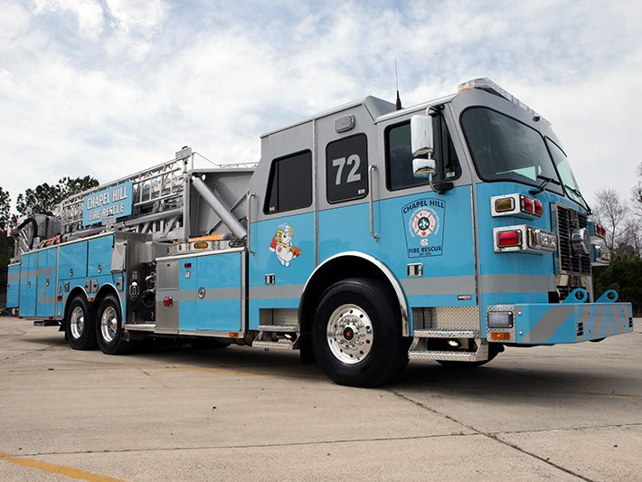
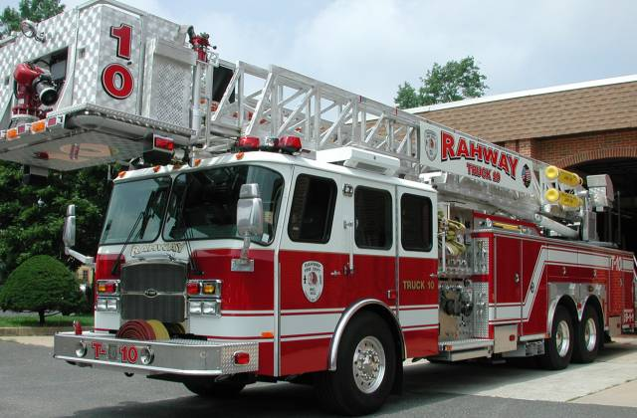
Aerial Device Mid-Mount Design
Truck Feature: The bucket/platform is located at the rear of the truck
Benefit and Value:
  Providing unobstructed visibility for driver, safer for firefighters
  Lower overall height to fit in stations and constricted areas
  Able to tilt cab for engine maintenance without lifting aerial device
Sutphen’s Mid-mount Aerial Platform
Rear-mount Aerial Platform
No obstruction of
driver’s view.
Blocking driver visibility for traffic lights, etc.
VS.

Slide 11
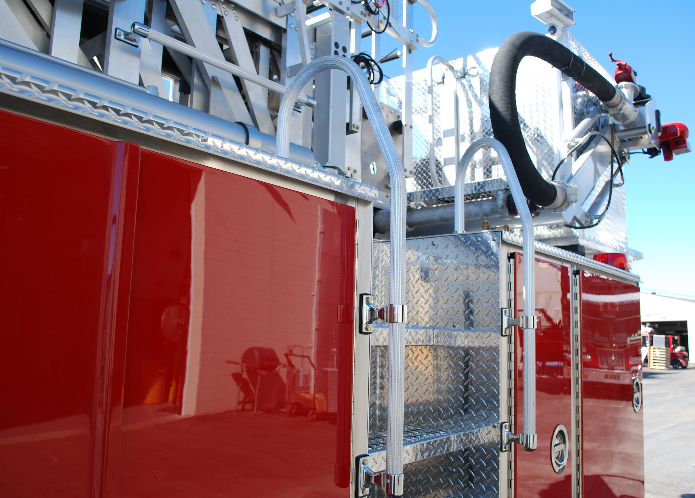
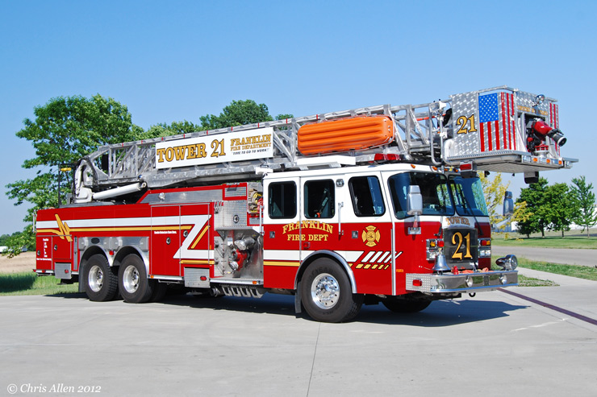
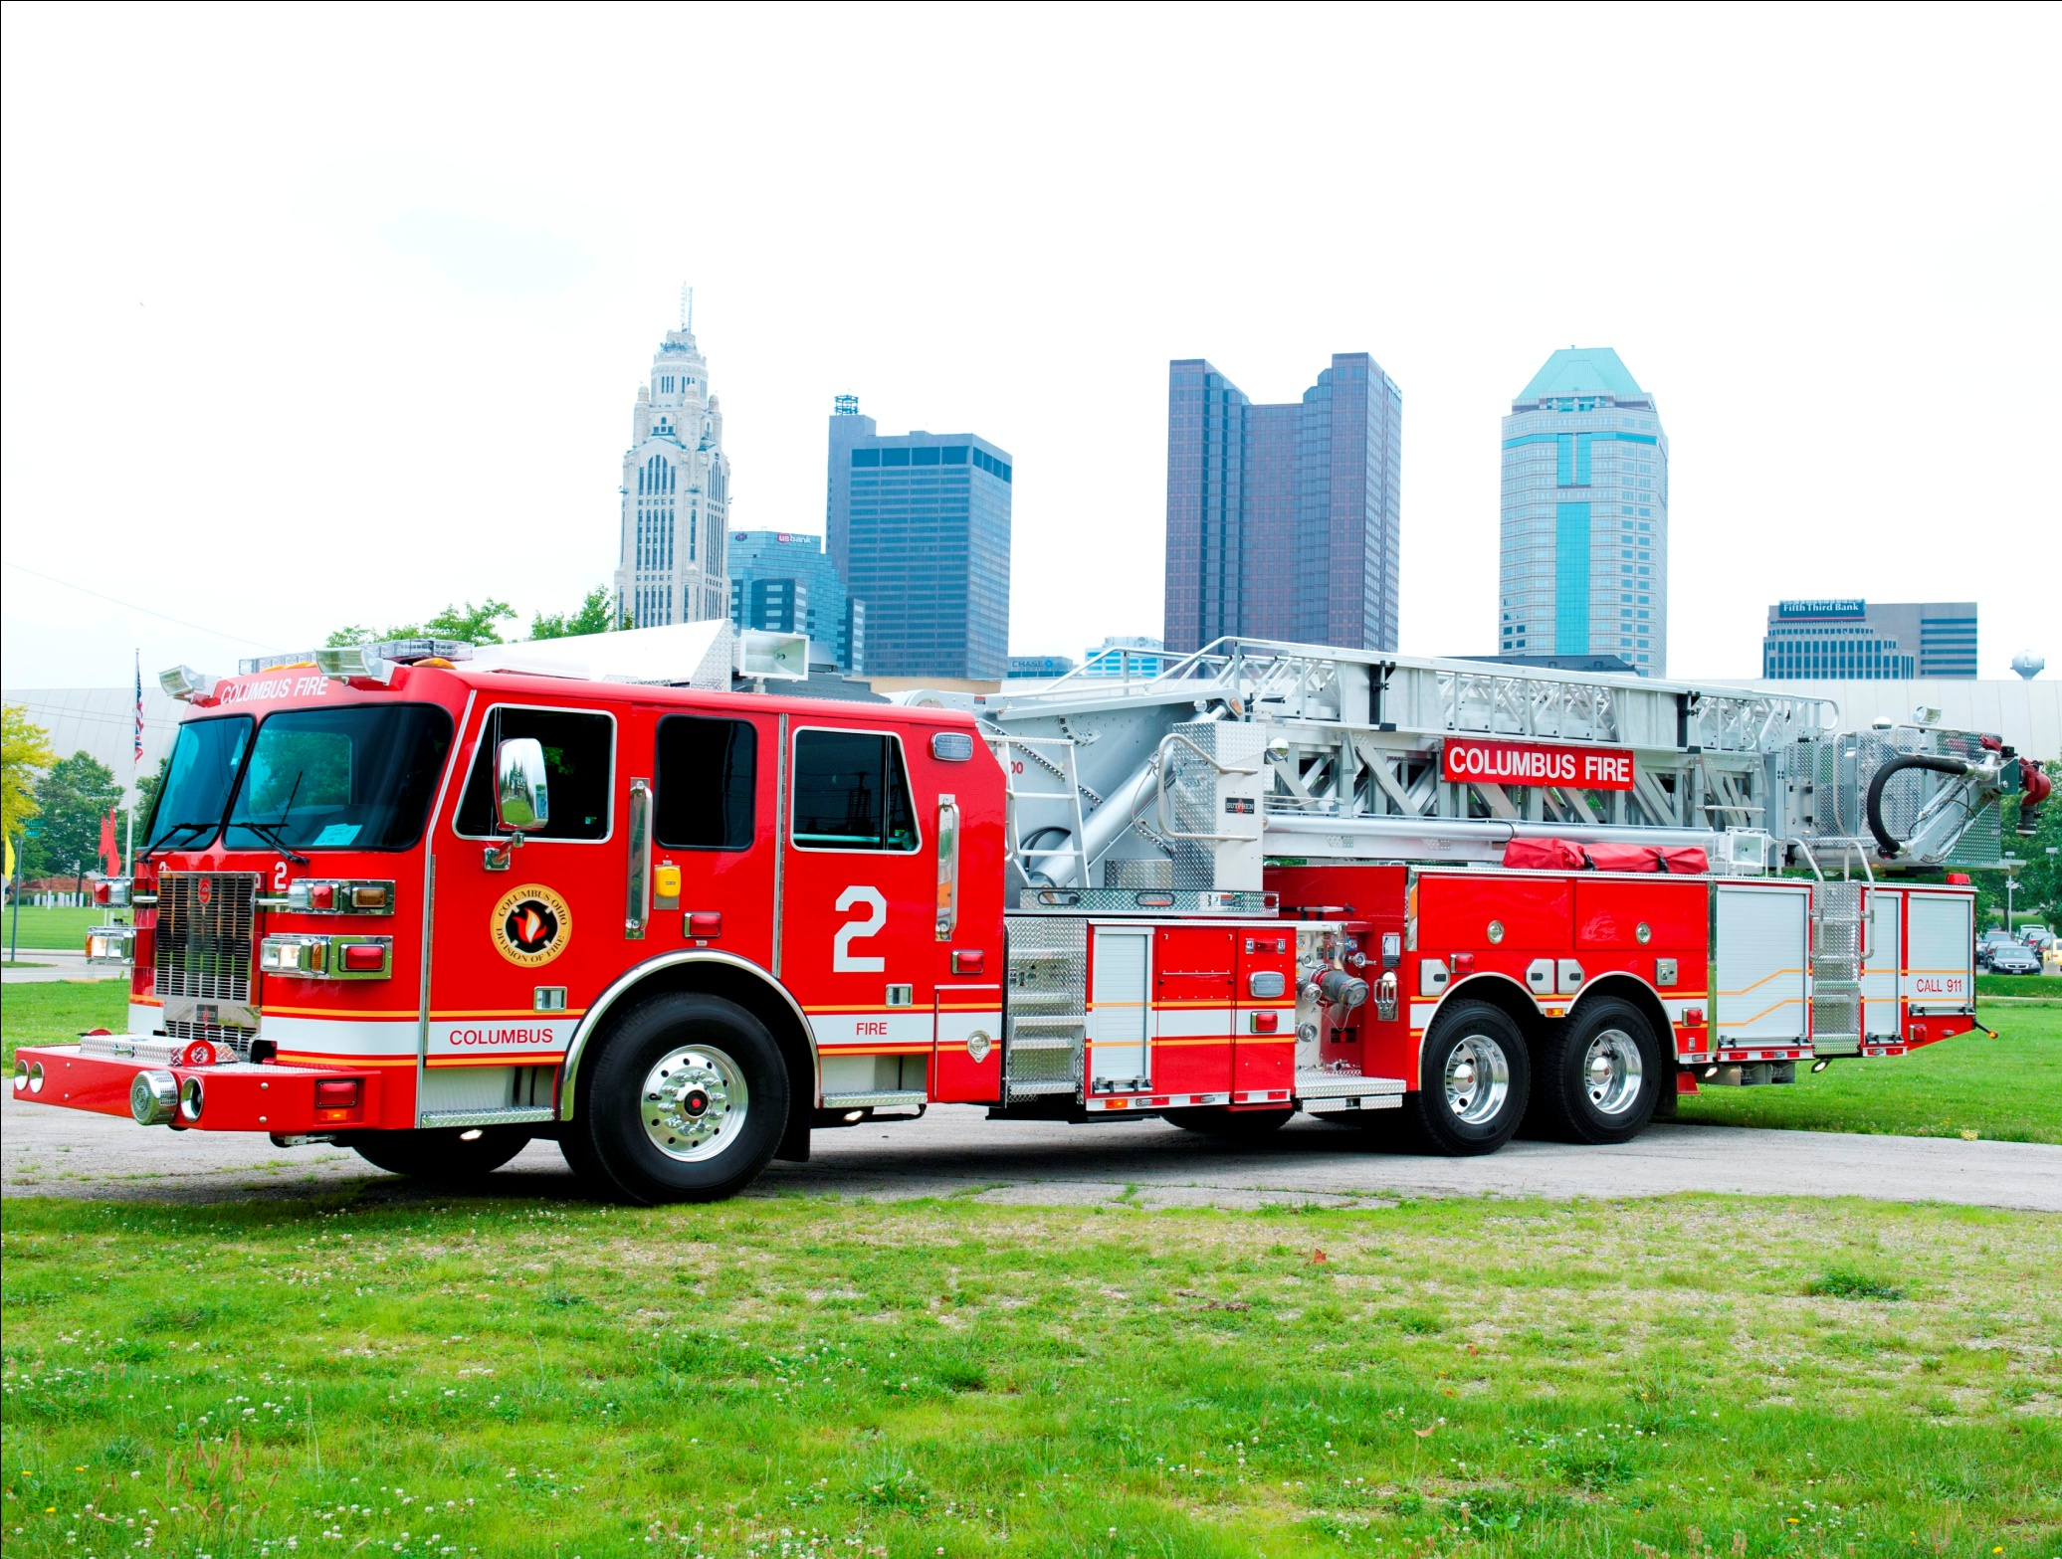
Aerial Device Mid-Mount Design
Truck feature: Rear access ladder provided to enter bucket quickly
Benefit and Value: Greatly shorten the set up time for aerial operation, gaining valuable minutes and seconds to save lives and property
Have to walk across ladder to enter platform.
Quick, easy access to platform
VS.
Rear Mount Aerial
Sutphen Mid-Mount Aerial

Slide 12
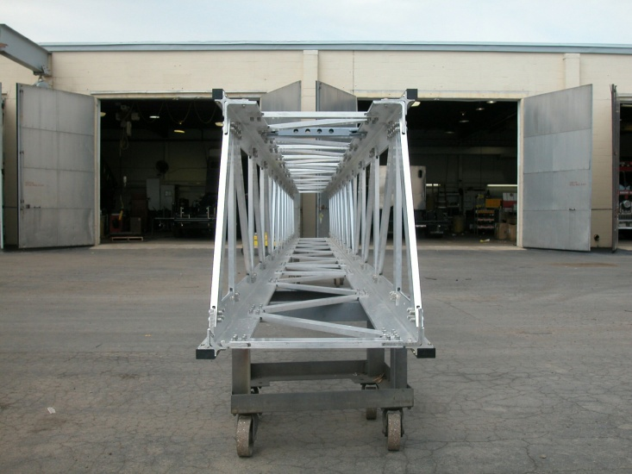
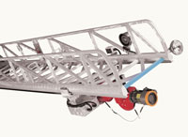
Aerial Device Box Boom Structure
Truck Feature: aerial structure’s four-sided box design
Benefit and Value:
  Providing maximum strength, no twisting in the air, unmatched structural safety factor of 3:1 in the industry
  No load chart. Aerial will operate at full capacity anywhere within the operating envelope regardless of elevation and extension.
Sutphen’s Four-sided Box Boom Aerial design
Three sided Aerial Design
VS.

Slide 13
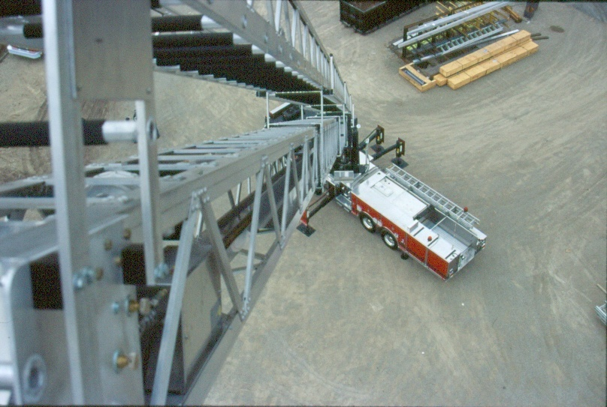
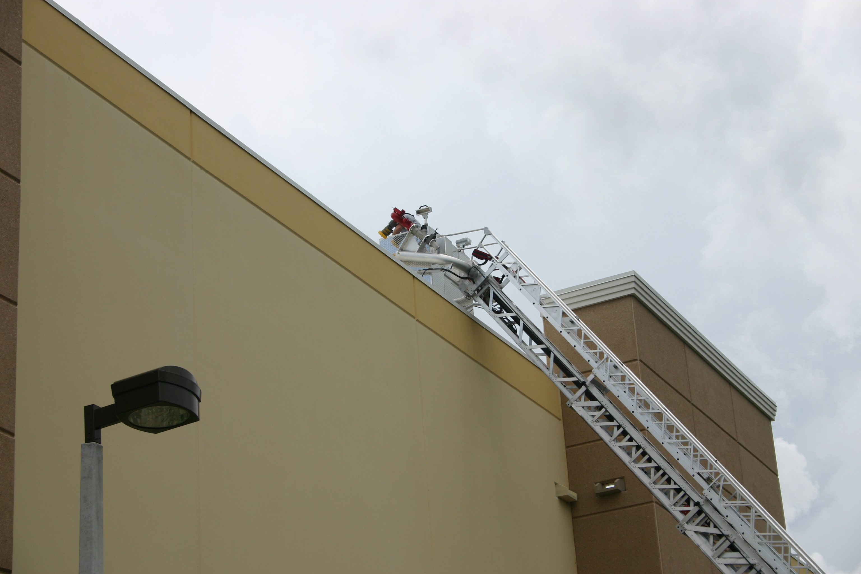
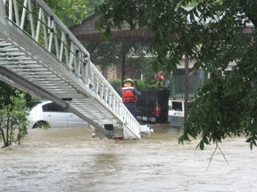

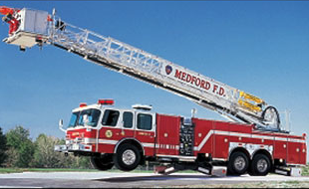
Aerial Device Box Boom Structure
Truck Feature: The entire waterway, electrical cables and breathing air system are inside the four-sided box boom structure.
→ Benefit and Value: Maximum protection for these systems.
VS.
Sutphen’s Box Boom
Three-sided Ladder

Slide 14
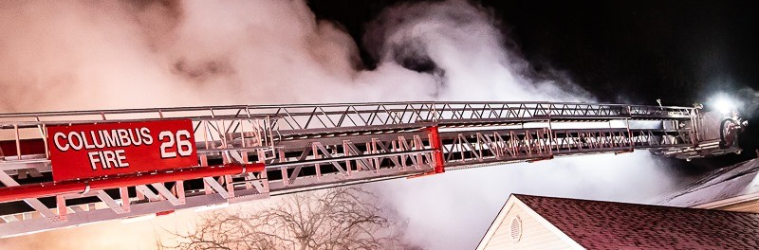
Huck Bolt Fastening Technology
Truck Feature: The aerial device is entirely constructed of 6061-T6 aluminum and aluminum Huck Bolts.
Benefit and Value, due to the material we use:
  Aluminum aerial dissipate heat better, extending the longevity of the aerial device.
  Sutphen’s Huck bolted aluminum aerial device weigh 10,000lbs to 20,000lbs less than welded aerials.
  The lighter weight aerial system means lighter overall vehicle weight, which means Sutphen’s aerial fire trucks provide better braking, better acceleration, as well as less chassis wear and tear, resulting in the outstanding durability and longevity of Sutphen aerial fire trucks.
Notes:
Sutphen’s 4-sided box-boom design performs like a tube, providing maximum rigidity versus most other brands’ 3-sided open-channel designs, which can twist from wind and weight. The company’s box-boom technology and HuckBolt® fasteners are two of the major engineering factors allowing Sutphen to offer a lighter, taller telescopic platform with the highest fully extended flow rate in the industry. The lighter aerial gives Sutphen a lower Gross Vehicle Weight Rating (GVWR) on tires and axles versus competitors’ products. And because all apparatus manufacturers use the same size brakes and engines, this means Sutphen apparatus offer superior braking performance and better acceleration than the other heavier apparatus on the market today. Lower overall weight means that Sutphen aerials only need two “out-and-down” outriggers for support – one on each side – versus the four required on comparative trucks.

Slide 15
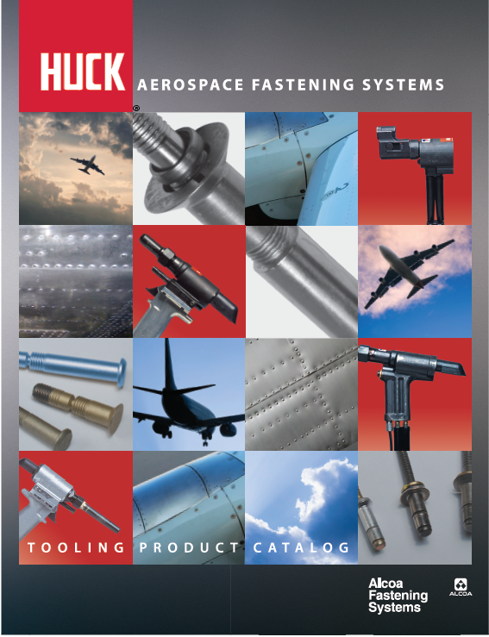
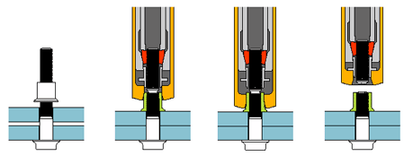
Huck Bolt Fastening Technology
Huck bolt fastening technology has been widely used by high performance products, such as satellite and airplane.
Sutphen is the only fire truck manufacturer in the world that integrate the Huck bolt fastening technology on fire truck’s aerial device.
The entire Sutphen aerial is fastened together by Huck bolts.

Slide 16
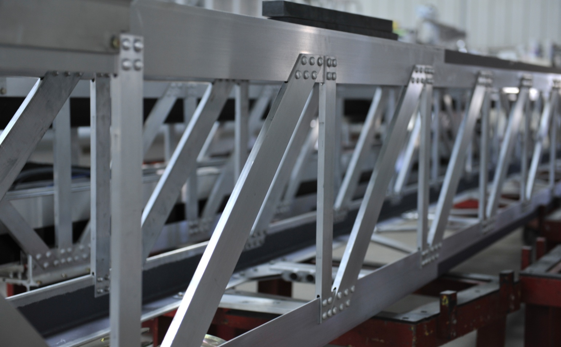
Huck Bolt Fastening Technology
Truck Feature: No welding, the entire aerial device is fastened together by Huck bolts.
Benefits and Value:
  No cracking like welded aerial, ease of inspection, ease of maintenance.
  Saving your fire department valuable time and cost in service and maintenance.
Easy to inspect
Huck Bolt Fastening
Technology

Slide 17
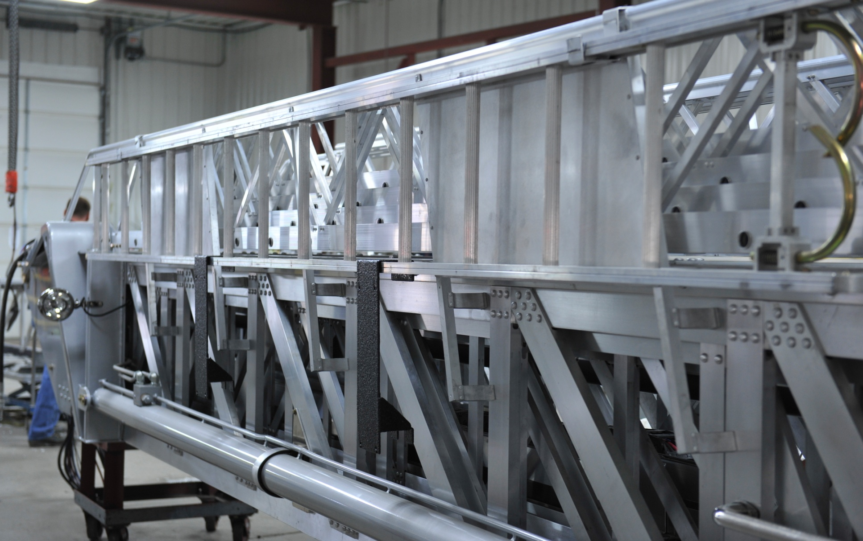
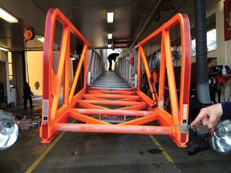
Huck Bolt Fastening Technology
Truck Feature: No need for paint, no corrosion
→ Benefit and Value: Saving you maintenance hour and cost on upkeep of the aerial device’s paint.
Sutphen’s huck bolted aluminum aerial device does not need paint
Welded steel aerial device requires paint
VS.

Slide 18
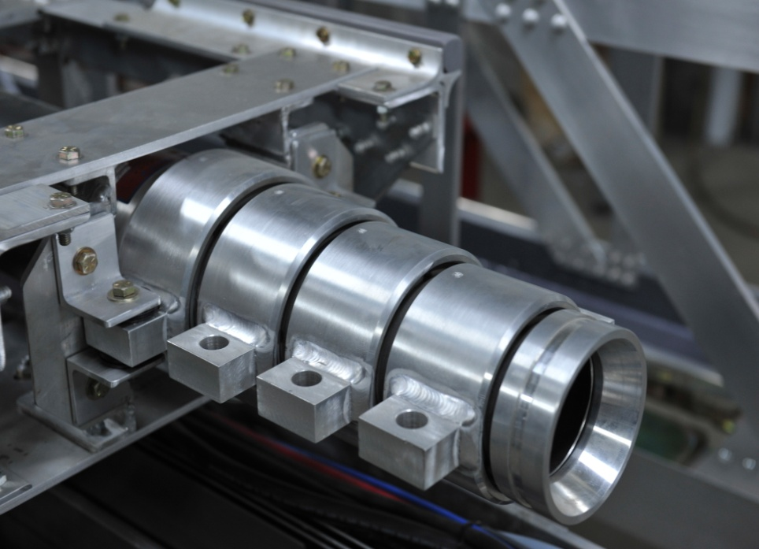
Aerial Flow
  Truck Feature: Unique inverted waterway design
  Benefit and Value: Guaranteeing minimum wear and tear on the seals between each section and excellent flow characteristics.
Direction of water flow
3.25”
3.75”
4.25”
4.75”
5.25”
Waterway size goes from small to large
Notes:
Sutphen incorporates two (2) 1000 GPM nozzles as standard equipment. The inverted waterway design is unique to Sutphen aerials. Where most other apparatus waterways are large at the bottom and reduce in size as the height increases, the Sutphen design starts at its smallest size, and progresses to its largest at the end of the last fly section promoting unsurpassed flow characteristics. With Sutphen’s box-boom construction, the waterway is totally encased inside the boom, thus providing optimum protection.

Slide 19
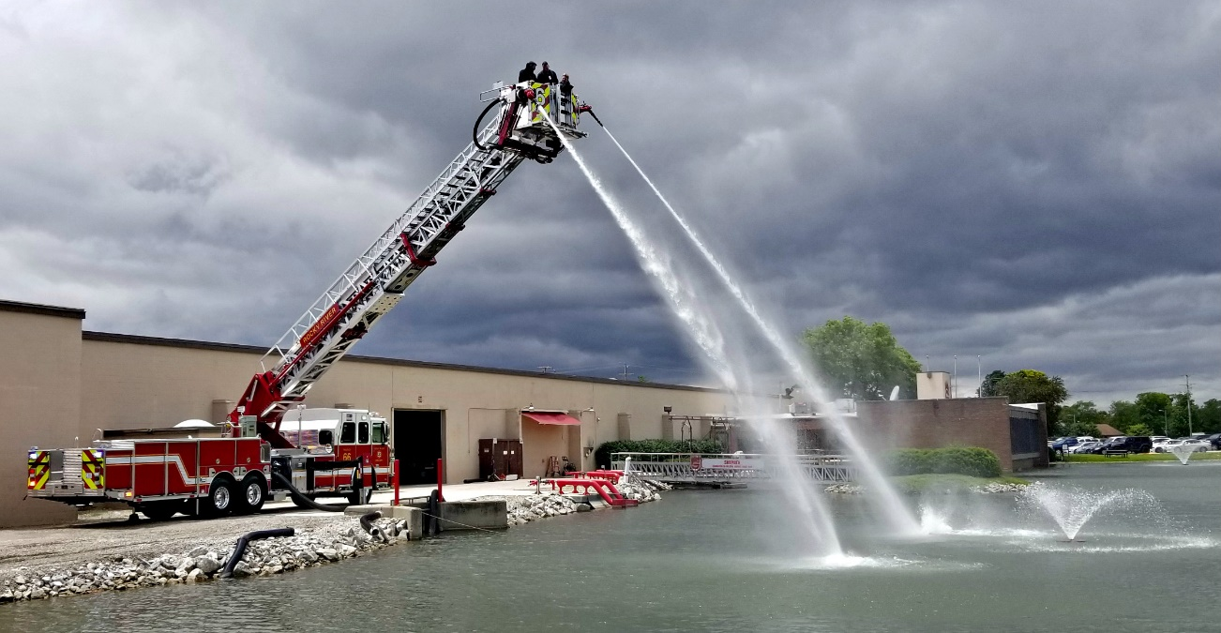
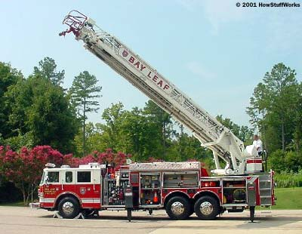
Aerial Flow
Truck Feature: Minimize flow re-direction
Benefit and Value: More efficient and higher water flow.
          Reduces friction loss.
VS.
Sutphen’s Mid-Mount Aerial Ladder
Rear-Mount Aerial Ladder

Slide 20
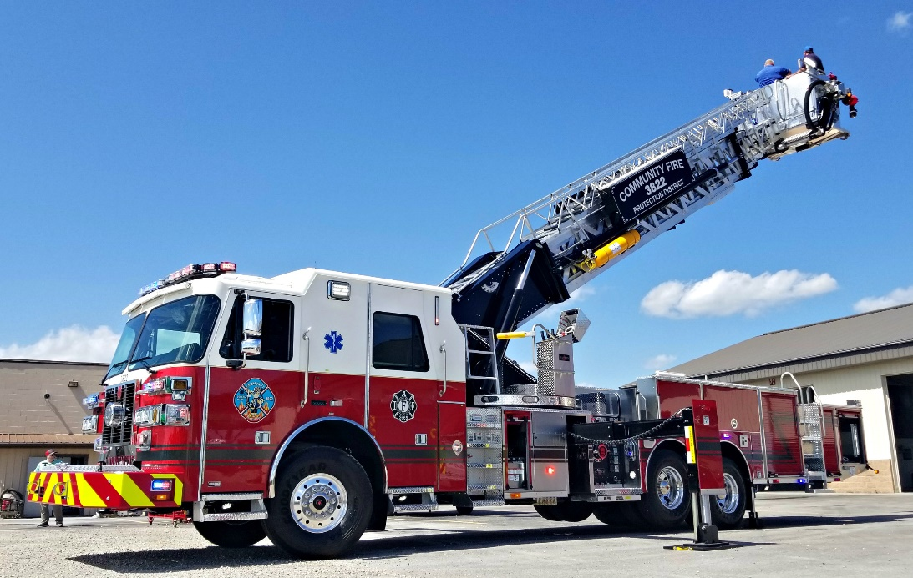
Centralized Stabilizer System
Truck Feature: One sets of stabilizer/outriggers in the center of the truck
→ Benefit and Value: Easy to set up on scene in confined space. Setup time less than 45 seconds starting at the driver’s seat.
VS.
Sutphen’s Mid-Mount Aerial Ladder
Rear-Mount Aerial Ladder

Slide 21
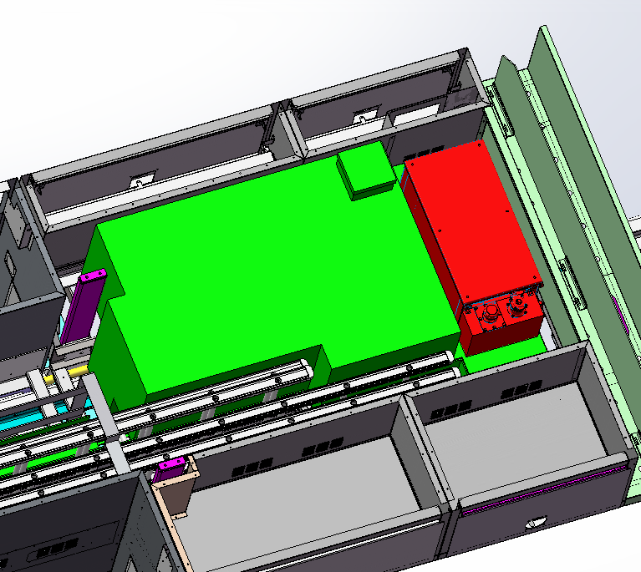
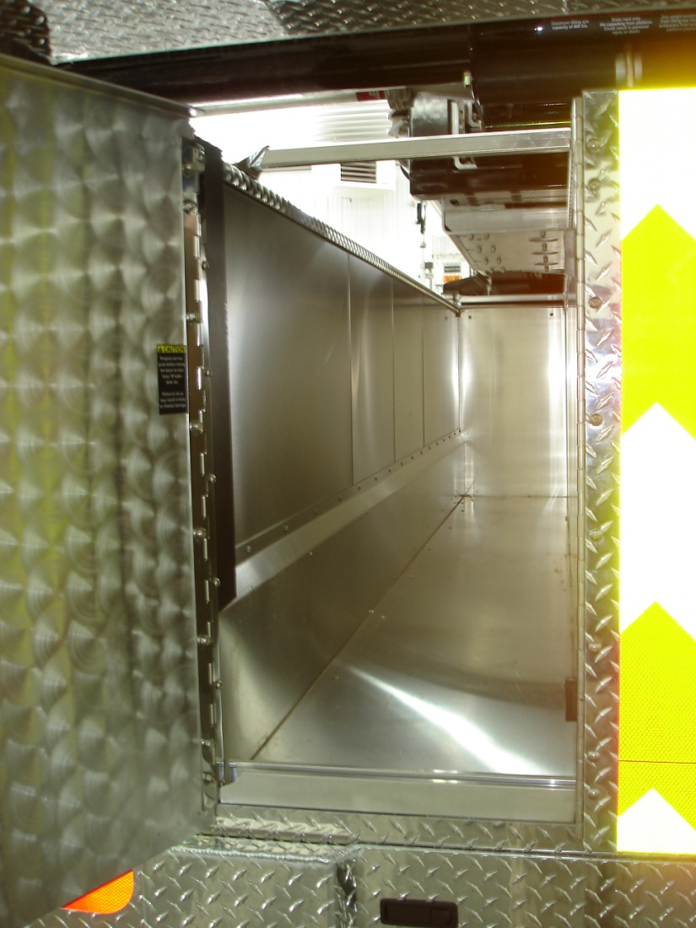
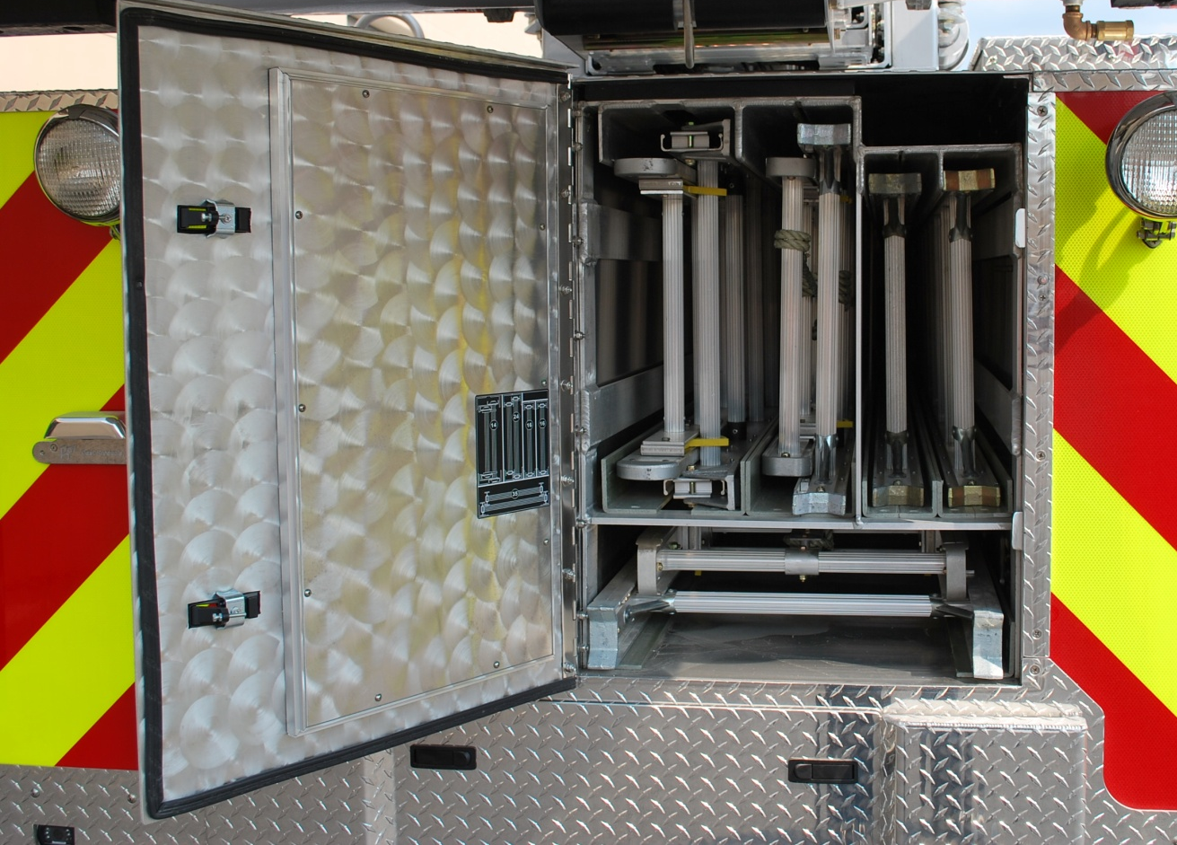
SPH100 Water Tank Configurations
Standard Configuration:
300 Gallons of Water
Space for generator at front of body
Standard ladder compliment
  (1) 35’ 2-section ladder
  (1) 24’ 2-section ladder
  (2) 16’ roof ladders
  (1) 14’ combo ladder
Full-length hose bed (130”L)

Slide 22
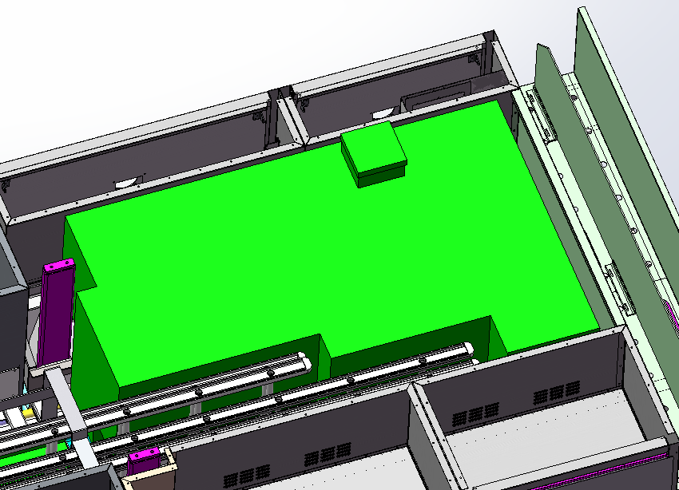
SPH100 Water Tank Configurations
Option #1 (relocate generator):
Adds 55 gallons of water (355 total)
Standard ladder compliment
  (1) 35’ 2-section ladder
  (1) 24’ 2-section ladder
  (2) 16’ roof ladders
  (1) 14’ combo ladder
  Full-length hose bed (130”L)

Slide 23
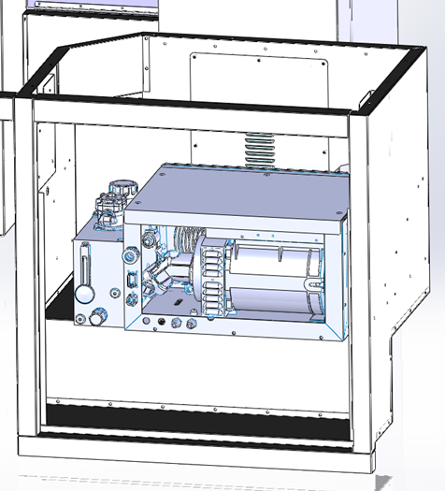
Generator Location Options
Option 1:
  In R1 compartment above exhaust notch (example shown using Harrison MAS 6-10kw)

Slide 24
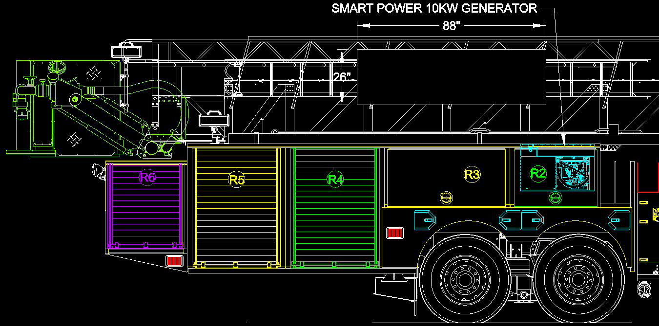
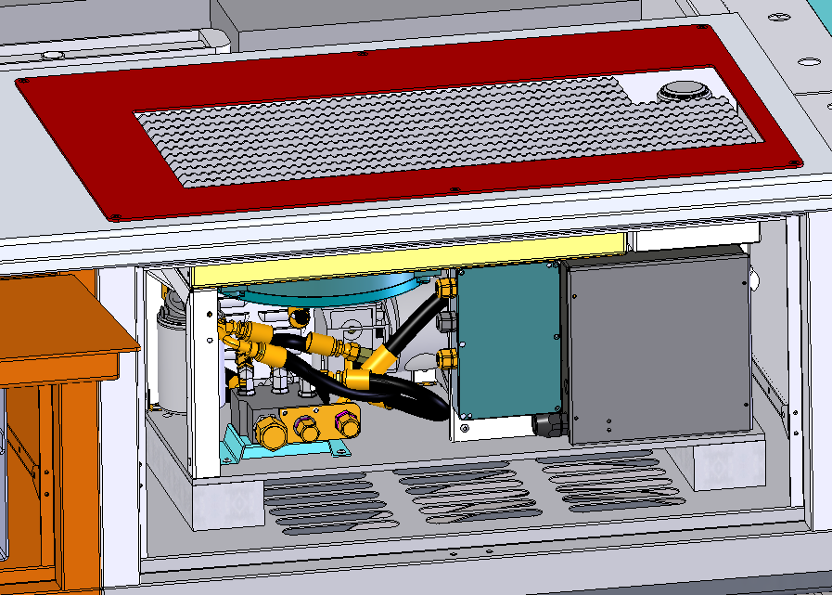
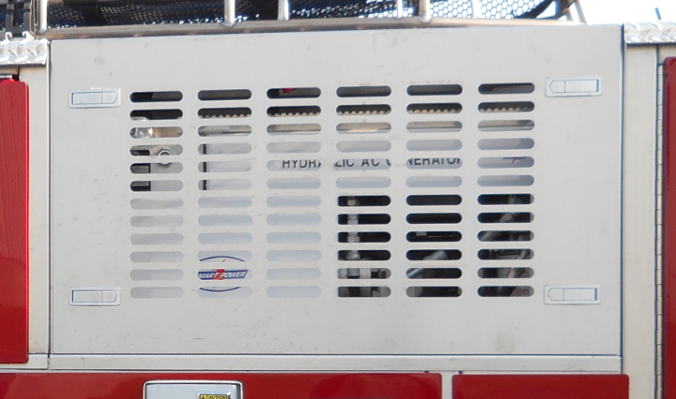
Generator Location Options
Option 2:
  In R2 compartment (example shown using Smart Power HR Series 6-10kw)

Slide 25
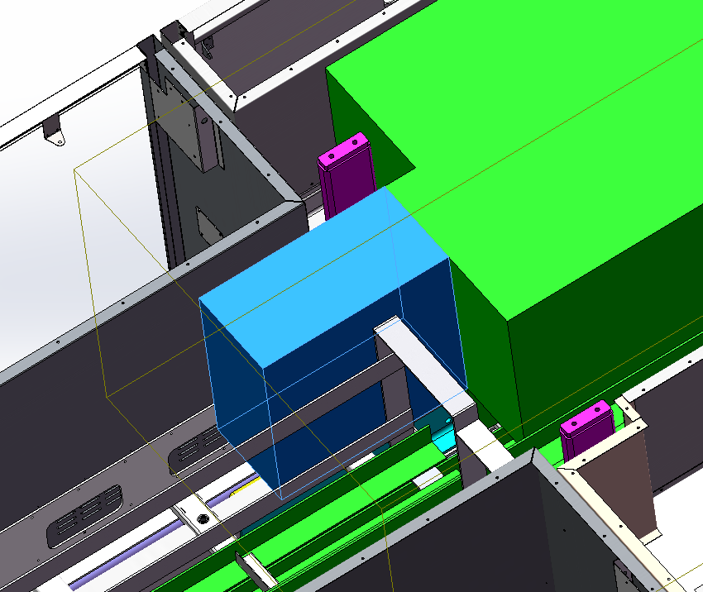
How can I get even MORE water?
Shortening the hosebed to gain water.
  Add a 24” long x 12” wide overhang on the rear of the water tank)
    gains 25 gallons of water (325 total)
    looses 20” of hose bed length (approx. 130’ of 5” hose)
Notes:
If you do not want to lose side compartment space by relocating the generator. Another option would be to losing some hosebed capacity.
Note that this cannot overhang the water tank more than 24” past the body flex joint (unsupported wing)

Slide 26
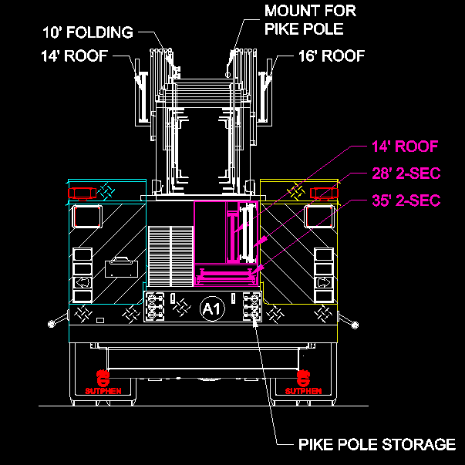
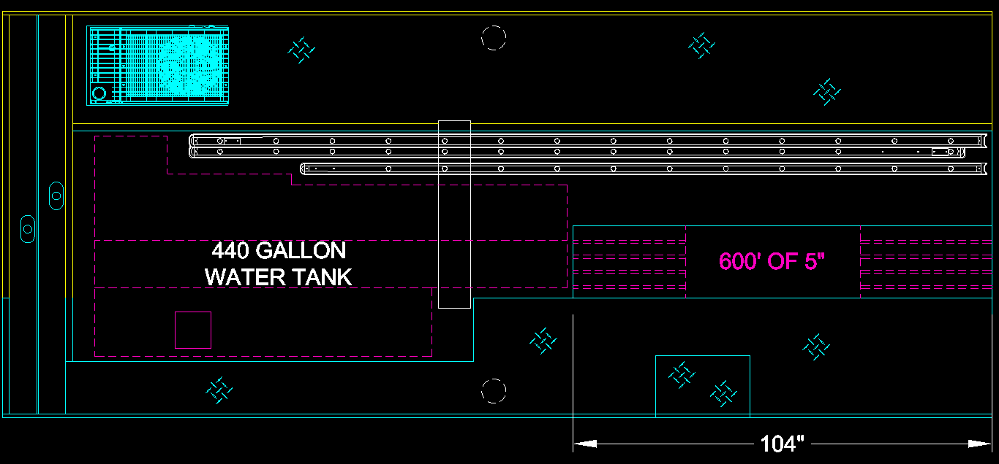
How can I get even MORE water?
Lose hose bed capacity and ladders (or relocate)
Various examples:
  440 gallons w/relocated generator, 600’ of 5” hose bed, and reduced/relocated ladder setup
    (1) 35’ 2-sec ladder in body
    (1) 28’ 2-sec ladder in body
    (1) 14’ roof ladder in body
    (1) 16’ roof on boom
    (1) 14’ roof on boom

Slide 27
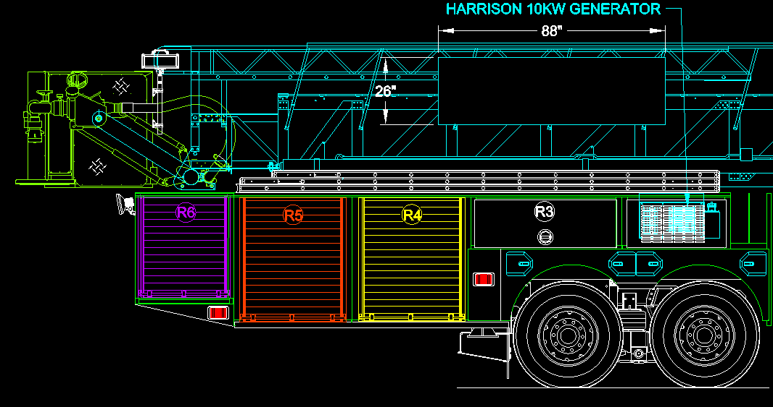


How can I get even MORE water?
500 gallons w/relocated generator, 800’ of 5”/500’ of 2.5” hose bed, and reduced/relocated ladder setup
  (1) 35’ 3-sec on right side
  (1) 28’ 2-sec in body
  (1) 18’ roof in body
  (1) 16’ roof on boom

Slide 28

Truck Company Ladder Banking
A Full Ladder Compliment would require no tank configuration
(1) 35’ 2-sec
(1) 28’ 2-sec
(2) 16’ roof
(2) 24’ 2-sec
(1) 22’ 2-sec
(1) 12” fresno
(3) NY Pike Pole Slots
Slot for folding ladder
* Contact Sutphen is different compliment of ladders is requested

Slide 29


Platform Benefits
A Large Platform measuring over 19.5 sq ft.

Slide 30

Platform Benefits
Unobstructed Platform Front for Rescue or Roof Work

Slide 31


Platform Benefits
Retractable Stokes Arms that allows easy access and storage for a rescue.

Slide 32

Platform Benefits
Integral Parapet Ladder that can be deployed form inside of the platform with a pull of a lever.

Slide 33

Platform Benefits
Built for rope rescue with a single 800 lbs. lifting eye located behind the platform on the bottom side of the boom.

Slide 34
Sutphen Aerial Product
Competitive Advantage Summary
1. AERIAL DEVICE MID-MOUNT DESIGN
Lower Center of Gravity：better driving stability and maneuverability
Platform in the rear：unobstructed visibility, safer driving
Mid-Mount Design: lower overall vehicle height and cab tilt capability for ease of servicing engine
Rear access to Platform: reduced set up time
Large, user friendly hose
Stainless Steel body as standard for maximum durability.
3. HUCK BOLT FASTENING TECHNOLOGY
High quality, high performance
No welding, no cracking
Easy to inspect, easy to service
No paint needed, no corrosion
Cost saving on maintenance and service
Lighter overall weight: better braking, better acceleration, less wear and tear on chassis components, resulting in truck durability and longevity
2. AERIAL DEVICE BOX BOOM STRUCTURE
Maximum aerial strength, no twisting in the air
Unmatched 3:1 structural safety factor
All aerial system (waterway, cable, breathing air) are safely protected within the four-sided box boom structure
No Load Chart. Full capacity operation.
4. AERIAL FLOW
Inverted Waterway Design: reduce wear and tear on seals
Minimize Flow Re-direction: more efficient flow
5. CENTRALIZED STABILIZER SYSTEM
Easy to setup in confined space

Slide 35


Sutphen Corporation

