Slide 1
Sales Application Engineer (SAE) Roles
Sutphen Dealer Meeting 2015
C. Green – 10/13/2015

Slide 2
Purpose:
To provide an overview of the former SAE roles, how they are changing and what is to come, and who will be doing some of the formerly assigned duties

Slide 3

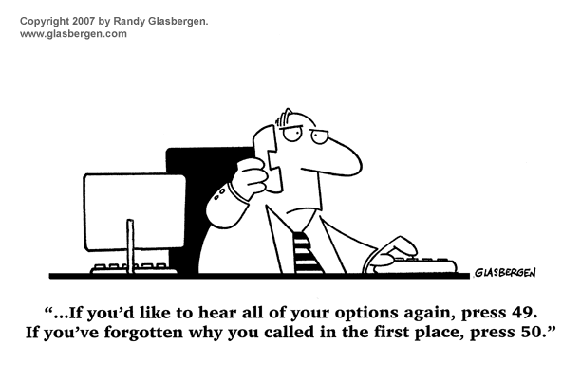
Who do I contact when I need….??

Slide 4
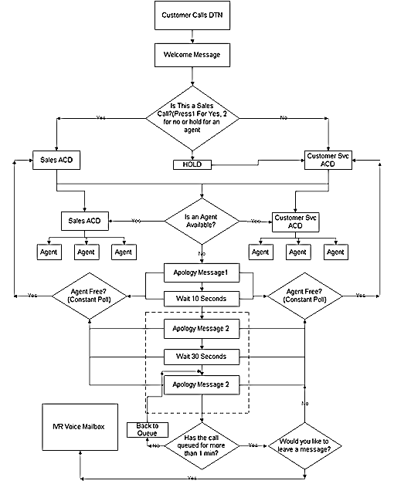

Who do I contact when I need….??
“If the phone doesn’t ring, it’s me.”
– Jimmy Buffett

Slide 5
Who do I contact when I need…??
Special pricing for a non-published option?
What product?
What facility?

Slide 6
Who do I contact when I need…??
Configuration support?
What product?
What facility?

Slide 7
Who do I contact when I need…??
A proposal drawing?
What product?
What facility?

Slide 8
Who do I contact when I need sales support??
Working with a department that wants to buy a Program 1 pumper, a custom tanker, a SL75, and a SPH100?
Contacting three (or more) different individuals depending on which product requires the support

Slide 9
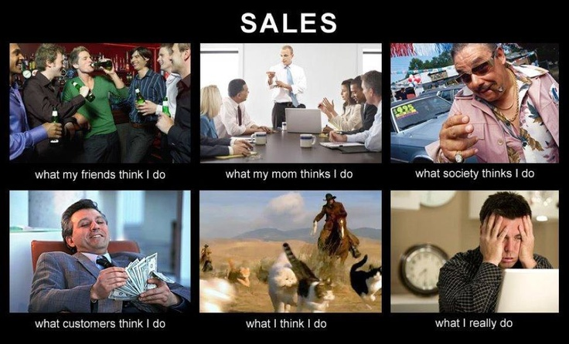

Slide 10

Supporting the Sale (Current)
Proposal Drawing, Configuration Support, Special Pricing
Product Type
Pumper
Aerial
Program
Custom
Program 1
Body Type or Facility
Aluminum or Stainless
Facility
Dublin
Steve Dorfman
SAE
Brandon Finnegan
Darryl Rhyne
SA75, SL75, SP70, SL100
Jim Garver
Adam Fout
Chris Minor
SP95, SP100, SP110, SPH100, Industrial Aerial
SAE
Tanker
Body Type or Facility
Aluminum or Stainless
Facility
Dublin
New York
SAE
New York
Steve Dorfman
Brandon Finnegan
Darryl Rhyne
Jason Haulman
Program 2
SAE

Slide 11
Supporting the Sale (New)
Proposal Drawing, Configuration Support, Special Pricing, etc.
SAE

Slide 12
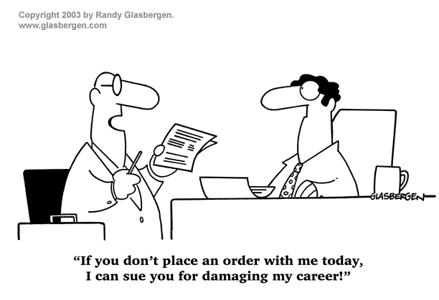

Slide 13


Slide 14
(Better) Supporting the Sale
BETTER & MORE TIMELY Dealer Support
Expand to all facilities (as much as possible) pricing, configuration support, proposal drawings

Slide 15
Dealer Support/Training
Product Knowledge/Configurations
Competition Knowledge (manufacturers and dealers in territory)
Configurator/SQS2
Tools for Selling Against the Competition
Using Cooperative Purchasing Agencies
Dedicate Time for Training New Dealers

Slide 16
Dealer Support/Training
Be Available for Dealer & Customer Visits
Attend Local Trade Shows & Dealer Open House Events
Work with Marketing Manager Acting as Advocates for Demo Requests/Scheduling
Dealer Website

Slide 17


Slide 18
Transition of Order/Review Process
Order MUST be submitted to your SAE (copy Judi Sutphen)
Email notifying us that the order is ready for processing with all supporting documents (proposal page w/pricing, down payment discount page, customer’s spec, Sutphen proposal, etc.)

Slide 19
Transition of Order/Review Process
SAE will review for overall costing accuracy, configuration, etc.
SAE will approve order in Configurator BEFORE HS # is assigned and final processing of order.
HS # will be assigned and released to production facility.

Slide 20

SAE Role Change/Project Coordinators
Managing Apparatus in Dublin
Project Coordinators (3)
Megan Phelps
Mark Clark
Richie Miller

Slide 21
Project Coordinators
Managing Apparatus in Dublin
Take over project after receipt of order
Create Initial Shop Order
Create/Revise Truck Drawing
Schedule Preconstruction Meeting
Conduct/Manage Preconstruction Meeting
Revise Documents After Preconstruction Meeting (Including Change Order)
Follow Apparatus Through Production (Shop Order Review Meetings, Production Support etc.)

Slide 22
Uniform Process
Same Process for All Facilities
SAE Supports Sale
SAE Reviews/Approves Order
Project Coordinator/Project Engineer handles project
SAE to support as needed (attend preconstruction meeting, inspection visits, assist with customer, pricing, etc.)
Will take some time to fully implement

Slide 23
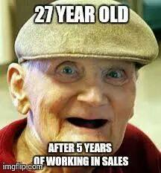
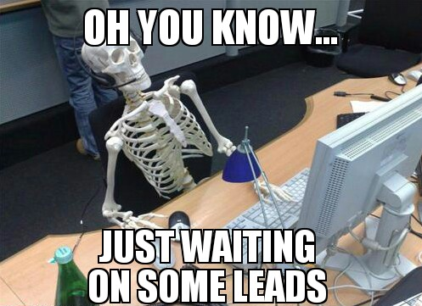
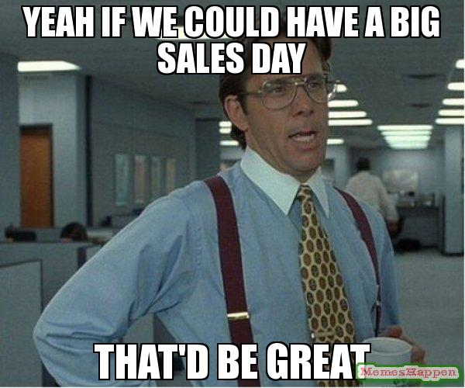


Slide 24
QUESTIONS??

