Slide 1
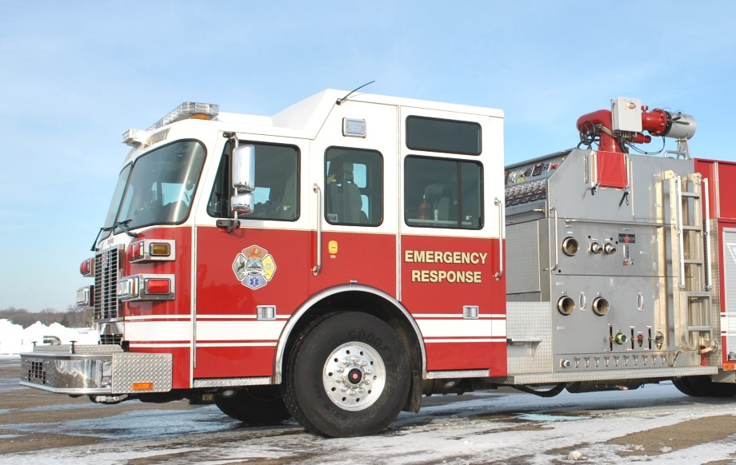
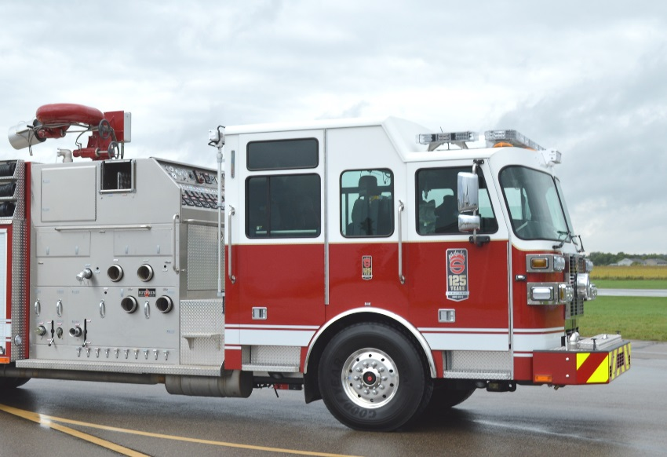
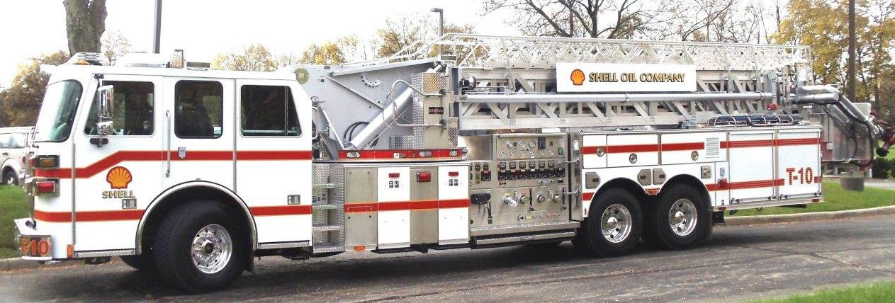
INDUSTRIAL PUMP SYSTEMS
Custom Manufactured for Sutphen Corporation

Slide 2
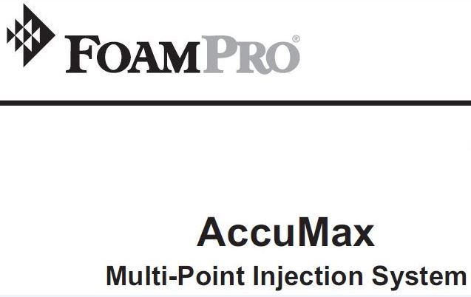


‘
FOAM PROPORTIONING SYSTEMS
AccuMax: Flow Based Direct Discharge Injection
Hot Shot-II & Servo Command: Demand Balanced Pressure

Slide 3
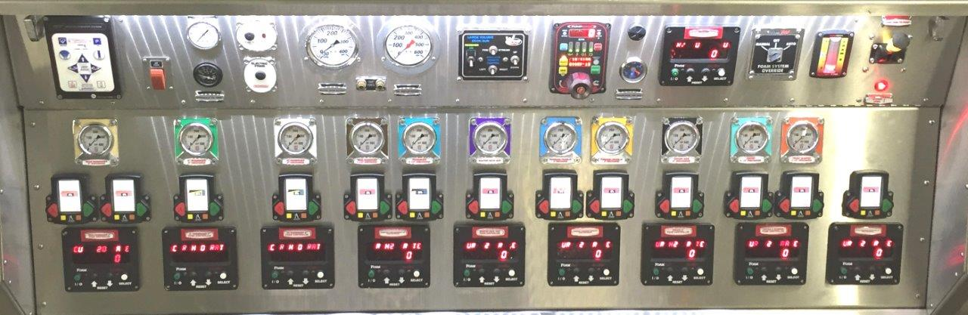
AccuMax Multi-Point, by FoamPro
Flow Based Direct Discharge Injection Foam Proportioning System
Master Control Digital Display
Digital Display Line Controller x # of Foam Capable Discharges
Flowmeter Line Controller x # of Foam Capable Discharges
Edwards Rotary Gear Foam Pump, 90, 150, & 300-GPM
NOTE: 90-GPM allows for Hydraulic Pump to be Fire Pump Transmission Auxiliary Drive-Driven

Slide 4
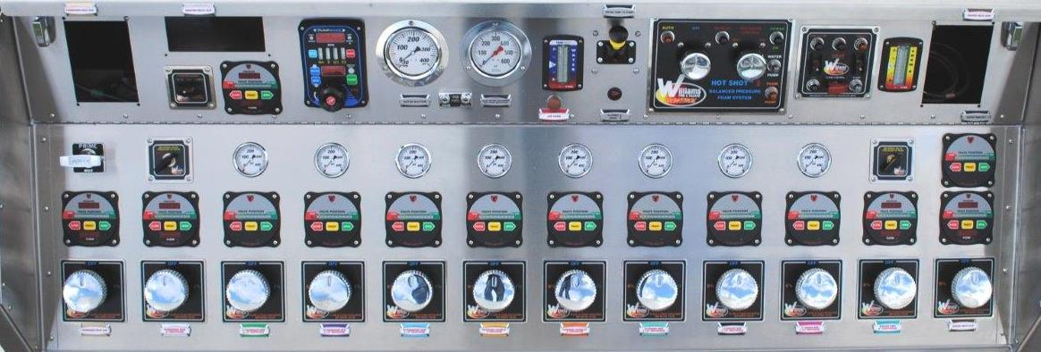
HOT SHOT-II, by Williams Fire Control
Demand Type Balance Pressure Foam Proportioning System
System Control Panel
Rotary Foam Metering Valve x # of Foam Discharges
Ratio Controller (Venturi) x # of Foam Capable Discharges
Edwards Rotary Gear Foam Pump, 60, 150, 250 & 300-GPM

Slide 5
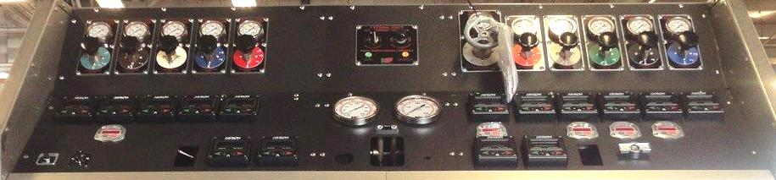
Servo Command, by NATIONAL FOAM
Demand Type Balance Pressure Foam Proportioning System
System Main Control Panel
Rotary Foam Variable Proportioning Valve (VPV) x # of Foam Discharges
Foam Concentrate Proportioner (Venturi) x # of Foam Capable Discharges
Edwards Rotary Gear Foam Pump, 150, & 300-GPM

Slide 6
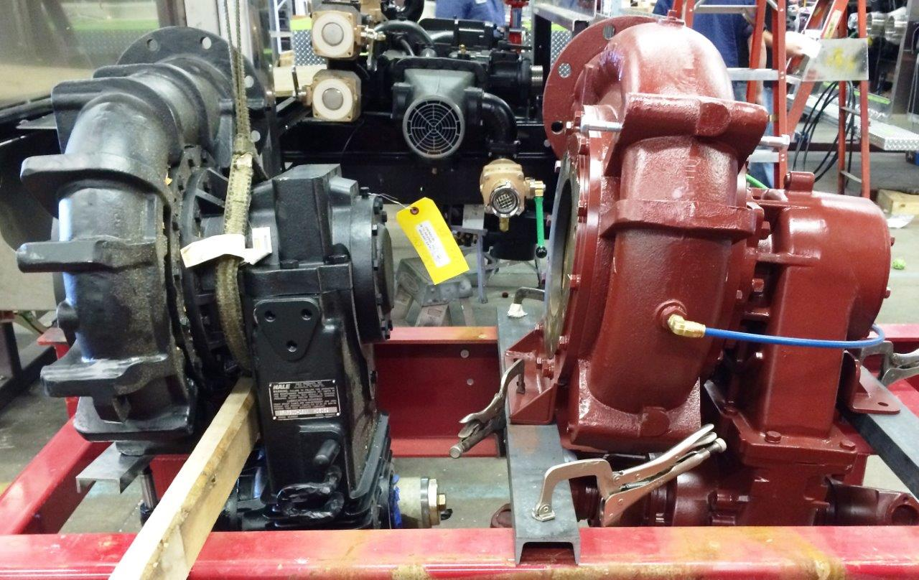
INDUSTRIAL FIRE PUMP SYSTEMS
HALE 8F 3000-GPM / WATEROUS CRU-2 4000-GPM

Slide 7
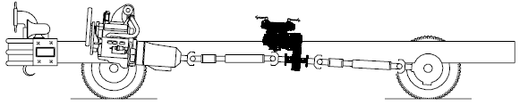
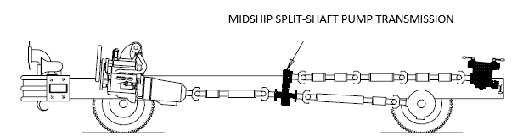
INDUSTRIAL WATER PUMP SYSTEMS
MIDSHIP or REAR MOUNT
MIDSHIP SPLIT-SHAFT PUMP SYSTEMS:
REAR MOUNT PUMP/MIDSHIP SPLIT-SHAFT SYSTEMS

Slide 8
SPLIT-SHAFT WATER PUMP TRANSMISSIONS
WATEROUS: CHAIN DRIVE – HALE & DARLEY: GEAR-DRIVE
  Waterous CRU-2C21 (TC21 Rear Mount): 16,000 ft. lb.
    C-21 CHAIN Drive Front Transmission/Suction Facing Rear (for Aerials)
    C-21 CHAIN Drive Rear Transmission/Suction Facing Front (for Pumpers)
  Hale 8FG or 8FK: “G” (RGA Rear Mount): 16,000 ft. lbs. “K” 18,500 ft. lbs.
    G or K, GEAR Drive Front Transmission/Suction Facing Rear (for Aerials)
    G or K, GEAR Drive Rear Transmission/Suction Facing Front (for Pumpers)
  Darley ZSM: MegaTrans (MegaTrans PTO Rear Mount): 19,300 ft. lbs.
    GEAR Drive Front Transmission/Suction Facing Rear (for Aerials)
    GEAR Drive Rear Transmission/Suction Facing Front (for Pumpers)

Slide 9
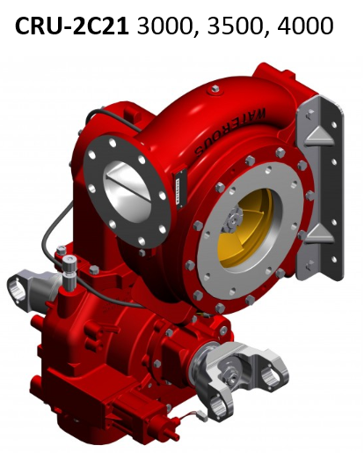
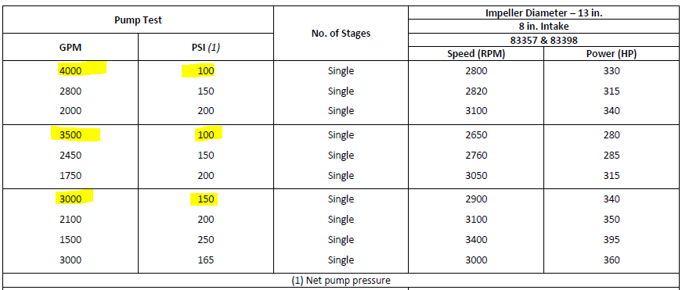
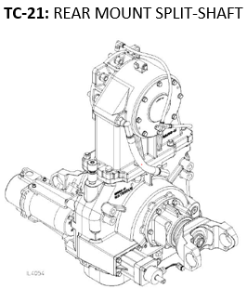
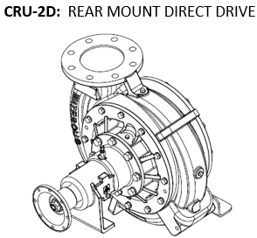
WATER PUMPS BRAND/TYPE/MODEL/CAPACITIES
WATEROUS SINGLE STAGE, SINGLE SUCTION IMPELLER, SPLIT-SHAFT DRIVEN

Slide 10
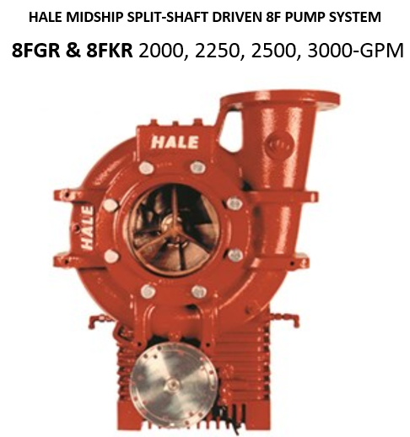
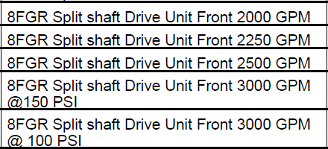
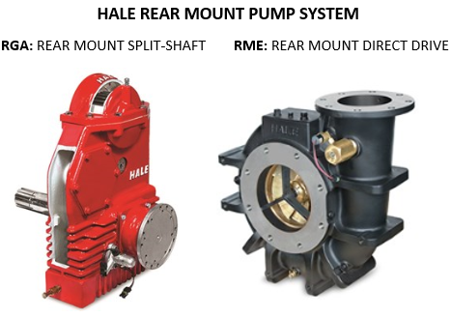
WATER PUMPS BRAND/TYPE/MODEL/CAPACITIES
HALE SINGLE STAGE, SINGLE SUCTION IMPELLER, SPLIT-SHAFT DRIVEN

Slide 11
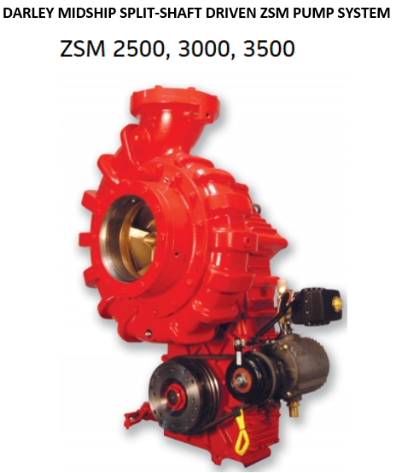
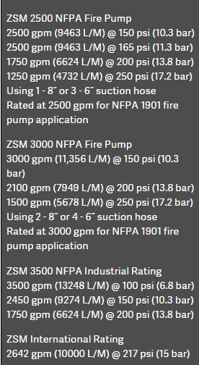
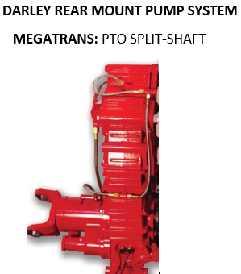
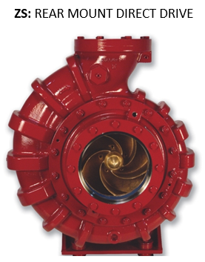
WATER PUMPS TYPE/BRAND/MODEL/CAPACITIES
DARLEY SINGLE STAGE, SINGLE SUCTION IMPELLER, SPLIT-SHAFT DRIVEN

Slide 12
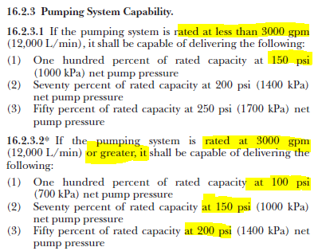
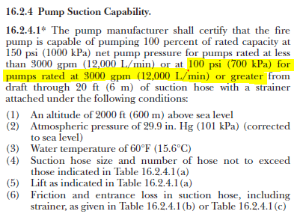
NFPA 1901 PUMP SYSTEM & SUCTION CAPABILITIES
2016 EDITION: 3000-GPM & ABOVE@ 100 PSI

Slide 13
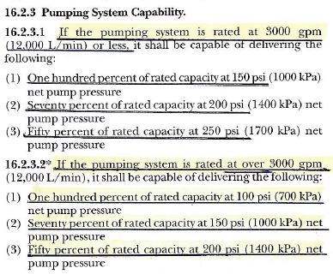
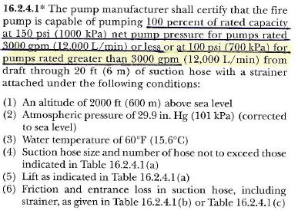
NFPA 1901 PUMP SYSTEM & SUCTION CAPABILITIES
2009 EDITION: 3000-GPM AND BELOW@ 150 PSI

Slide 14
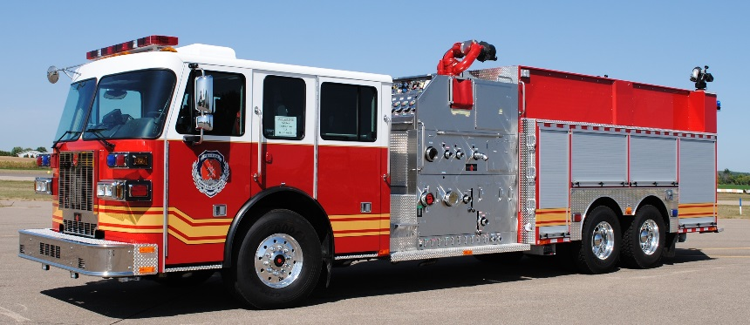
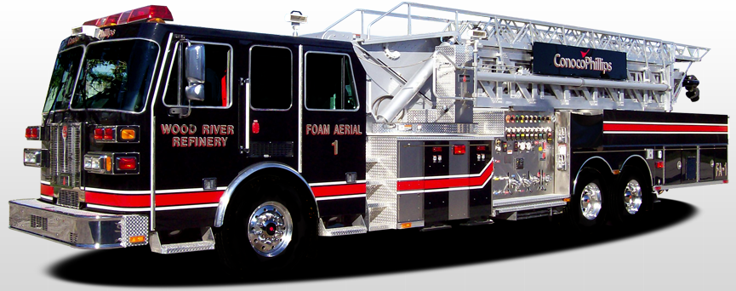
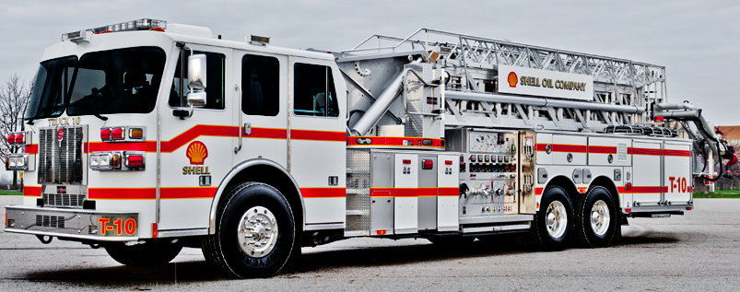
INDUSTRIAL PUMP MODULE APPLICATIONS
INDUSTRIAL PUMPERS & PUMPER TENDERS/TANKERS
SAI: INDUSTRIAL AERIALS
SPI: INDUSTRIAL AERIAL PLATFORMS

Slide 15
INDUSTRIAL PUMPER & PUMPER/TANKER
PUMP MODULES
  Side Mount, Street Side Controls
    LDH (8” reduced to 6”) Suctions 2-Curb Side / 2-Street Side (Optional 5” Rear is Available) + Multiple 2-1/2”
    LDH (5” or 6”) Discharges Curb Side and Rear (None Street Side) + Multiple 2-1/2”
    Overhead 2” and/or 2-1/2” Cross-Lays
    Forward “Stacked” 2” and/or 2-1/2” Speed-Lays
    Overhead Monitors, 1000 to 5000-GPM Akron, 2000 to 6000-GPM Williams
    Rear Monitors, 1000 to 2000-GPM
  Top-Mount Controls “Open/Exposed” or “Fully Enclosed”
    LDH (8” reduced to 6”) Suctions 2-Curb Side / 2-Street Side (Optional 5” Rear is Available) + Multiple 2-1/2”
    LDH (5” or 6”) Discharge: Driver Side, Curb Side and Rear + Multiple 2-1/2”
    Overhead 2” and/or 2-1/2” Cross-Lays
    Forward “Stacked” 2” and/or 2-1/2” Speed-Lays
    Overhead Monitors, 1000 to 5000-GPM Akron, 2000 to 6000-GPM Williams
    Rear Monitors, 1000 to 2000-GPM
  Rear-Mount Controls
    LDH (8” reduced to 6”) Suctions Up To 3-Opposite Side of Operator’s Panel and/or Rear + Multiple 2-1/2”
    LDH (5” or 6”) Discharges: Opposite Side of Operator’s Panel and/or Rear + Multiple 2-1/2”
    Overhead Rear Monitor(s), 1000 to 5000-GPM Akron, 2000 to 6000-GPM Williams
    Midship Monitor(s), 1000 to 2000-GPM

Slide 16
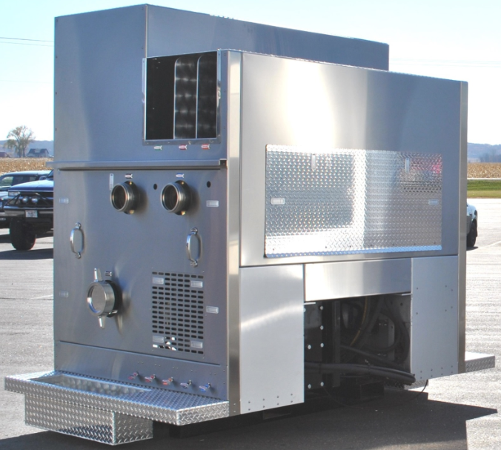
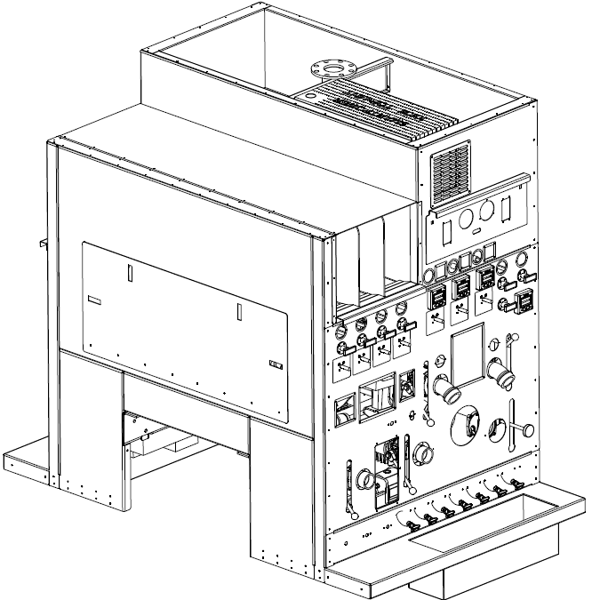
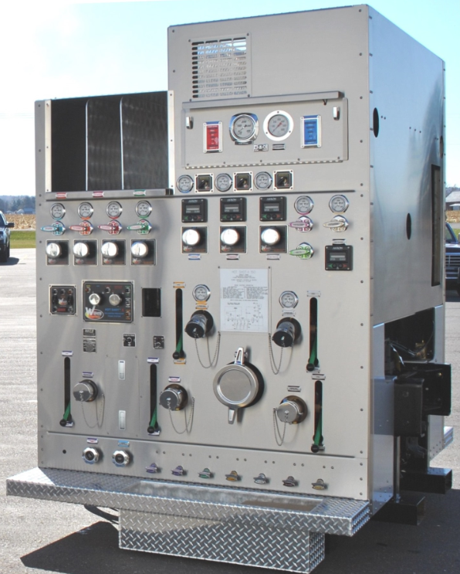
INDUSTRIAL PUMPER & PUMPER-TANKER
SIDE MOUNT PUMP CONTROLS
AccuMax, Hot Shot-II or Servo Command
(Hot Shot-II System Shown)

Slide 17
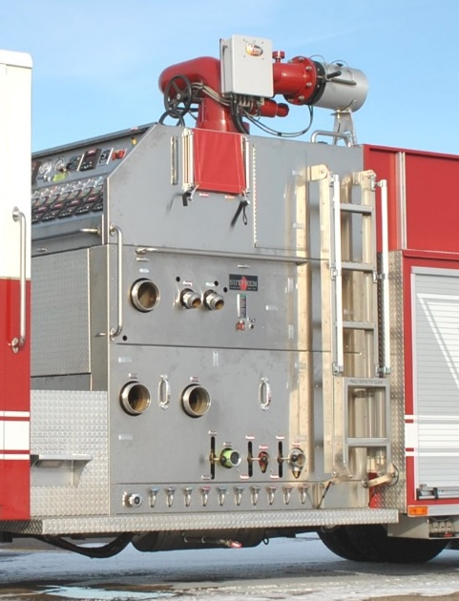
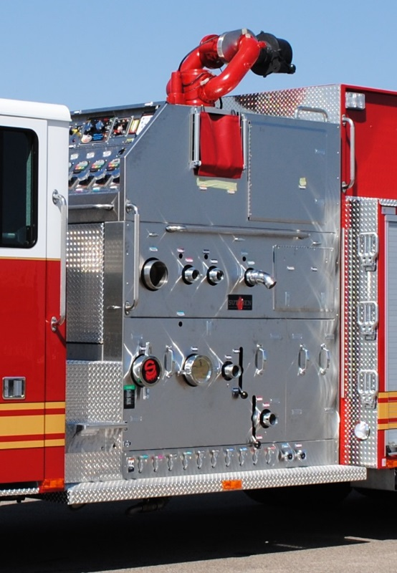
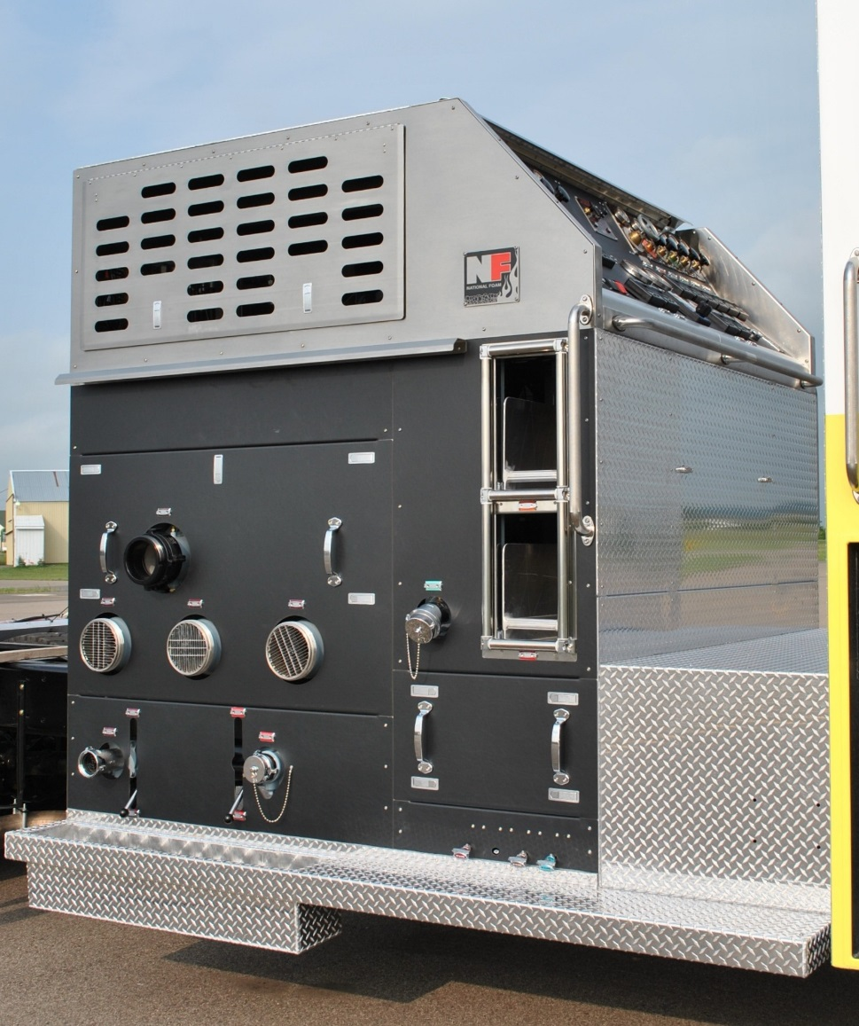
INDUSTRIAL PUMPER & PUMPER-TANKER
TOP-MOUNT PUMP CONTROLS
AccuMax Hot Shot-II Servo Command

Slide 18
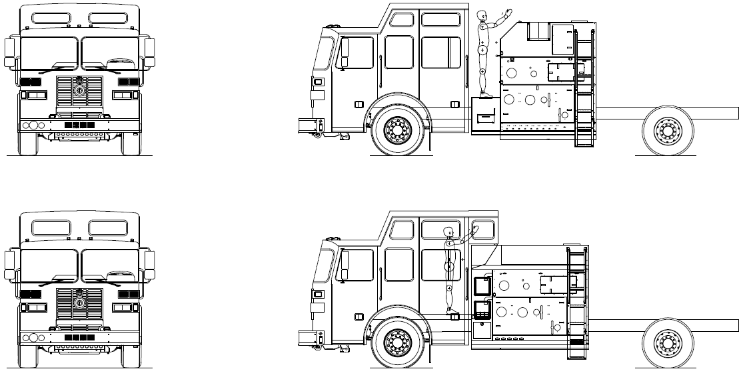
TOP MOUNT PUMP CONTROLS
Open Walkway < + > Fully Enclosed

Slide 19
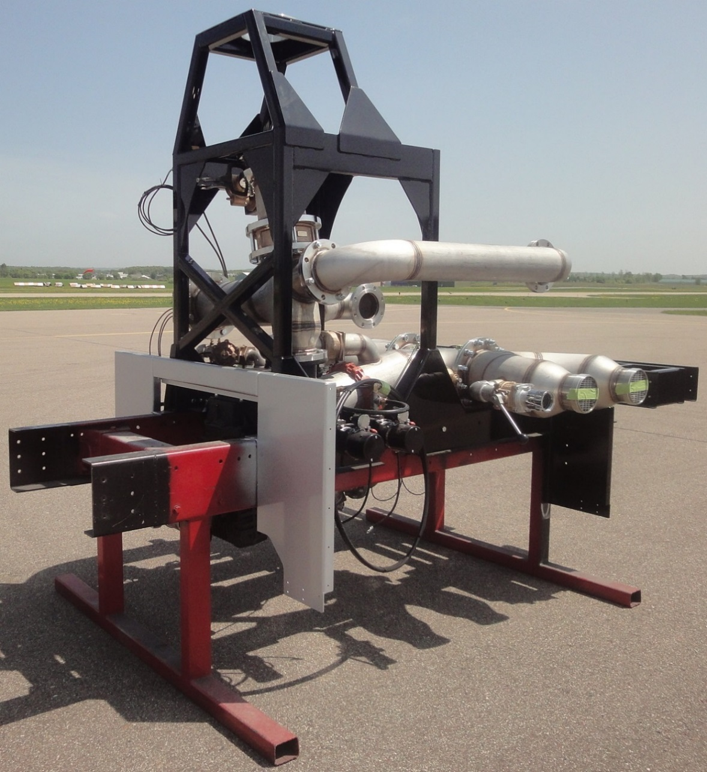
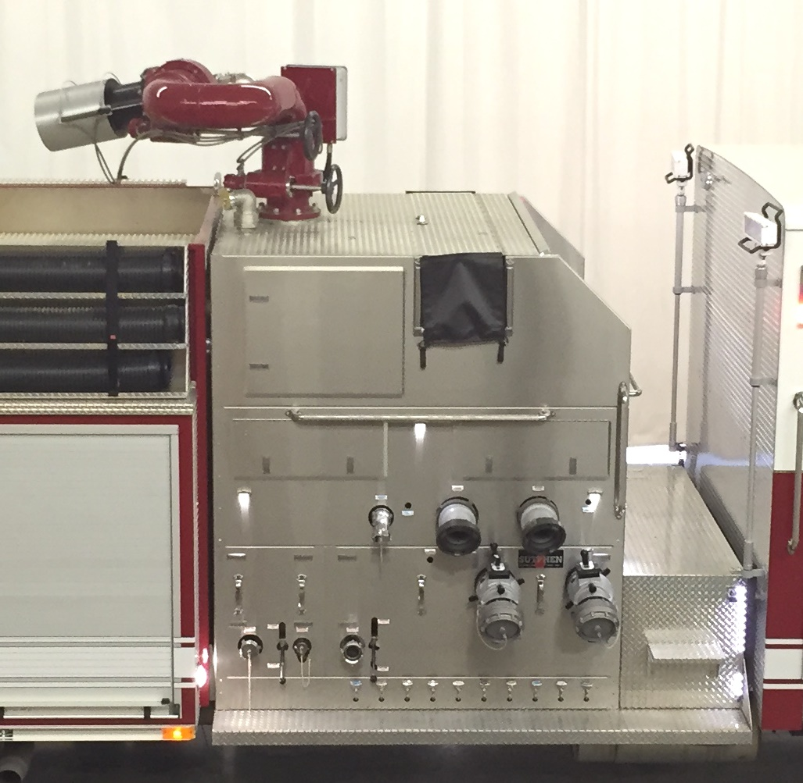
HIGH VOLUME MONITOR SUPPORT STRUCTURE
2:1 SAFETY FACTOR @ 6000-GPM

Slide 20
INDUSTRIAL AERIAL & AERIAL PLATFORM
PUMP MODULES
SAI-75 & 85+: Industrial Aerial, Side Mount, Street Side Controls
  LDH (8” reduced to 6”) Suctions 3-Curb Side (Optional 5” Rear is Available) + Multiple 2-1/2”
  LDH (5” or 6”) Discharges Curb Side Only + Multiple 2-1/2”
  Midship 2” and/or 2-1/2” Cross-Lays
  Midship Monitor(s) 1000 to 2000-GPM
  Aerial Waterway (8” reduced to 5” Swivel)
SPI: Industrial Platform, Side Mount, Street Side Controls
  LDH (8” reduced to 6”) Suctions 3-Curb Side (Optional 5” Rear is Available) + Multiple 2-1/2”
  LDH (5” or 6”) Discharges Curb Side Only + Multiple 2-1/2”
  Midship 2” and/or 2-1/2” Cross-Lays
  Midship Monitor(s) 1000 to 2000-GPM
  Aerial Waterway (8” reduced to 5” Swivel)

Slide 21
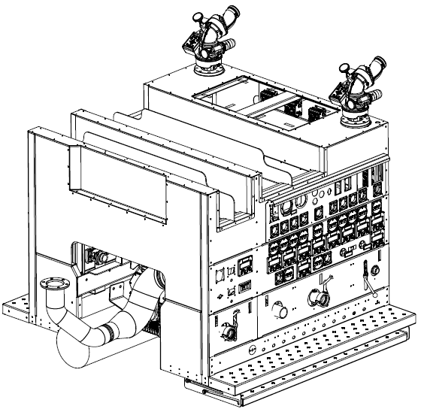
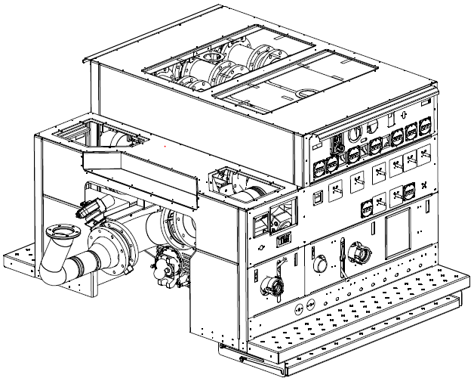
INDUSTRIAL AERIAL & PLATFORM MODULES
SAI-75 Pump Module SAI-85+ and SPI Pump Module
(AccuMax & Hot Shot-II systems shown)

Slide 22
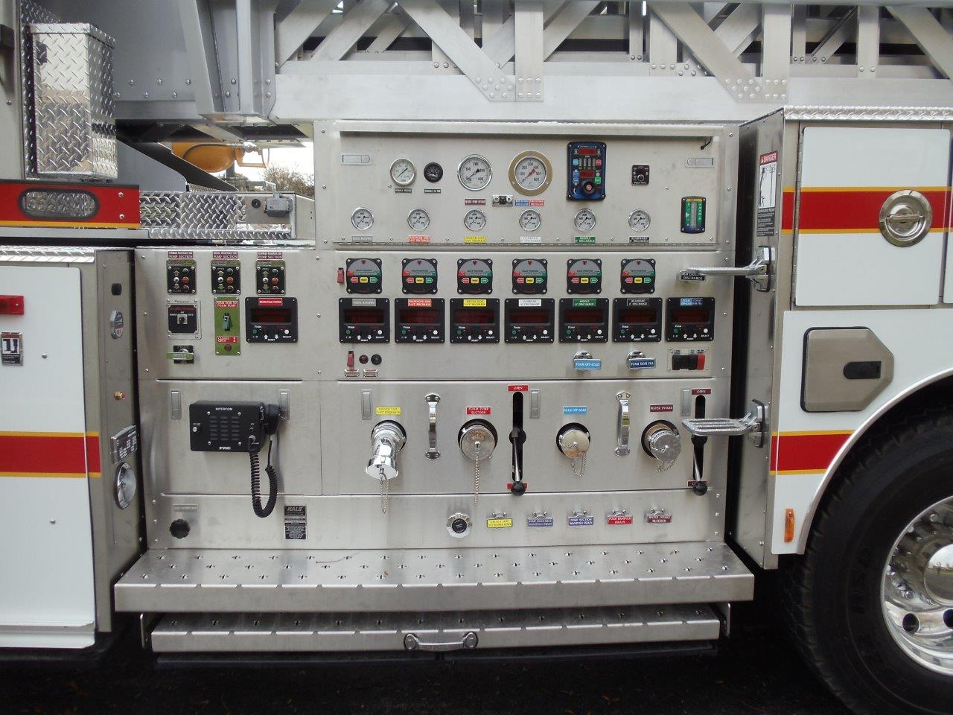
SAI 85+ & SPI AERIALS, STREET SIDE PUMP CONTROL PANEL
(AccuMax System Shown)

Slide 23
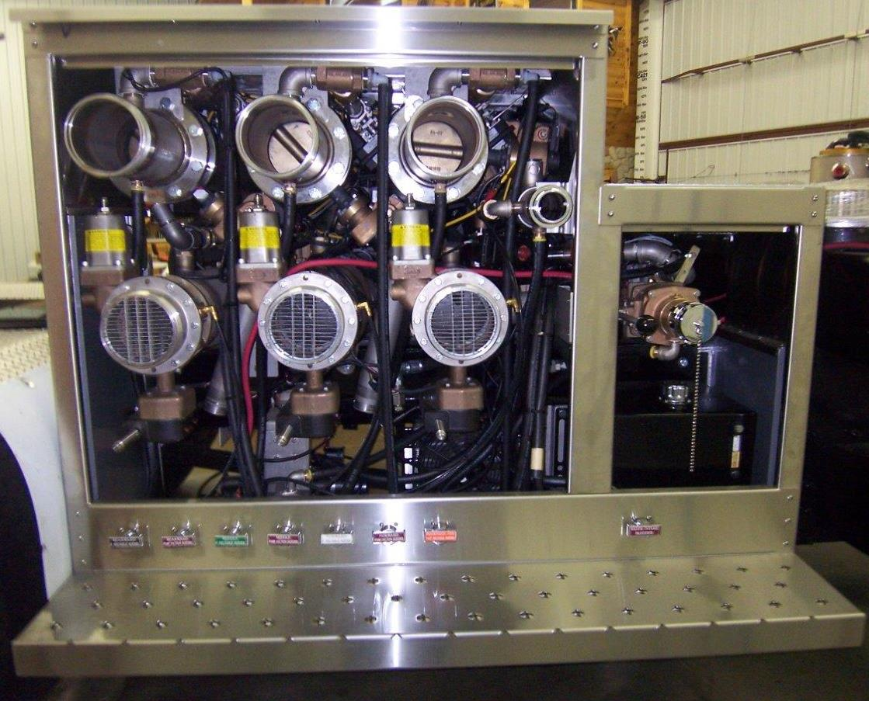
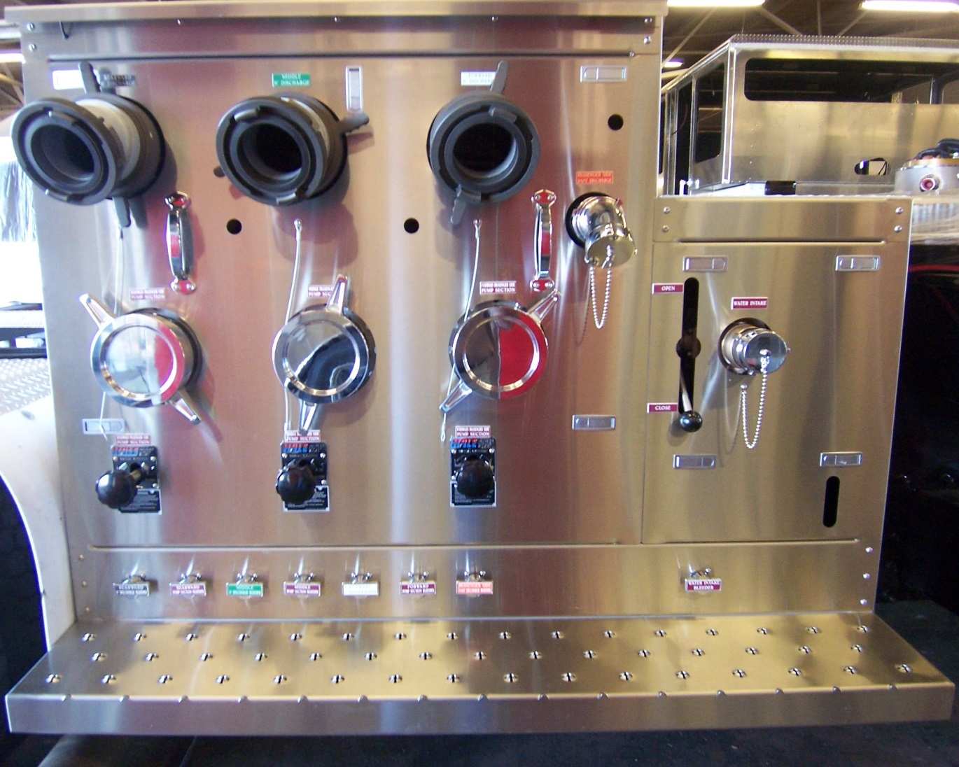
SAI 85+/SPI CURB SIDE SUCTION INLETS & DISCHARGE OUTLETS
Removable Service/Inspection Panels Concealed Electric Gate Valves with Overrides

Slide 24
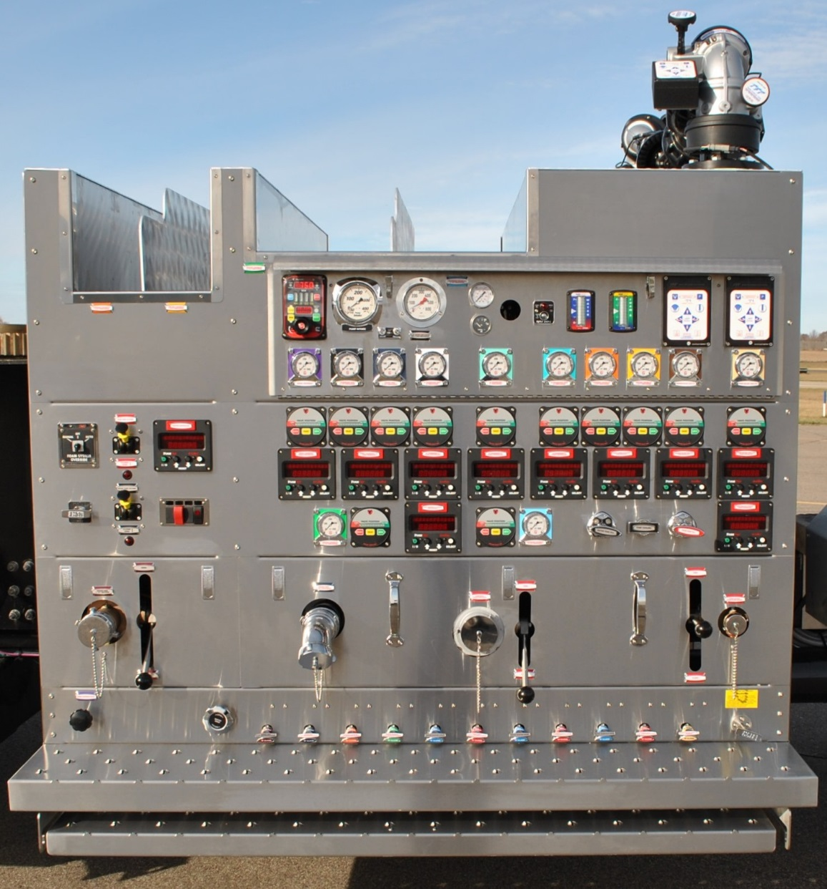
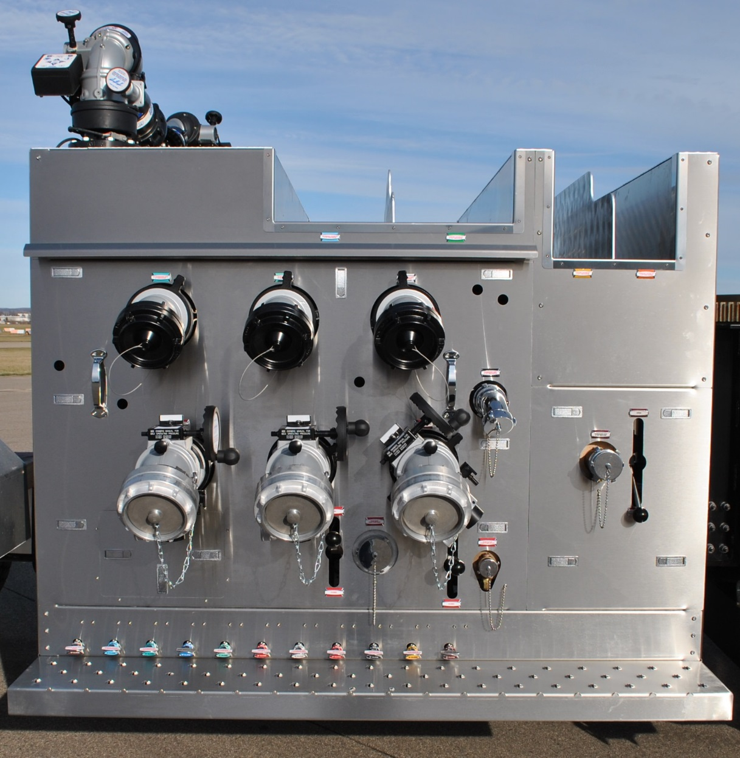
SAI-75 AERIAL STREET SIDE PUMP CONTROL PANEL
(AccuMax System Shown)
Street Side Control Panel Curb Side Outlets & Inlets

Slide 25
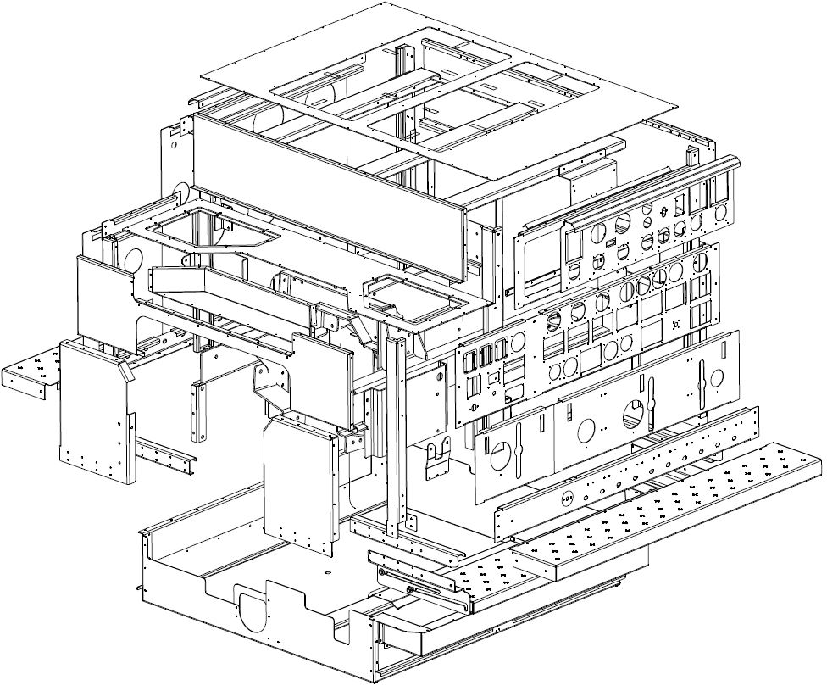
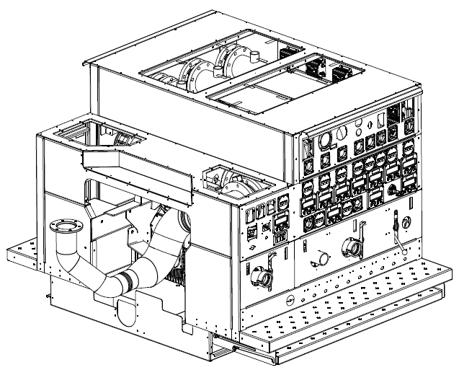
INDUSTRIAL PUMP MODULES
CONSTRUCTION METHODS & MATERIALS
304 STAINLESS STEEL CONSTRUCTION THROUGHOUT
BOLTED 12-GAUGE MODULE FABRICATIONS TIG WELDED WATER & FOAM MANIFOLDS

Slide 26
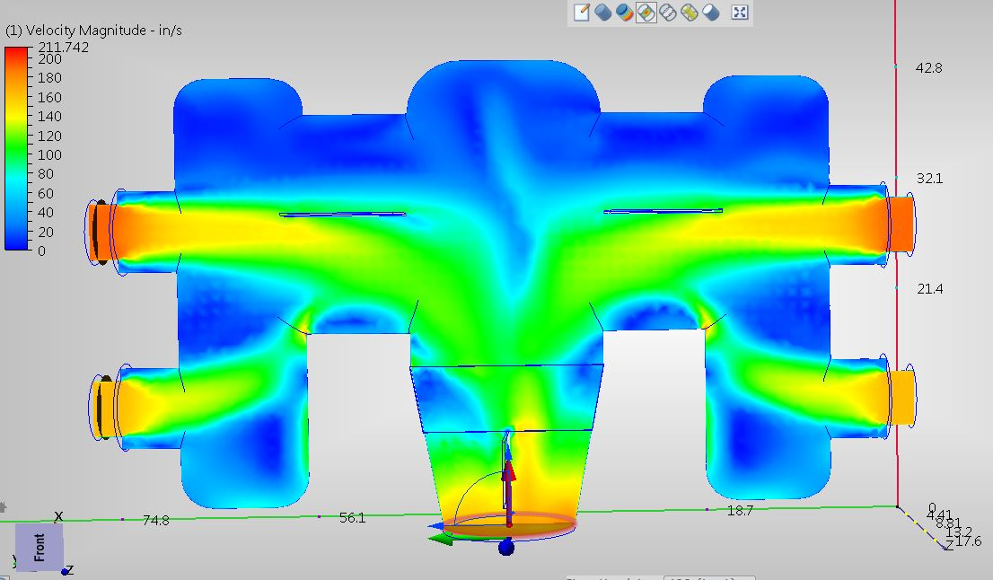
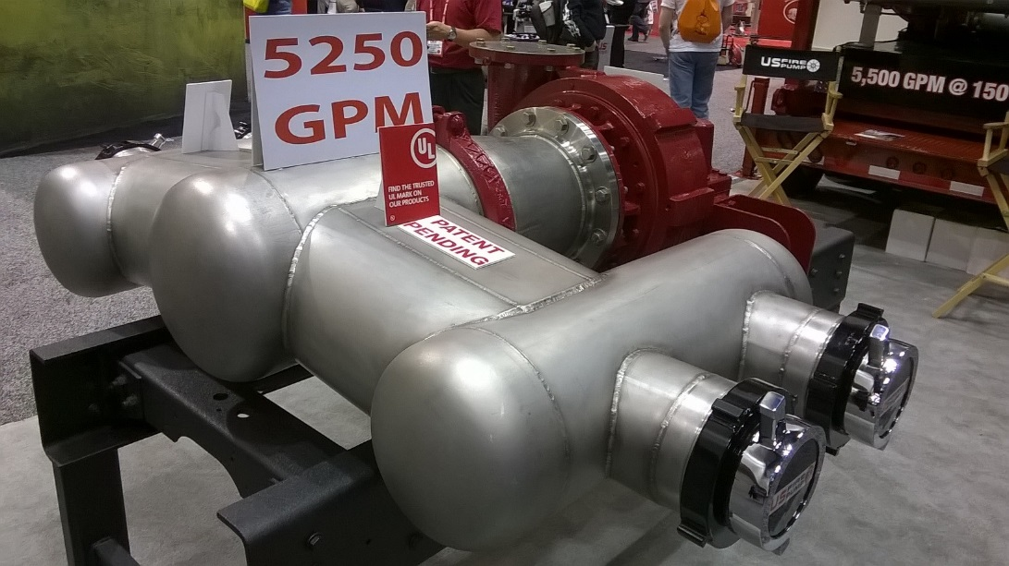
BRAND-X SUCTION INTAKE MANIFOLD
Competitor’s High-Volume Intake Manifold, Square Corners:
POOR FLOW: the upper intakes have more water flowing through than the lower ones (red on top versus orange on bottom), thus the flow of the water in the manifold is disjointed and turbulent.

Slide 27
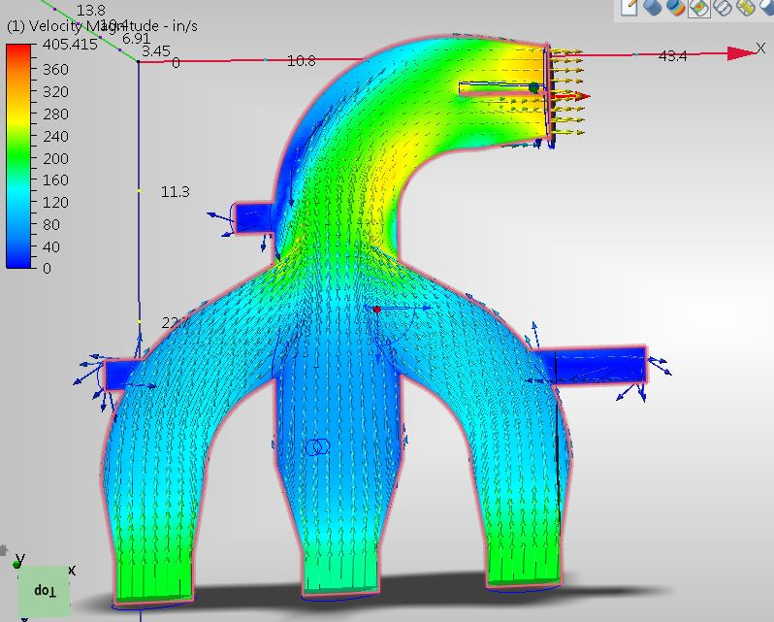
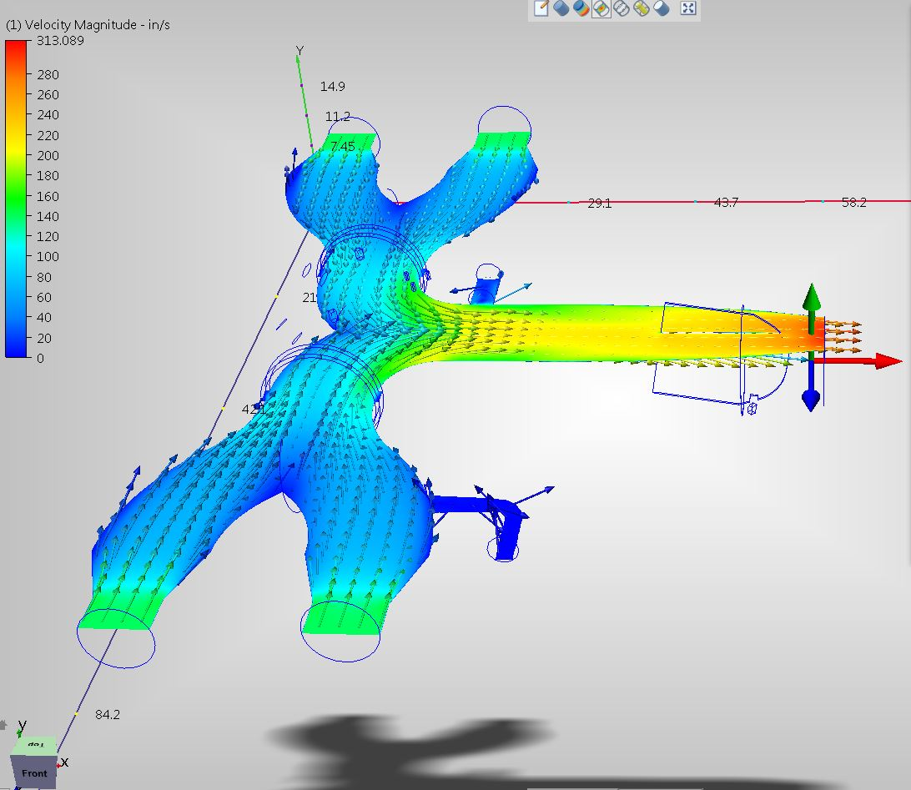
INDUSTRIAL FIRE PUMP SUCTION WATERWAYS
Computerized Photos of Sutphen Aerial (left) and Pumper (right) Suction Waterway depicts even volumetric flow at all intakes and laminar flow throughout the entire manifold, bottlenecked ONLY at the Pump Impeller Inlet.

Slide 28


CONVERSION OF EXISTING INDUSTRIAL APPARATUS
ORIGINAL HOT SHOT (Driveline-Driven/Non-Servo Controlled Foam Pump)

Slide 29






DISASSEMBLY/REMOVAL OF ORIGINAL HOT SHOT COMPONENTS

Slide 30






FABRICATE AND INSTALL NEW WATER & FOAM MANIFOLDS

Slide 31






CONVERTED FROM HOT SHOT DEMAND BALANCED PRESSURE TO FLOW BASED ACCUMAX

Slide 32




CONVERSION OF RESERVE APPARATUS: TO A TOTE HAULER WITH OFF-LOAD SINGLE-POINT MANIFOLD

Slide 33

For technical assistance with the promotion of or training on Industrial Apparatus Pump Systems, Jim Kirvida and Design Staff are personally available via email and phone calls; or, to accompany the Sutphen Sales Representative when visiting a Refinery, Terminal, or Oil Field.

