Slide 1
IN CASE YOU STILL DON’T KNOW…
Sutphen Dealer Meeting 2014 – SCE (Sutphen Continuing Ed.)
SAE Group: Bob Lively, Chris Chesson, Jerry Harley, Clark Green – 10/7/2014

Slide 2
Purpose:
To provide an overview of various areas of general knowledge to help aid in the selling of Sutphen apparatus.

Slide 3
What is the minimum required documentation to be submitted to obtain an HS #???
Signed Contract or Purchase Order (PO) made out to Sutphen Corporation
Order submitted through configurator/SQS2 (complete with #’s matching the contract or PO)

Slide 4
What documents are NOT acceptable??
Leasing Agreement
Notice of Award (even if it has a PO # on it)
PO # (must have the complete Purchase Order)

Slide 5
What is required to be submitted with an order to obtain the Perfect Score Award??
Signed Contract or PO (made out to Sutphen)
Order submitted through configurator/SQS2 (complete with #’s matching the contract or PO)
Completed Concession Form (if applicable)
Down Payment Discount Calculations (if applicable)
Sutphen Proposal w/cover page
Customer’s Specification
Paint Codes
CONSISTENCY!!

Slide 6
What is required to be completed/submitted when selling a Stock or Demo unit?
Inform your SAE ASAP
A letter of intent will ensure your customer that we will hold the truck for them (14 days max)
Signed Contract or PO
Completed Demonstrator Apparatus Sale Follow-Up Form
Signed Change Order covering any additions or changes to the Stock/Demo unit (work with SAE for pricing)

Slide 7
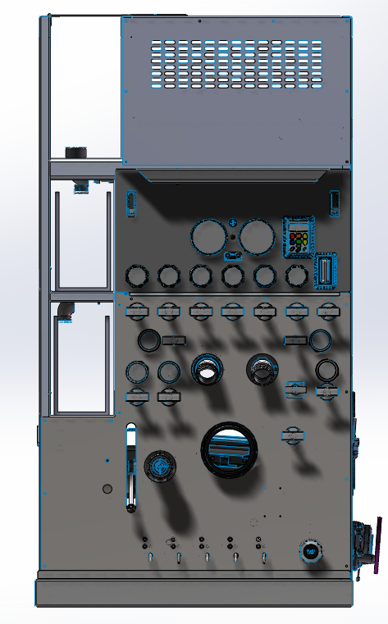
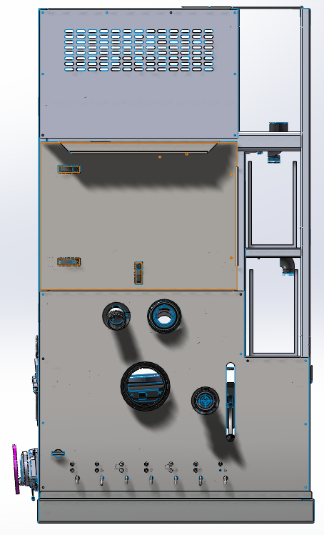
Did you know both Hale and Waterous have side mount speedlay module configurations for program pumpers?
Hale – Qmax-XS

Slide 8
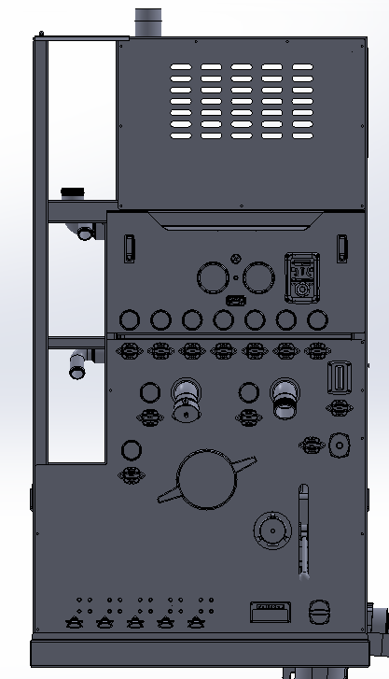
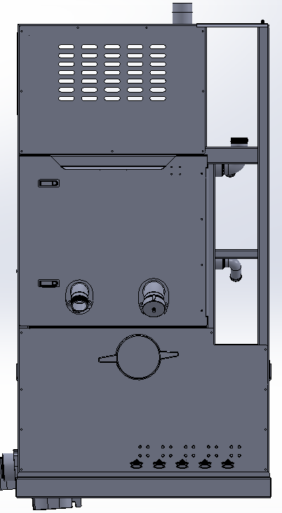
SIDE MOUNT SPEEDLAY CONFIGURATIONS
Waterous – S101
Reference STB-0002, STB-0003 & STB-0005 – All pricing referenced in the STB’s has been incorporated into the configurator/SQS2.

Slide 9
Did you know?
Program Modules
The Hale program modules come with pump packing. There is no option for a mechanical seal.
The Waterous program modules come with a mechanical seal with packing as the option (no charge/no credit).

Slide 10
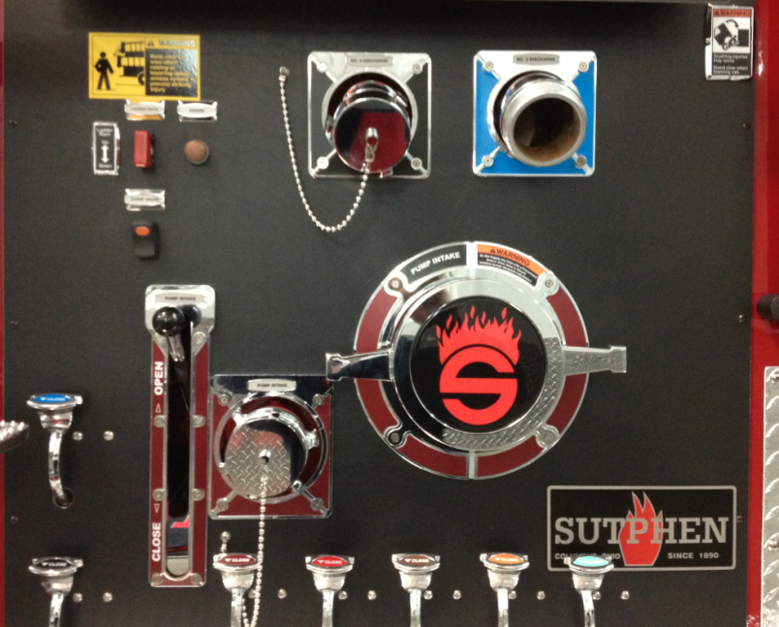
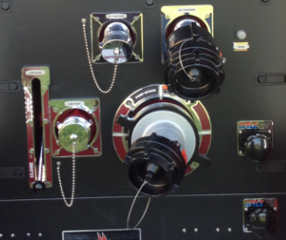
Did you know?
Behind the panel MIVs
Recommend a behind-the-panel Master Intake Valve for 6” inlets due to the close proximity of the inlets to the discharges (specifically with the Hale Qmax-XS).
Reference STB-0021

Slide 11
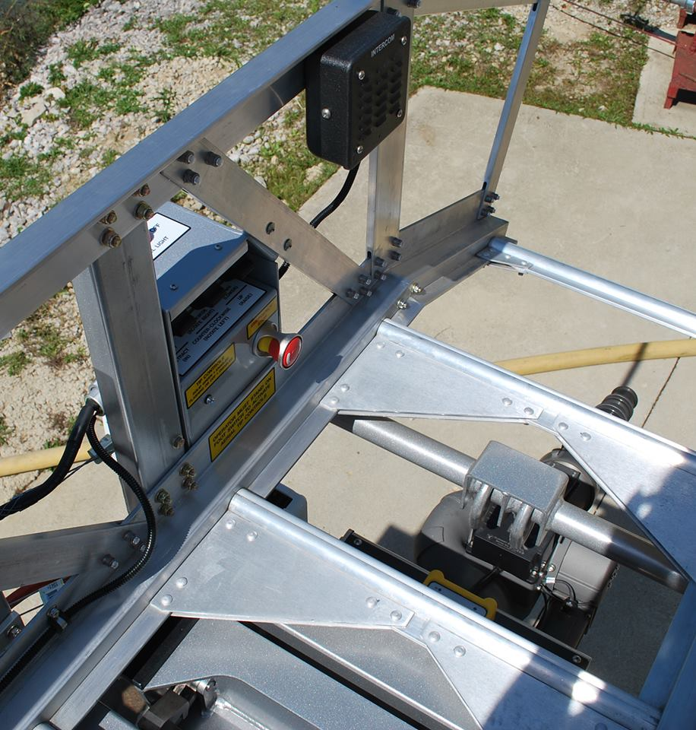
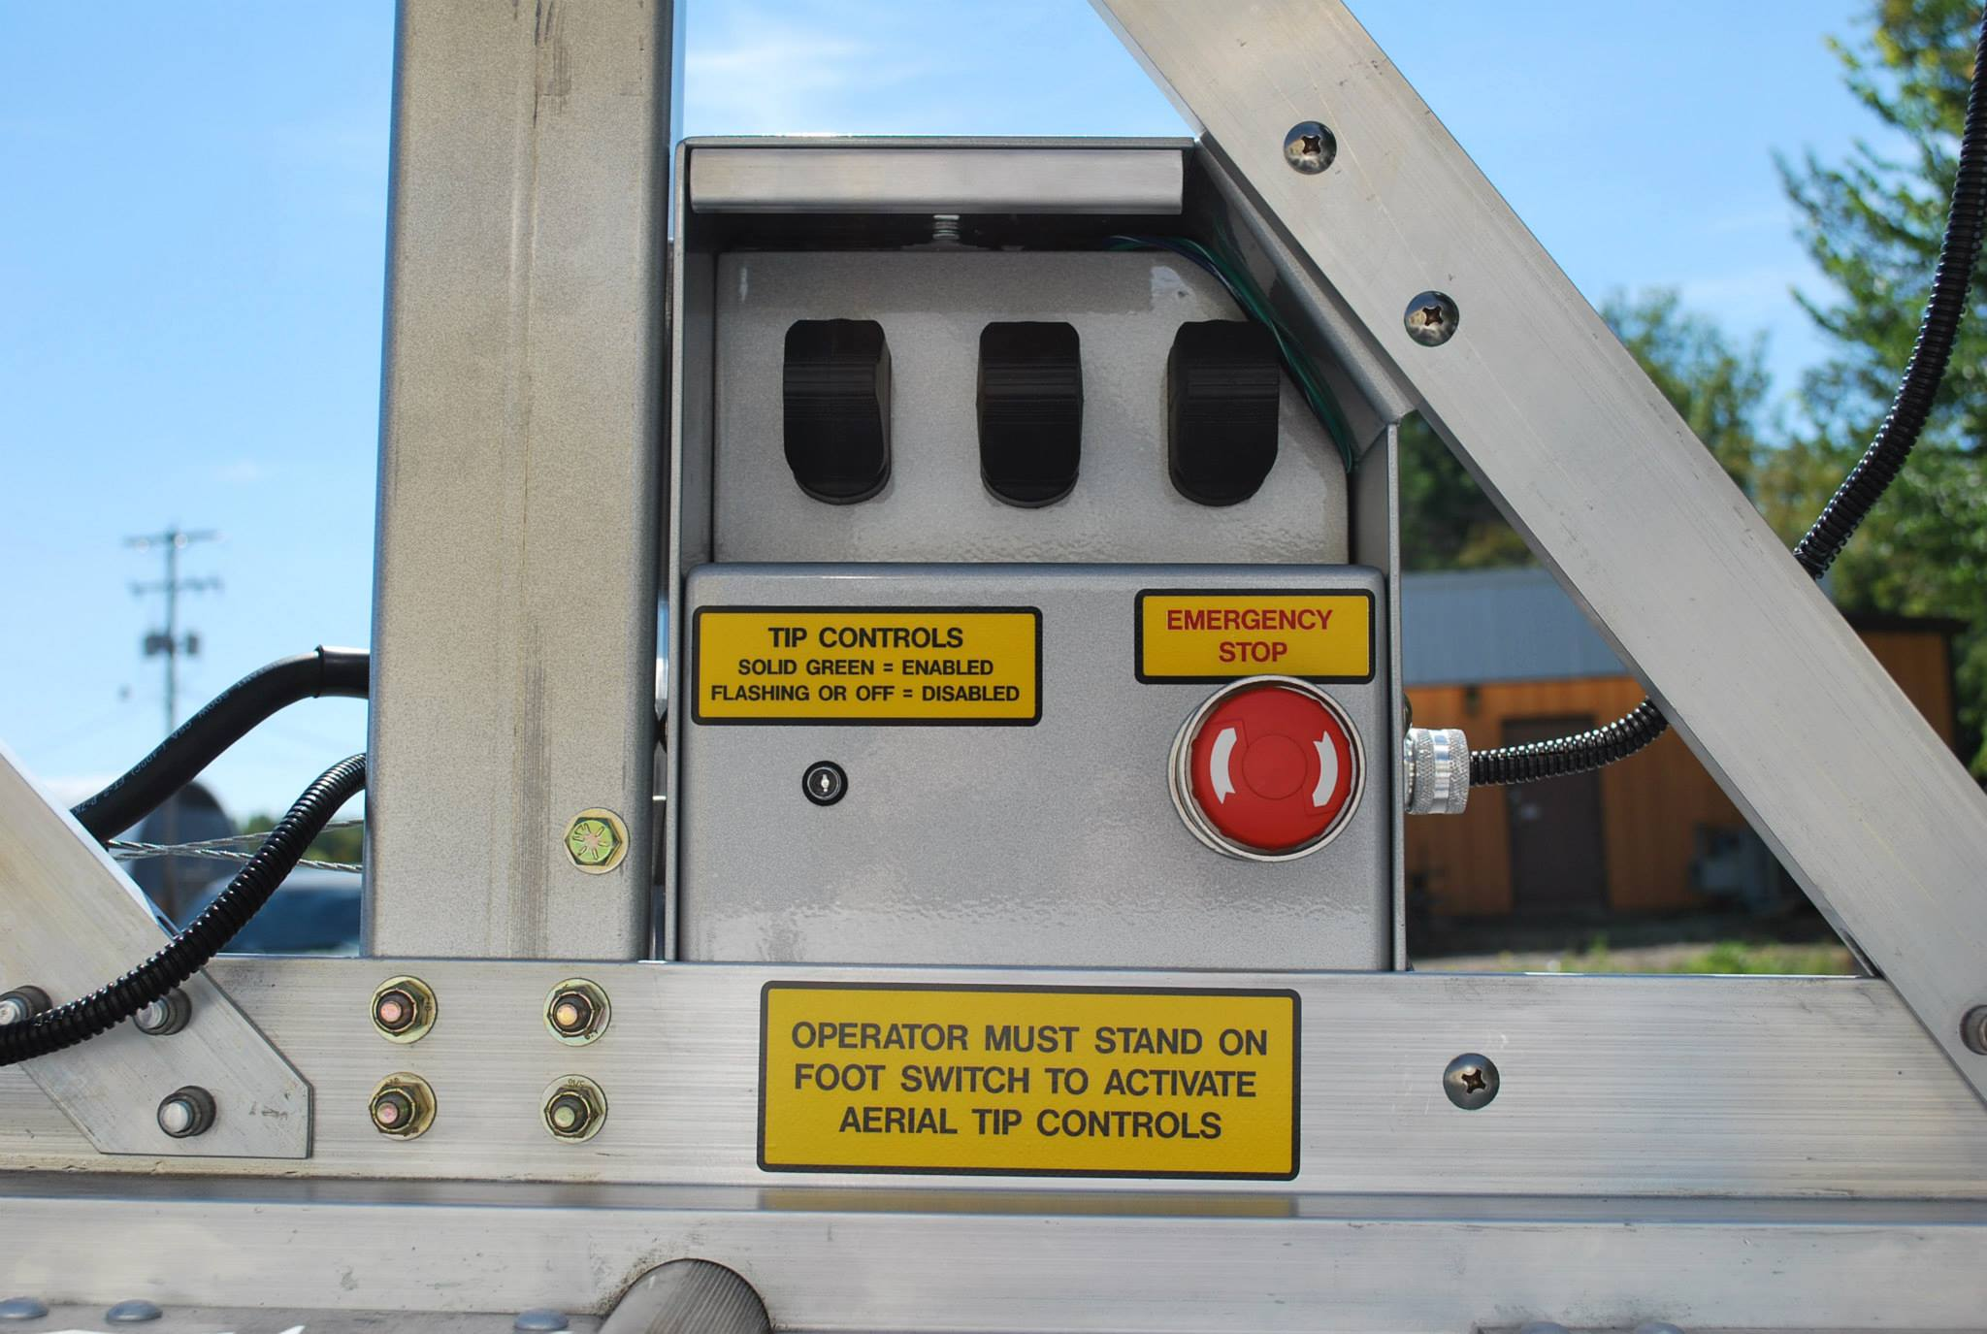
Did you know we now have an option for tip controls on the SL aerials?
Fly-section Controls:

Slide 12
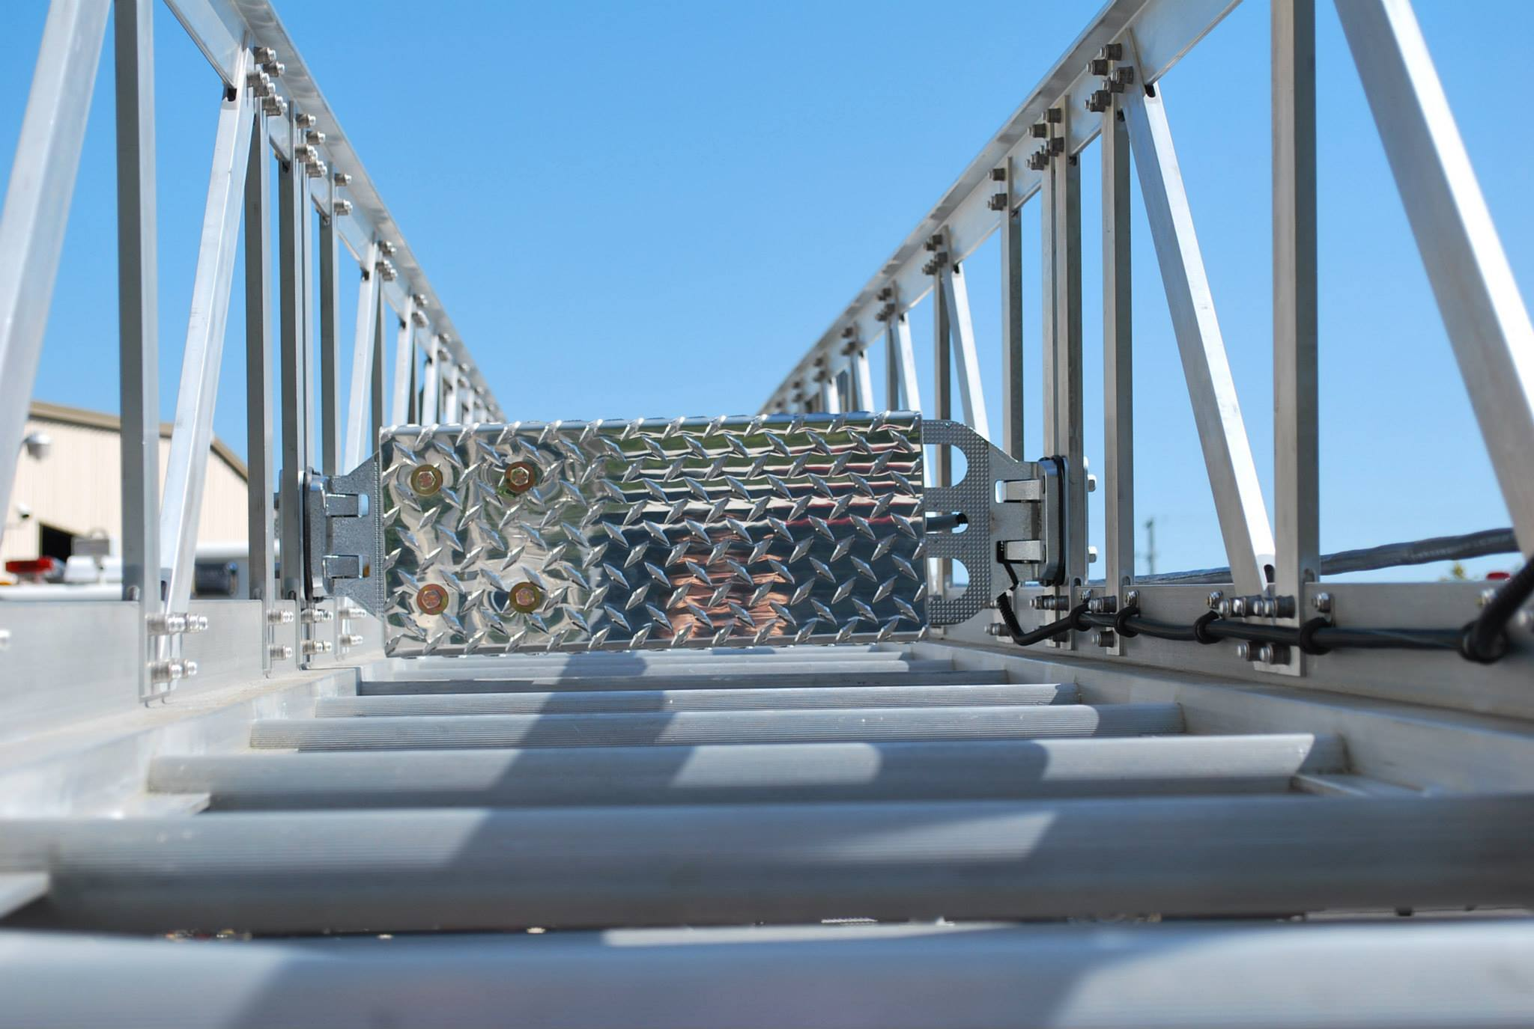
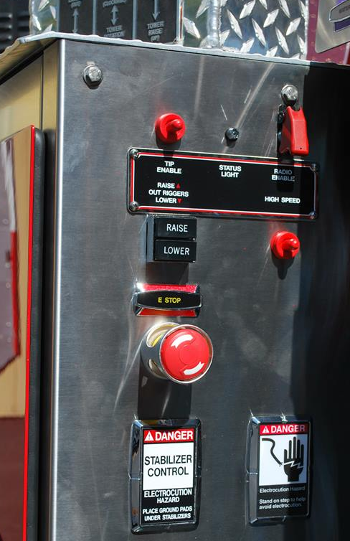
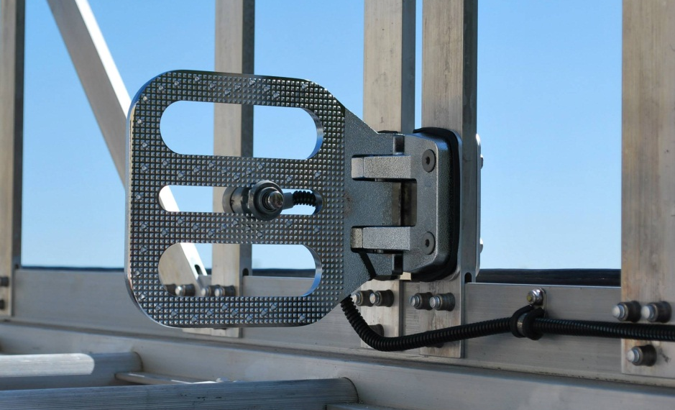
Tip Controls – SL Aerials
Pump Panel Controls
Operation Platform

Slide 13
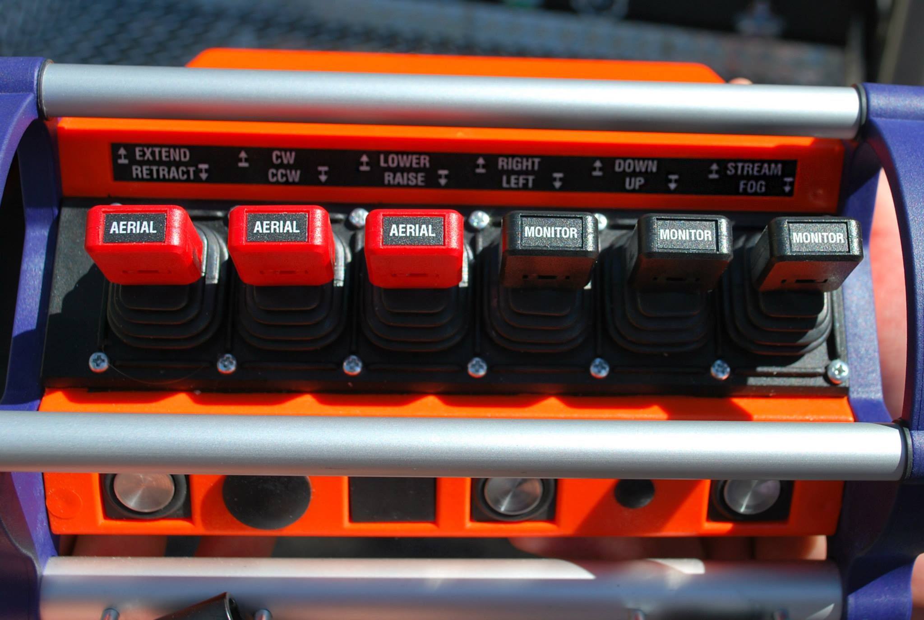
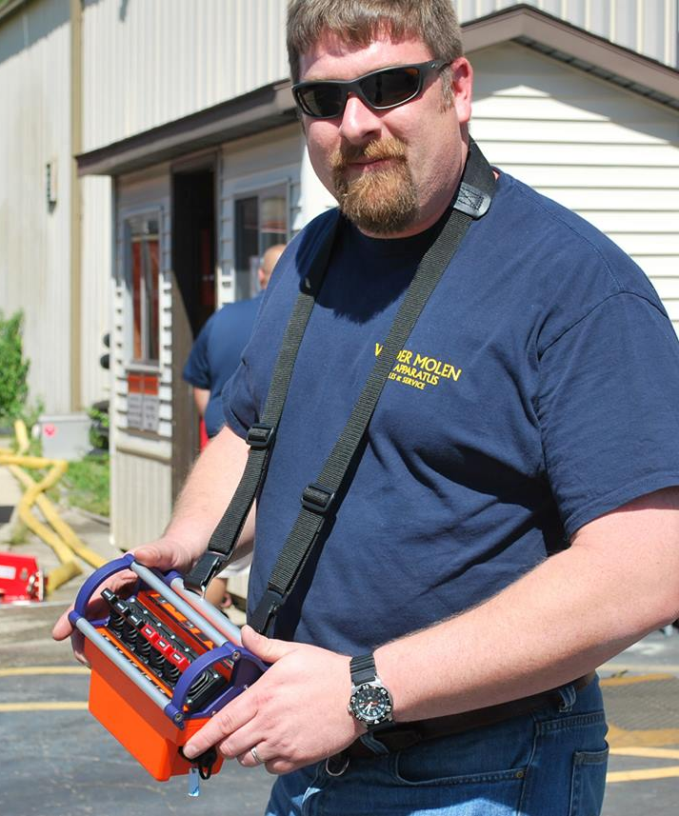
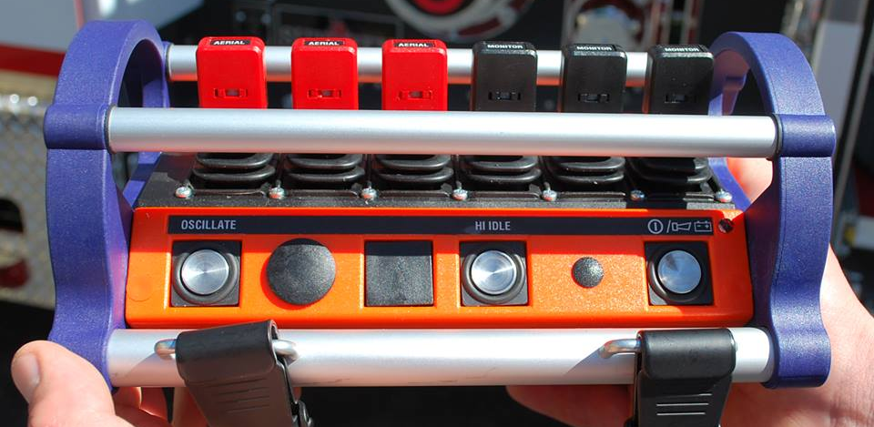
Did you know we also have an option for a wireless (or tethered) controller on the SL aerials?
Wireless Controller

Slide 14
Why is it so difficult to put more than 300 gallons of water on the SPH100 aerial platform??
The SPH100 was designed to be as short and compact as possible.
The SPH100 also is a 2-piece body with a flex joint between L3/R3 & L4/R4 compartments.

Slide 15
How can I get more water to fit in this compact configuration?
Option #1
Relocate the generator into a compartment.

Slide 16
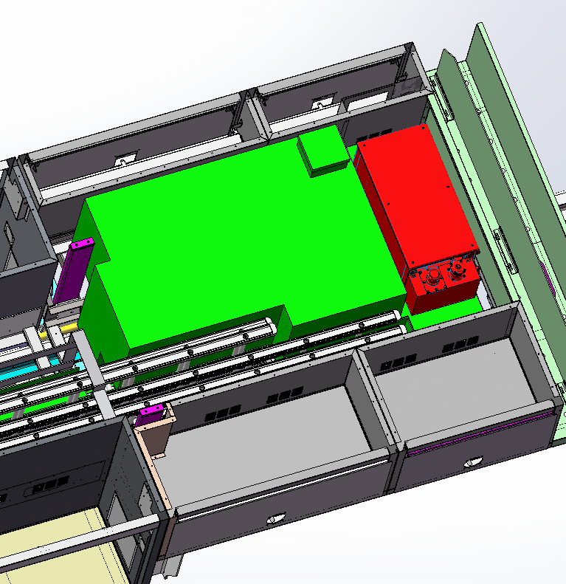
SPH100 Water Tank Sizes
Standard Configuration
Standard Configuration:
  300 Gallons of Water
  Space for generator at front of body
  Standard ladder compliment
        (1) 35’ 2-section ladder
        (1) 24’ 2-section ladder
        (2) 16’ roof ladders
        (1) 14’ combo ladder
  Full-length hose bed (130”L)

Slide 17
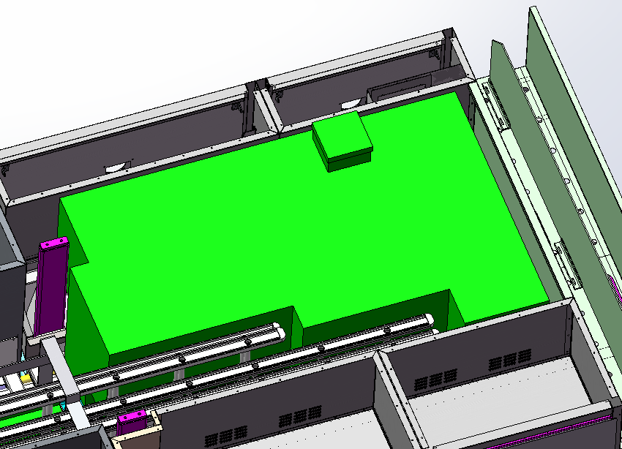
SPH100 Water Tank Sizes
Relocated Generator Only
Option #1 (relocate generator):
  Adds 55 gallons of water (365 total)
  Standard ladder compliment
        (1) 35’ 2-section ladder
        (1) 24’ 2-section ladder
        (2) 16’ roof ladders
        (1) 14’ combo ladder
  Full-length hose bed (130”L)

Slide 18
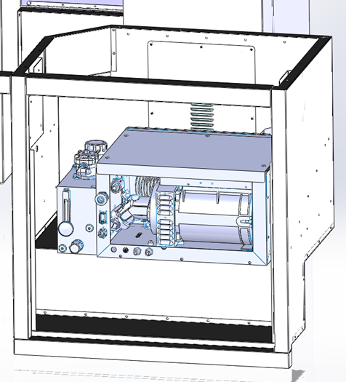
SPH100 Water Tank Sizes
Relocated Generator Location Options
In R1 compartment above exhaust notch (using Harrison MAS 6-10kw):

Slide 19
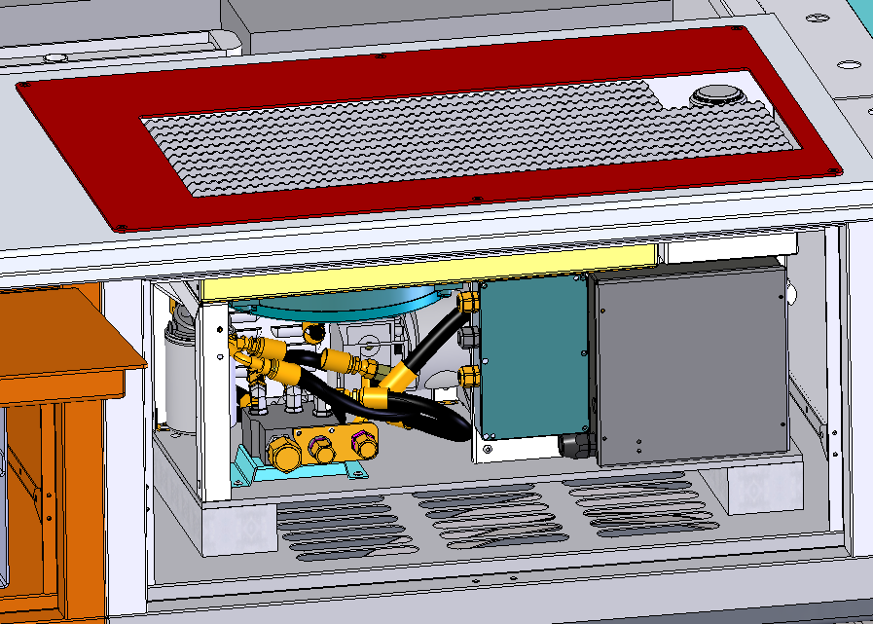
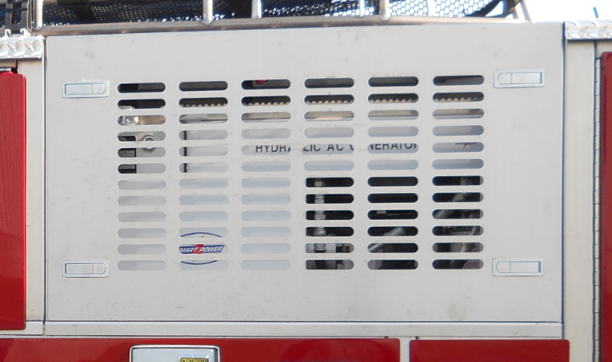
SPH100 Water Tank Sizes
Relocated Generator Location Options
In R2 compartment (using Smart Power HR Series 6-10kw or Harrison MAS 6-10kw):

Slide 20
How can I get even MORE water to fit in this compact configuration?
Lose some hose bed capacity
    can add a 24” long x 12” wide overhang on the rear of the water tank)
    gains 25 gallons of water
    looses 20” of hose bed length (approx. 130’ of 5” hose)
    Cannot overhang the water tank more than 24” past the body flex joint (unsupported wing)

Slide 21
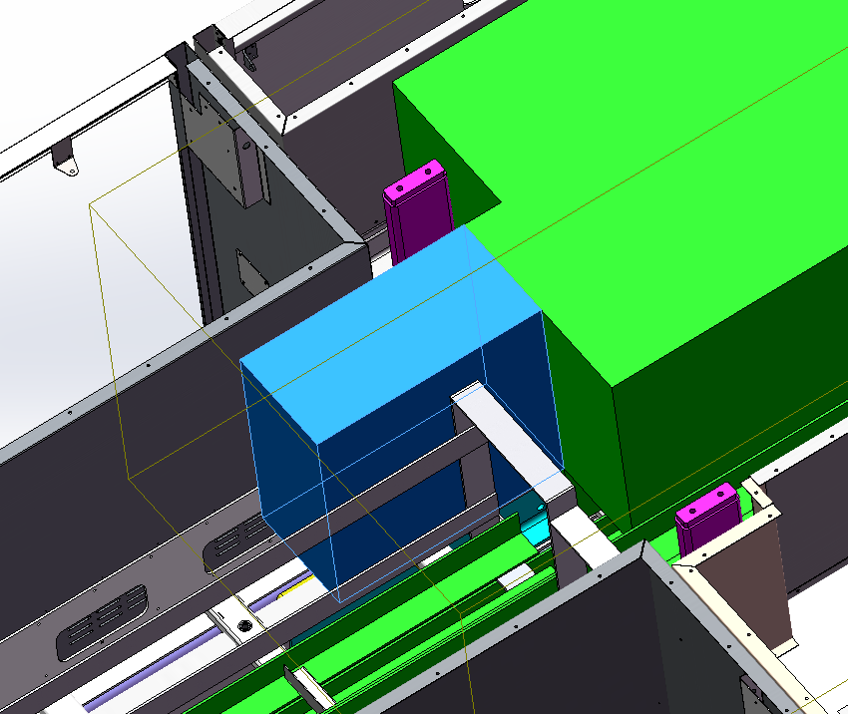
SPH100 Water Tank Sizes
Reduce Hose Bed Length

Slide 22
How can I get even MORE water to fit in this compact configuration?
Lose hose bed capacity and ladders (or relocate)
    Various examples:
        440 gallons w/relocated generator, 600’ of 5” hose bed, and reduced/relocate ladders ((1) 35’ 2-sec, (1) 28’ 2-sec, (1) 14’ roof ladder in body)
        500 gallons w/relocated generator, 800’ of 5”/500’ of 2.5” hose bed, and reduced/relocated ladders ((1) 28’ 2-sec, (1) 18’ roof in body)

Slide 23
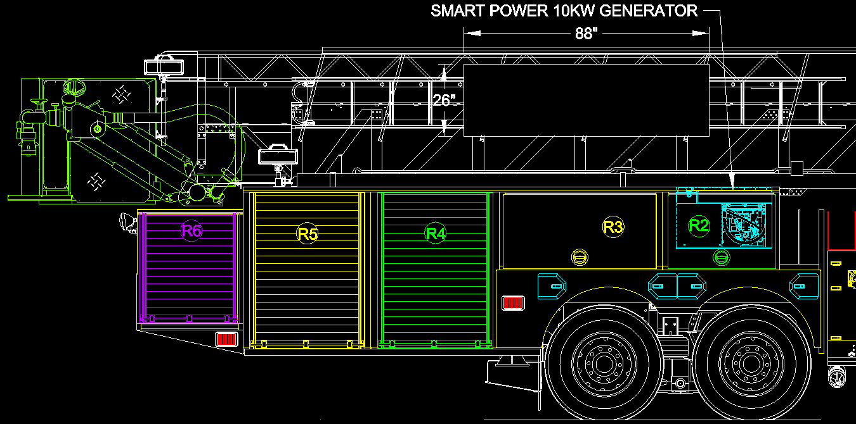
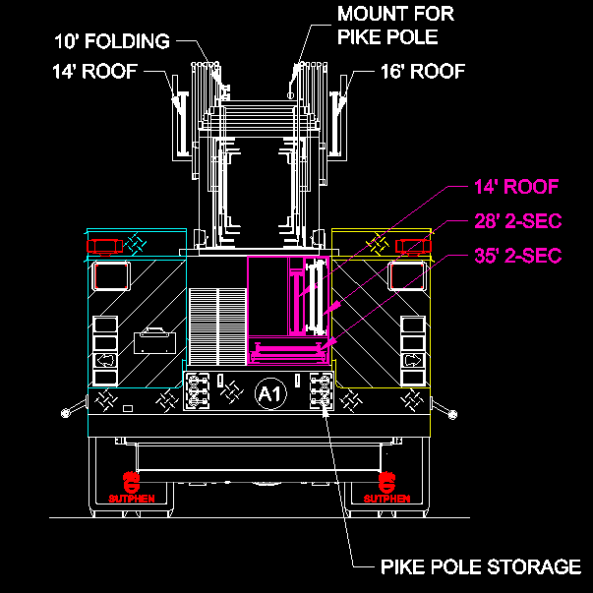
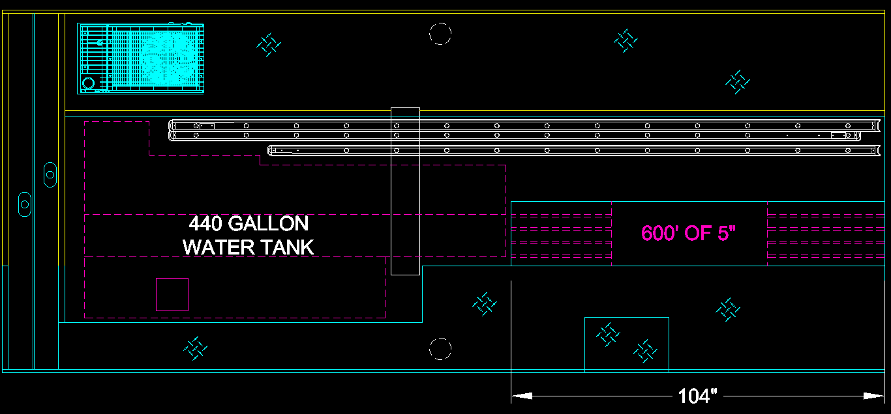
SPH100 Water Tank – 440 Gallons

Slide 24
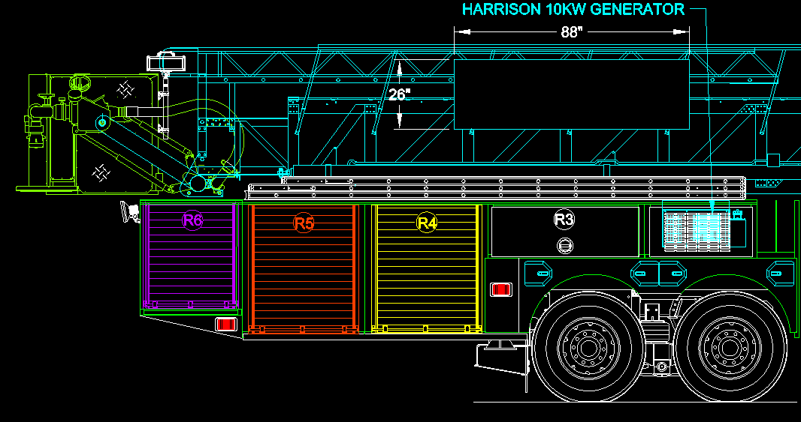
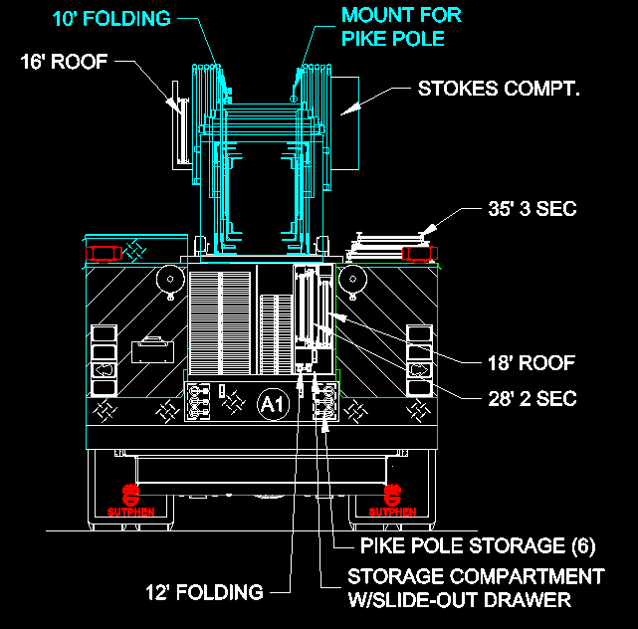
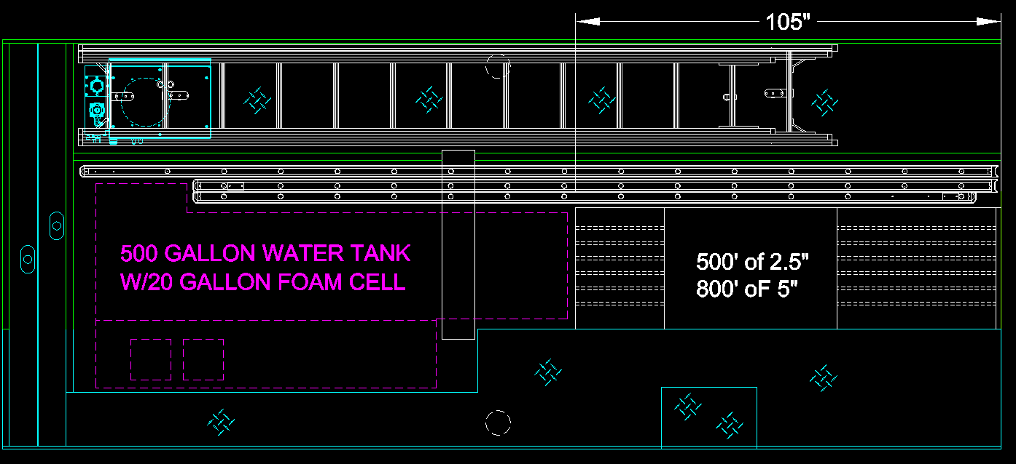
SPH100 Water Tank – 500 Gallons

Slide 25
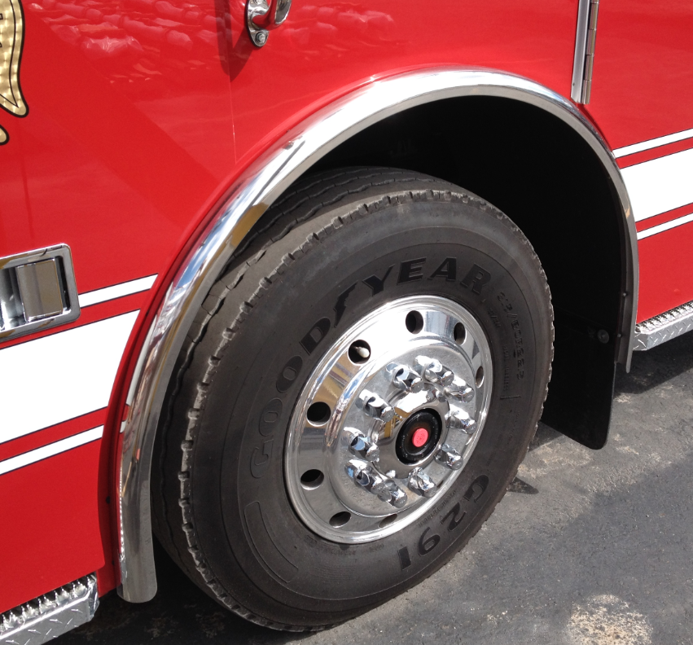
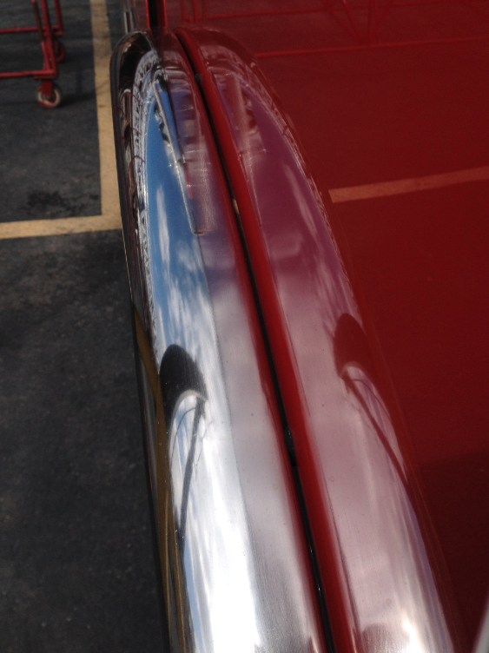
Did you know we have recently redesigned our cab fender trim to help reduce corrosion?
New Surface Mounted Fender Trim

Slide 26
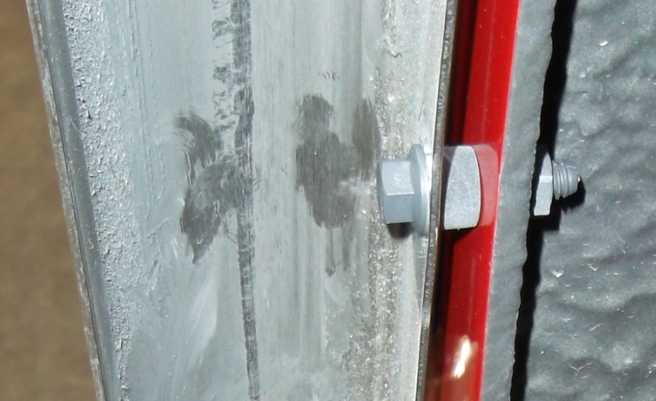
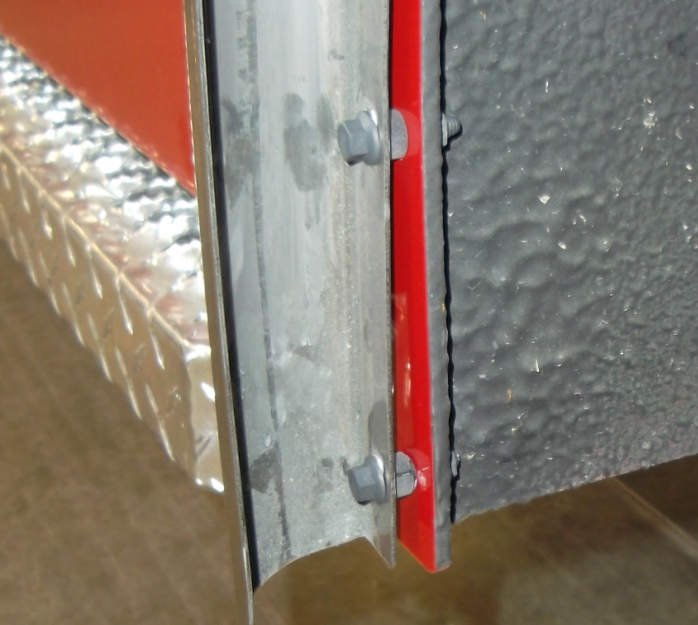
SURFACE MOUNTED CAB FENDER TRIM
Corrosion Resistant
Fiberglass nut and flange bolts
UHMW spacer ( UV stable / Moisture resistant )
Red Loctite
Stay tuned for an upcoming STB on this.

Slide 27

Did you know we have recently changed our interior cab coatings?
MultiSpec speckle paint (formerly Zolatone)
Gray
Black
Reference STB-0018
Red also available (not pictured)

Slide 28
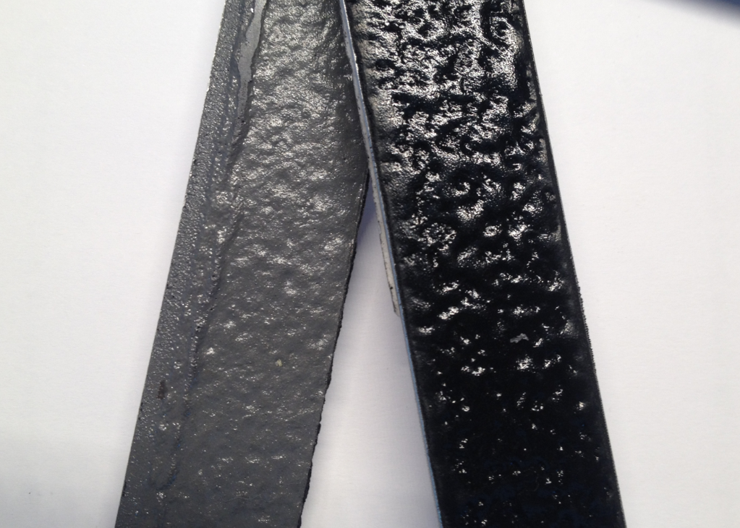
Interior Cab Coatings
Scorpion polyurethane blend (formerly Raptor)
Gray
Black
Reference STB-0018

Slide 29
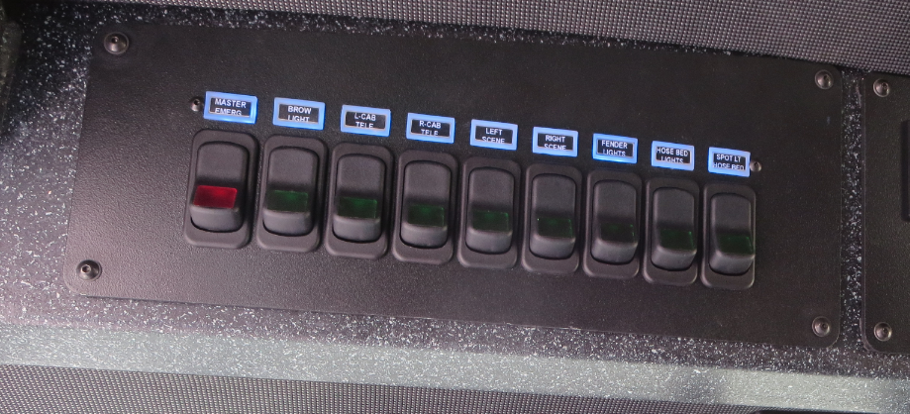
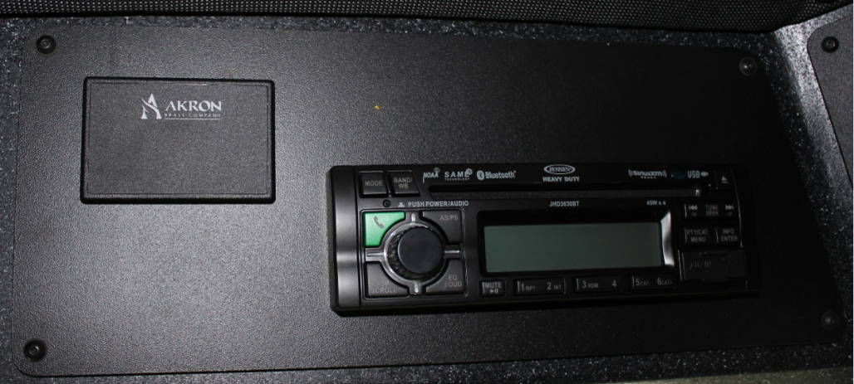
Do’s & Don’ts
Interior Cab Command Consoles
Overhead Command Consoles
Position #1 – above driver
Warning/scene light switches
Position #2 – above driver
Blank as standard
1 switch per function included above driver
Common items:
Stereo
Traffic advisor
Siren head
Reference STB-0017

Slide 30
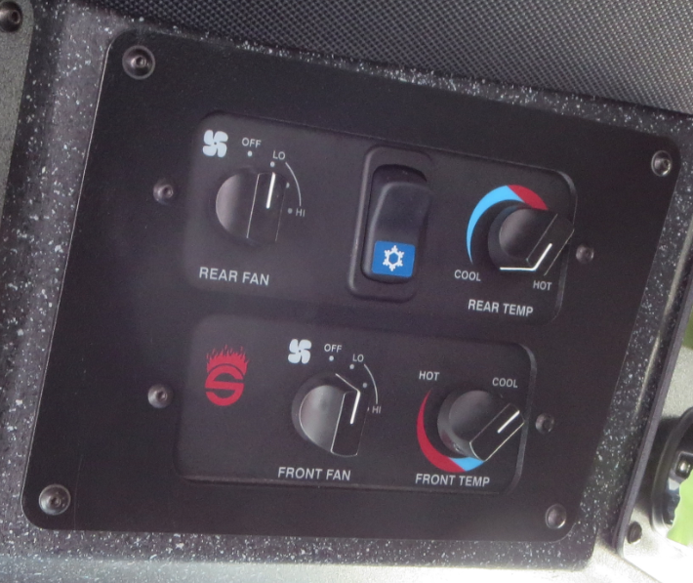
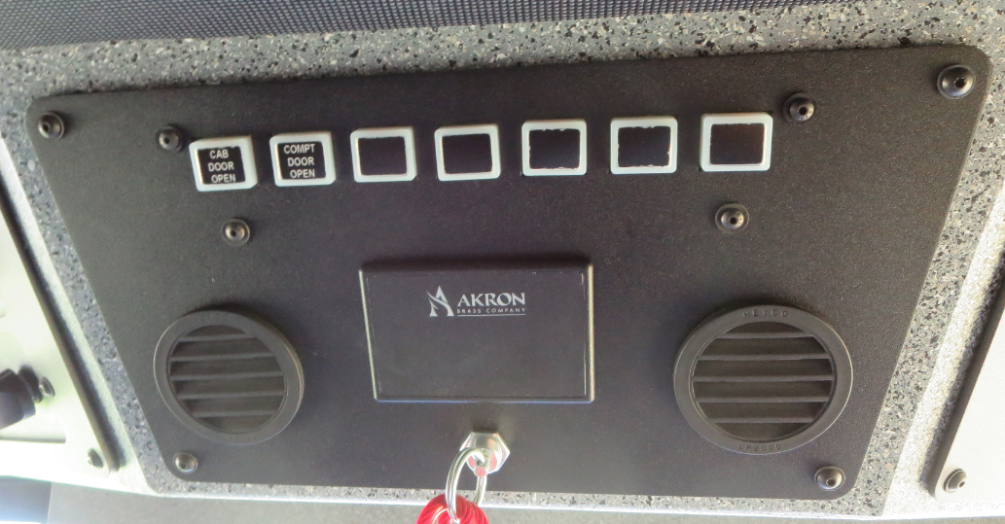
Do’s & Don’ts
Interior Cab Command Consoles
Overhead Command Consoles
Position #3 – above driver
Defroster/Heater/A-C Controls
Position #4 – center
Warning indicators & Seat belt monitor
These cannot be moved.

Slide 31
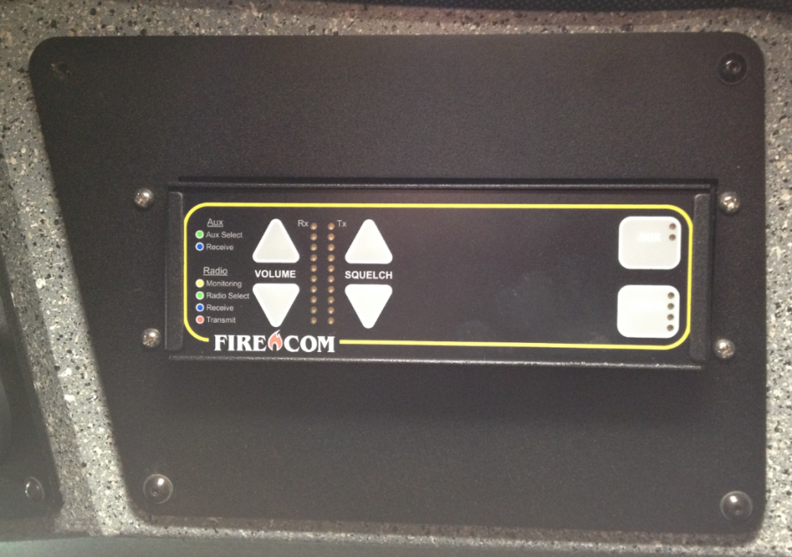
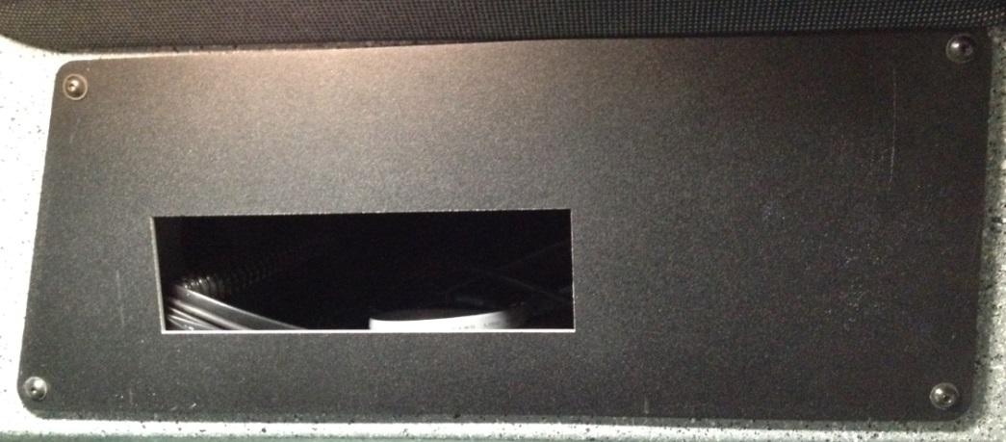
Do’s & Don’ts
Interior Cab Command Consoles
Overhead Command Consoles
Position #5 – above officer
Blank as standard (limited space)
Position #6 – above officer
Blank as standard
Common items:
Stereo
Mobile Radio
Siren Head
Common items:
Digital speedometer
Firecom intercom head

Slide 32
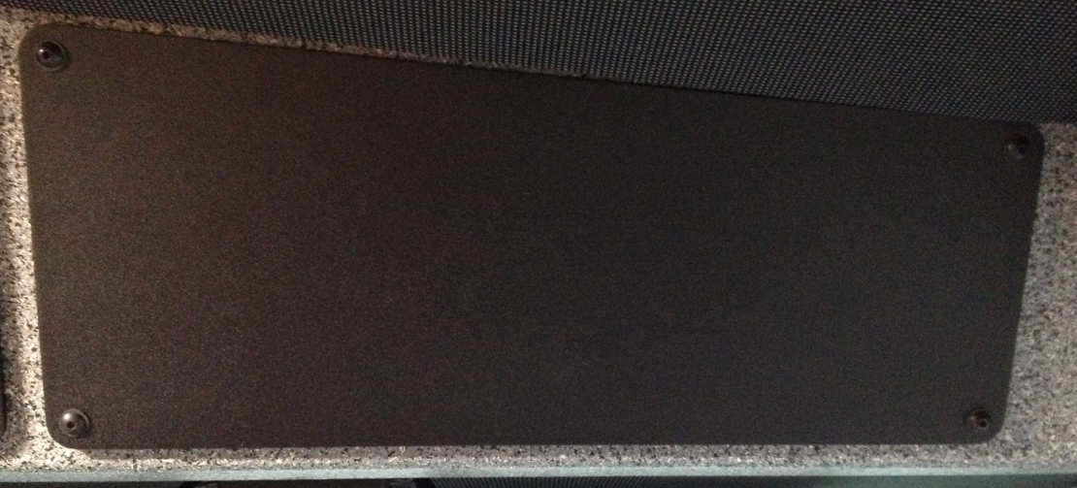
Do’s & Don’ts
Interior Cab Command Consoles
Overhead Command Consoles
Position #7 – above officer
Blank as standard
There is limited depth behind this panel due to coolant lines and wiring.
Common items:
Secondary switches
Stereo
Certain mobile radios
Siren head

Slide 33
Do’s & Don’ts
Interior Cab Command Consoles
Overhead Command Consoles
Position #7 – Secondary Switches
(2) Options for secondary switches:
  Standard secondary switch – This will require the item/function to be turned on or off from the same location. I.E. – if the driver turns on the brow light, the driver has to turn it off. The officer cannot turn it off from his side with this type of switch.
  3-way secondary switch – This will allow the item/function to be turned on or off from either location using a momentary switch and relay. I.E. – If the driver turns it on, the officer can turn it off, and vice versa.

Slide 34
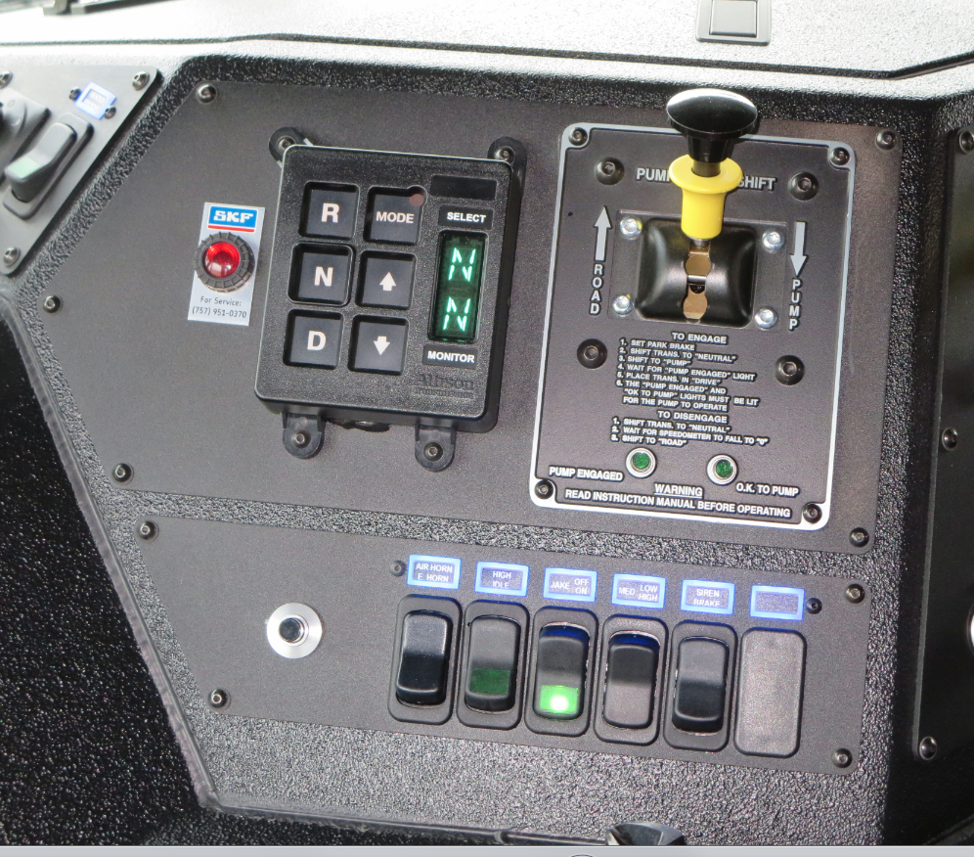
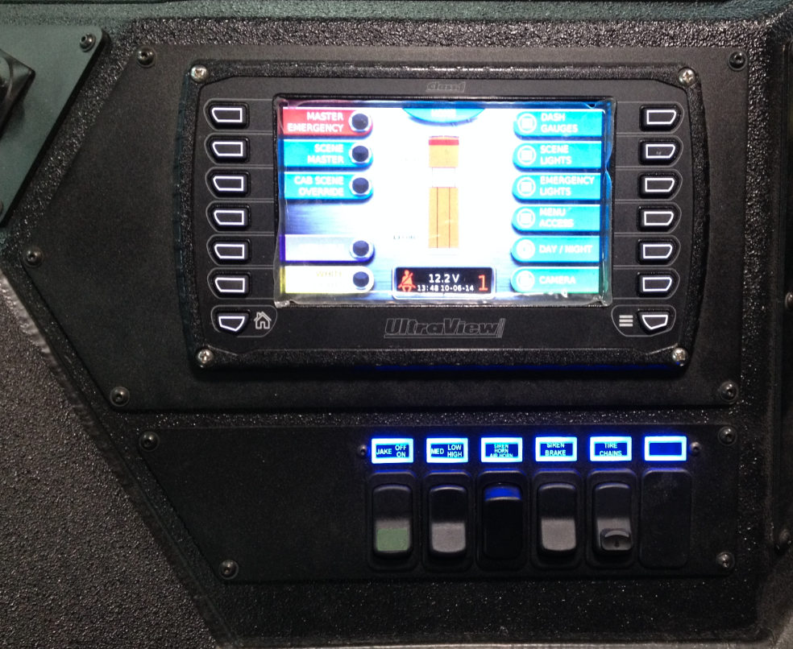
Do’s & Don’ts
Interior Cab Command Consoles
Lower Command Consoles
Position #1 (hard-wired) – near driver
Transmission shifter, pump shift, main truck function switches
Position #1 (multiplex) – near driver
Multiplex display, other truck function switches customer elects to not be controlled by the display

Slide 35
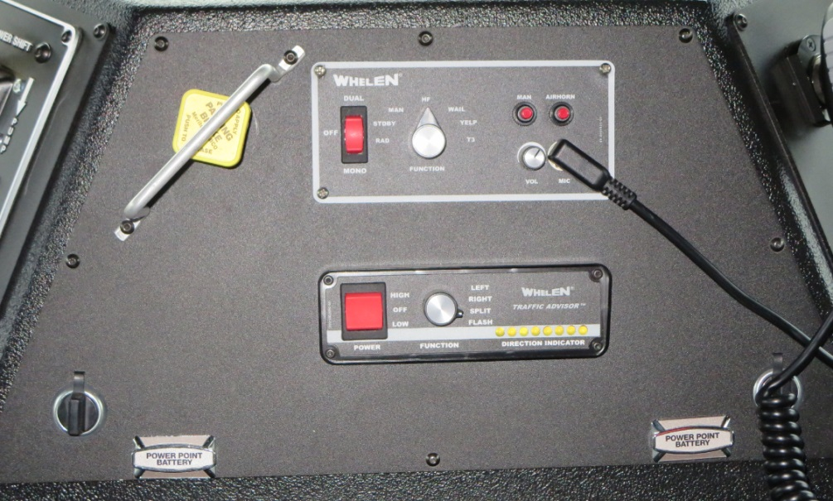
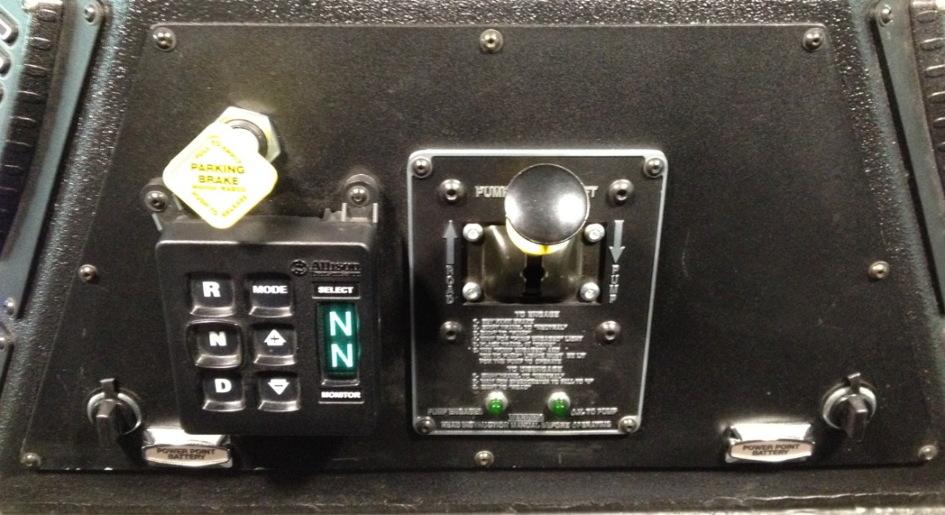
Do’s & Don’ts
Interior Cab Command Consoles
Lower Command Consoles
Position #2 (hard-wired) – center
Parking brake knob, 12v power points
Position #2 (multiplex) – center
Transmission shifter, pump shift, parking brake knob, 12v power points
Common items:
Siren head
Traffic advisor
Mobile radio

Slide 36
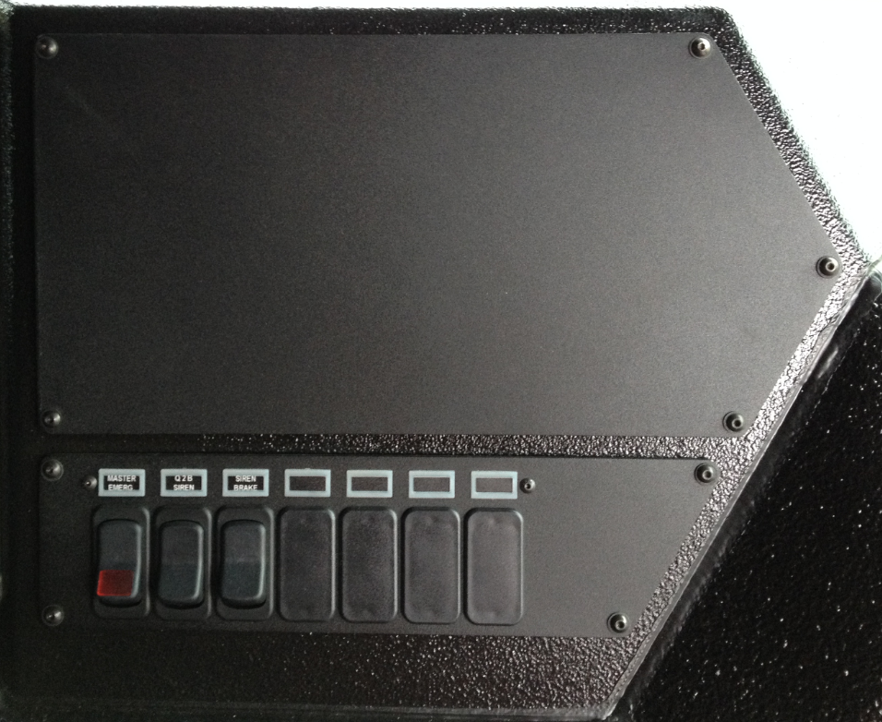
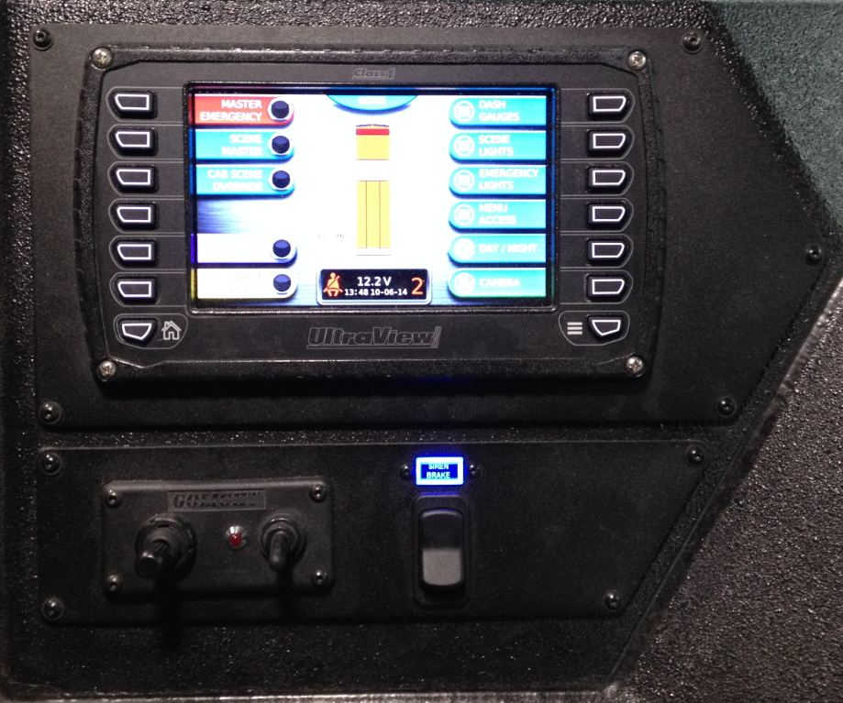
Do’s & Don’ts
Interior Cab Command Consoles
Lower Command Consoles
Position #3 (hard-wired) – near officer
Upper – blank
Lower – ME switch, Q2B siren brake
Position #2 (multiplex) – near officer
Multiplex display, other truck function switches customer elects to not be controlled by the display
Common items:
Certain siren heads
Traffic advisor
Golight controller

Slide 37
Do’s & Don’ts
Interior Cab Command Consoles
In the future we will NOT be providing laser cut holes in the overhead and lower command console panels for radios and other customer or dealer supplied/installed components (unless requested and costed appropriately).
Stay tuned for an upcoming STB on this.

Slide 38
Any Questions?

