Slide 1

Family Owned and Operated Since 1890
PRODUCT
HIGHLIGHTS

Slide 2
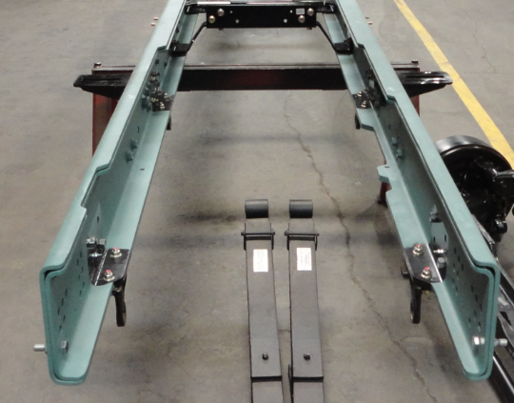
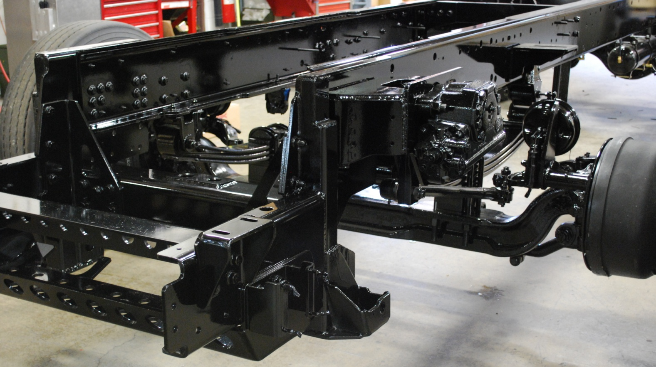

CHASSIS FRAME RAILS
10 3/16" x 3 1/2" x 3/8" thick (13” optional)
50,000 psi or 110,000psi Domex Steel
Treated with Cathacoat + Primer + Final Top Coat
Single or Double Rail

Slide 3
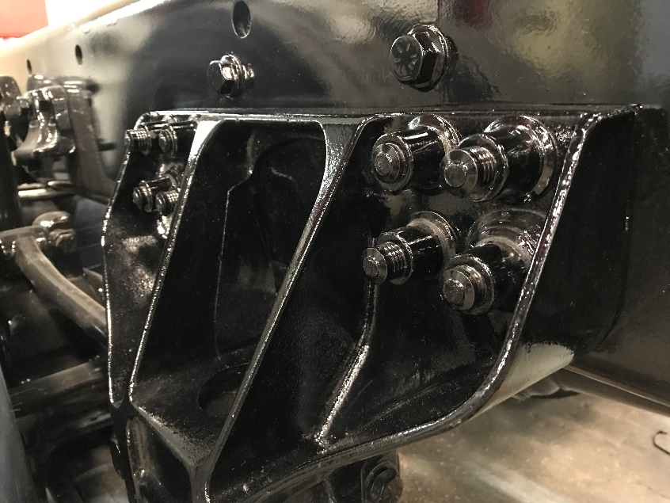
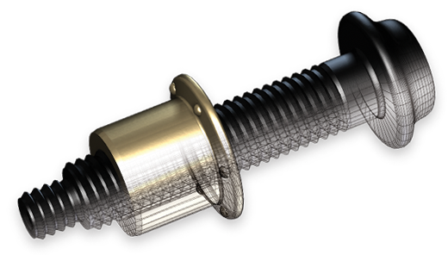
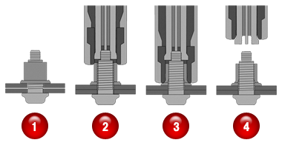
HUCK® BOBTAIL® FASTENERS
Used to attach cross members, suspension and other major components to the frame rails
Do not require torquing and will not work loose (maintenance free)

Slide 4
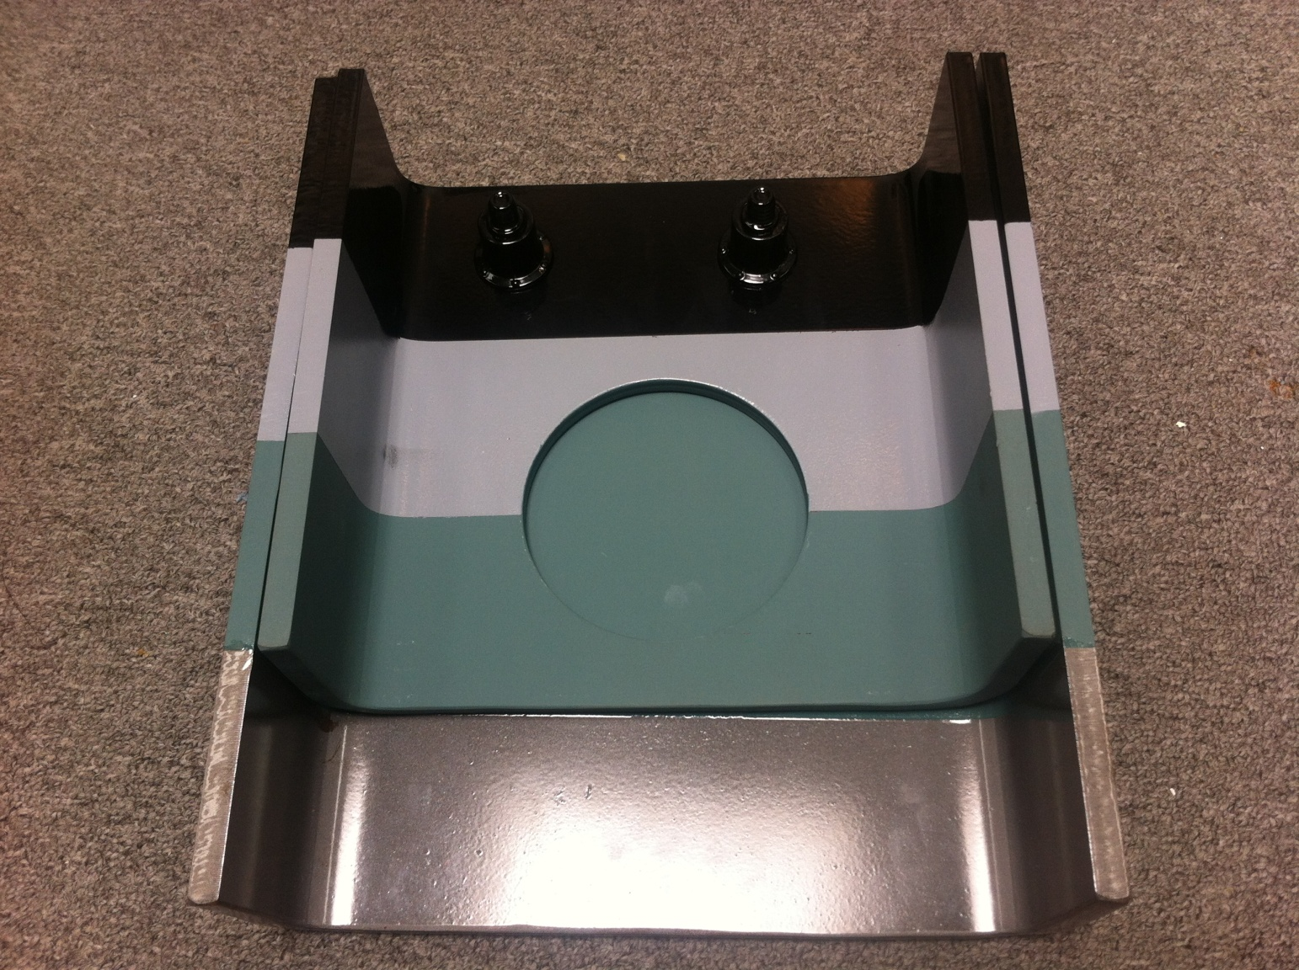
CATHACOAT® 302HB
High performance reinforced inorganic zinc-rich primer
Provides exceptional corrosion resistance & cathodic protection in severe industrial environments
Used to coat chassis components, aerial turntables, and other steel parts prior to priming and final top coat for unmatched corrosion protection

Slide 5
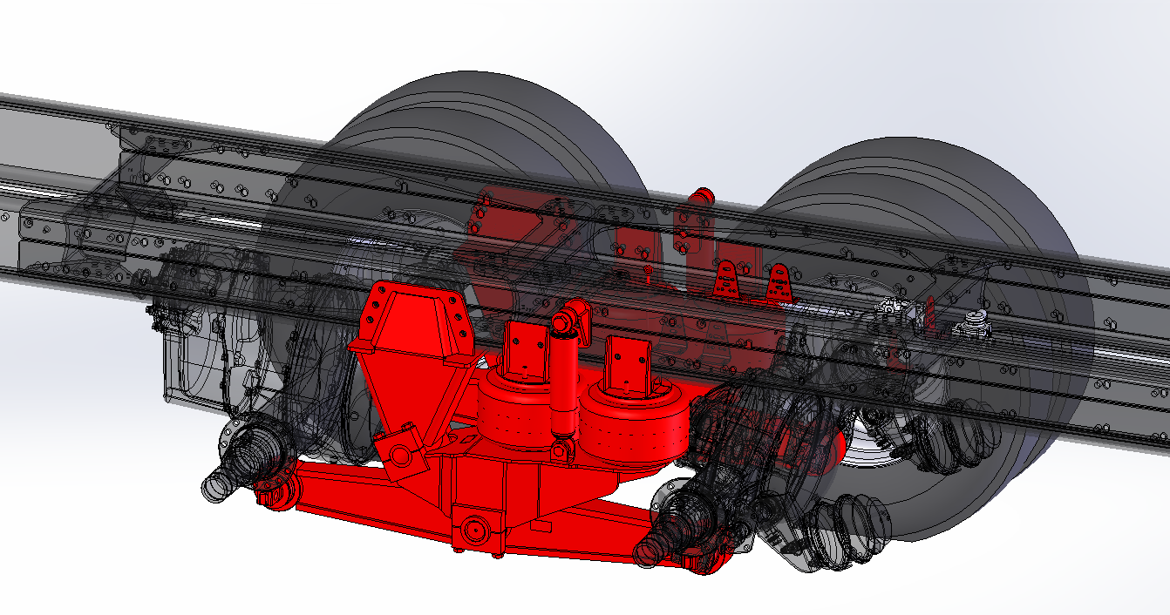
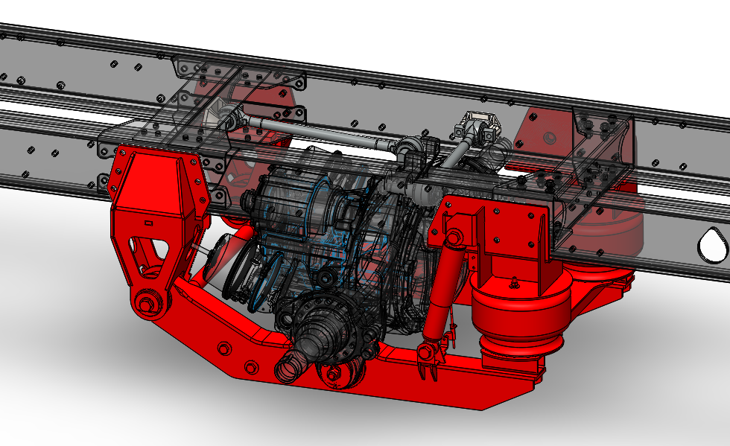
AIR RIDE SUSPENSION (AERIALS)
All Sutphen aerial apparatus come STANDARD with air ride rear suspension.

Slide 6
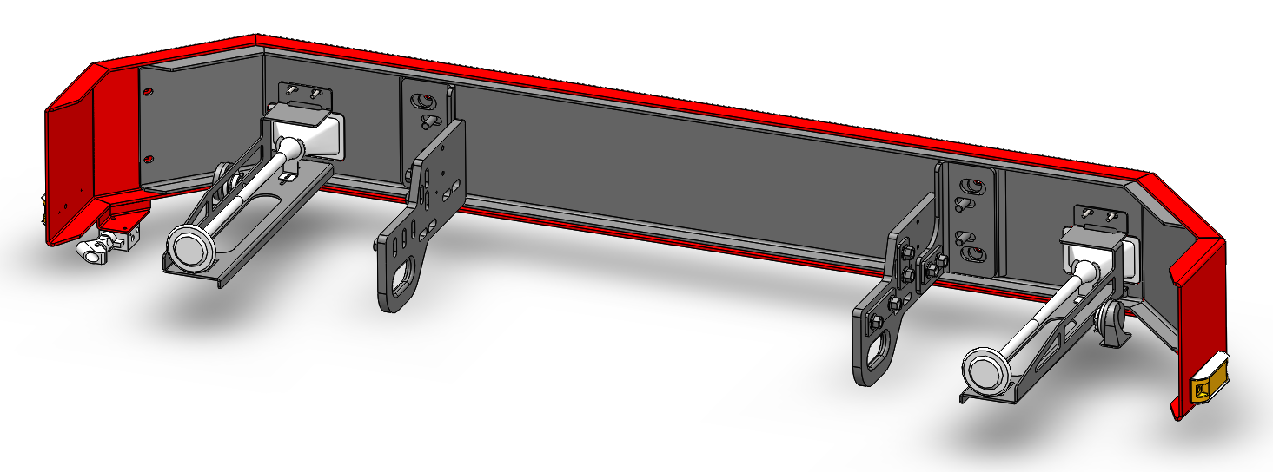
EXTREME DUTY BUMPERS
1/4" thick steel reinforcement behind 10 gauge stainless steel -OR- 1/4" thick painted steel outer skin
3/4" thick steel bumper extensions with integrated tow eyes (chamfered openings)
Extensions from 6" to 30" to accommodate numerous storage options

Slide 7
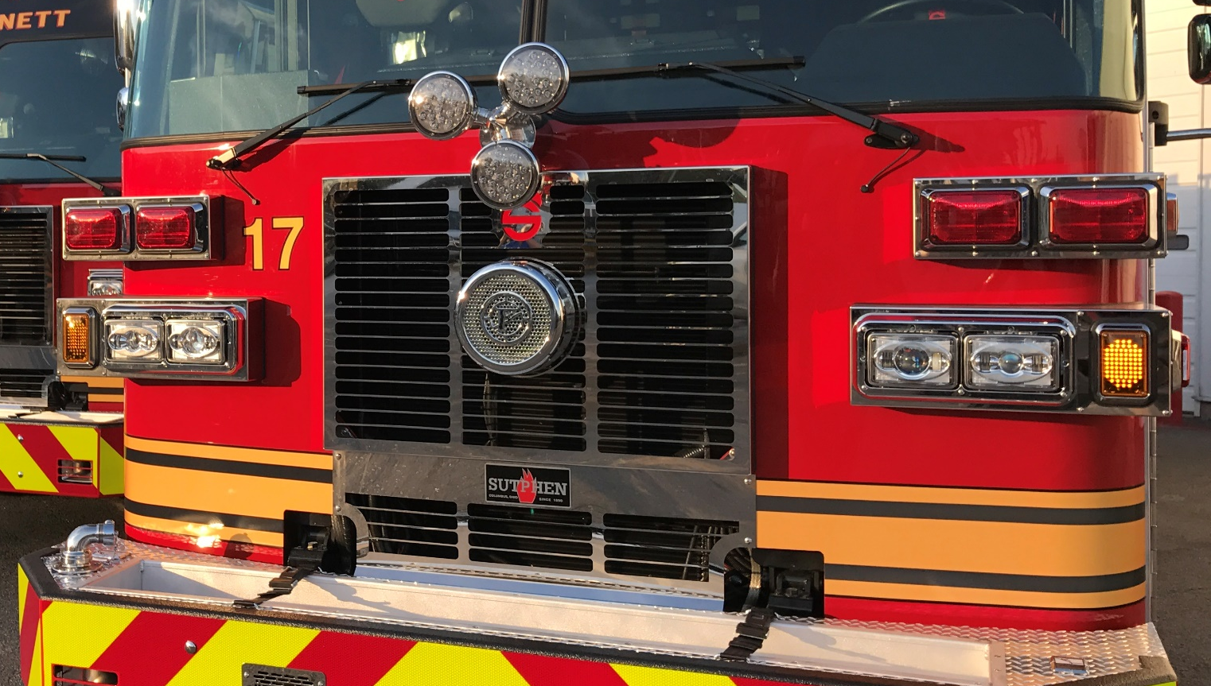
STAINLESS STEEL
GRILLE & LIGHT HOUSINGS
Front cab grille and light housings are 304 14-gauge stainless steel (no plastic).

Slide 8
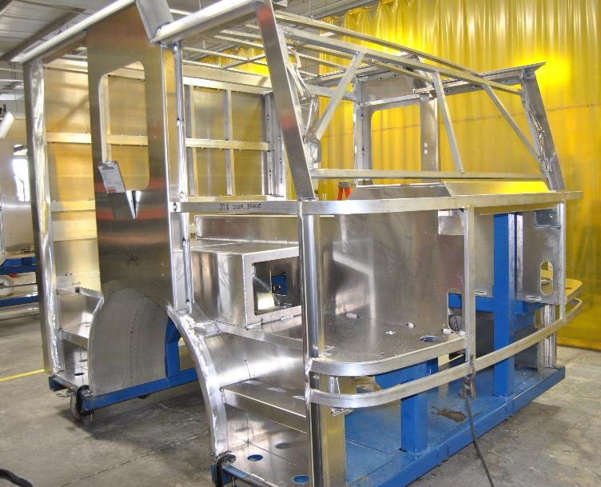
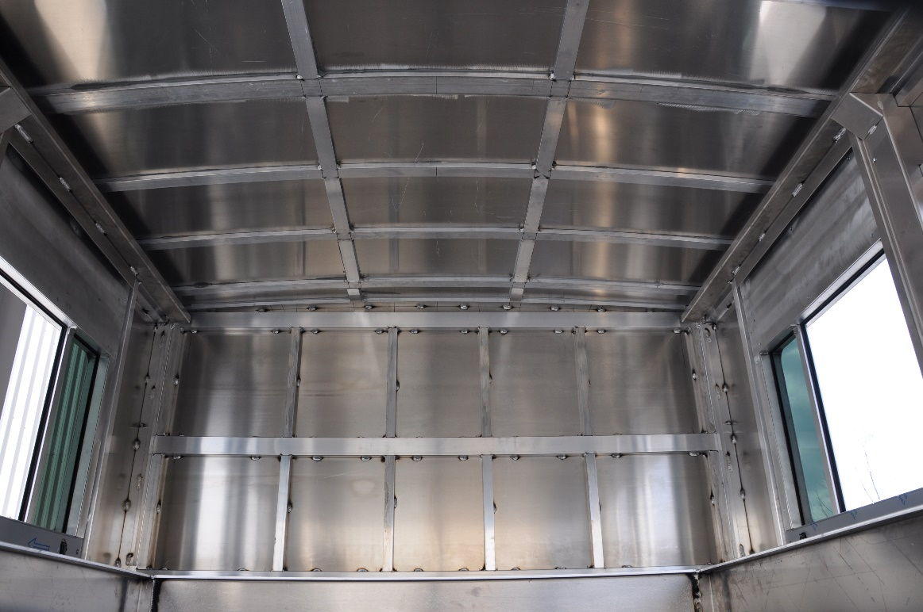
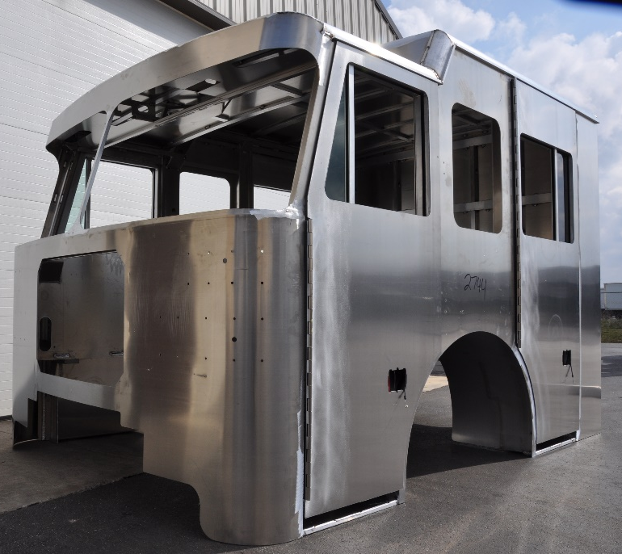
EXTREME DUTY ALUMINUM CAB
Constructed with 6061-T6 aluminum extrusions and 1/8” to 3/16” thick 5052-H32 aluminum outer skins
1/4” thick 5052-H32 aluminum floor
36”, 56", 62", 73", and 90" cab lengths (98” wide)
Flat, 10", 15", and 20" raised roof configurations

Slide 9
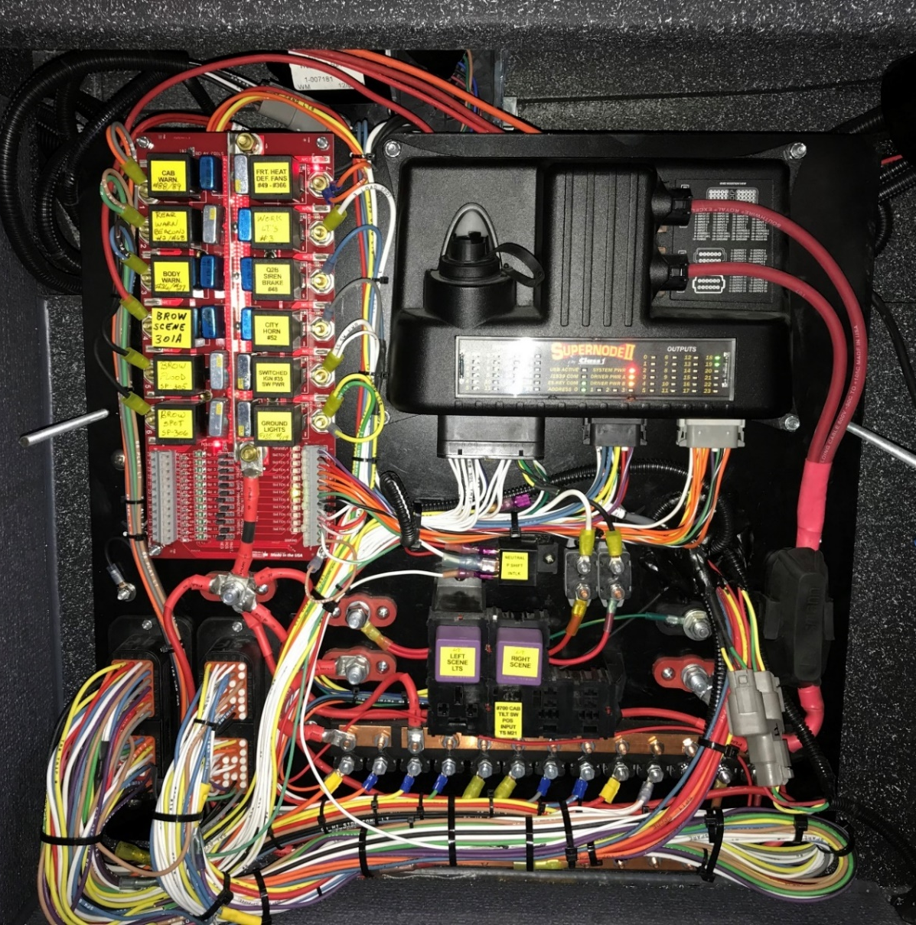
CAB ELECTRICAL DISTRIBUTION PANEL
Distribution panel is located in front of the officer behind a removable access panel.
Programmable Class 1 Super Node II utilized for load management and switching functions.

Slide 10
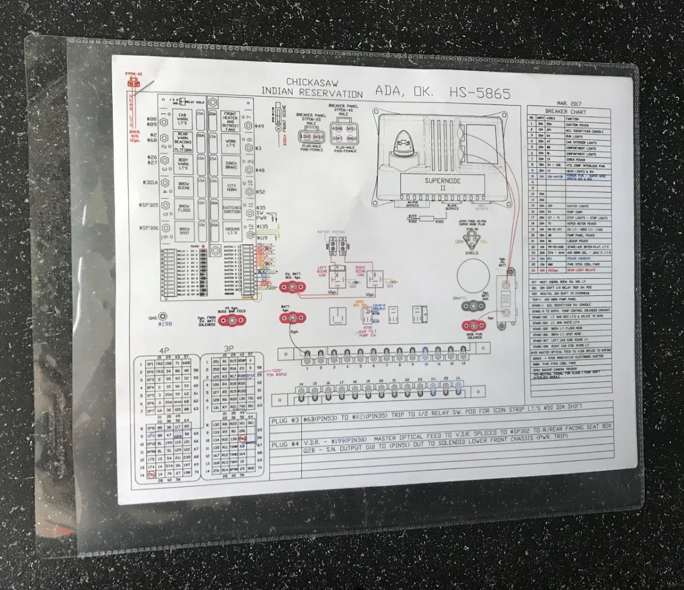
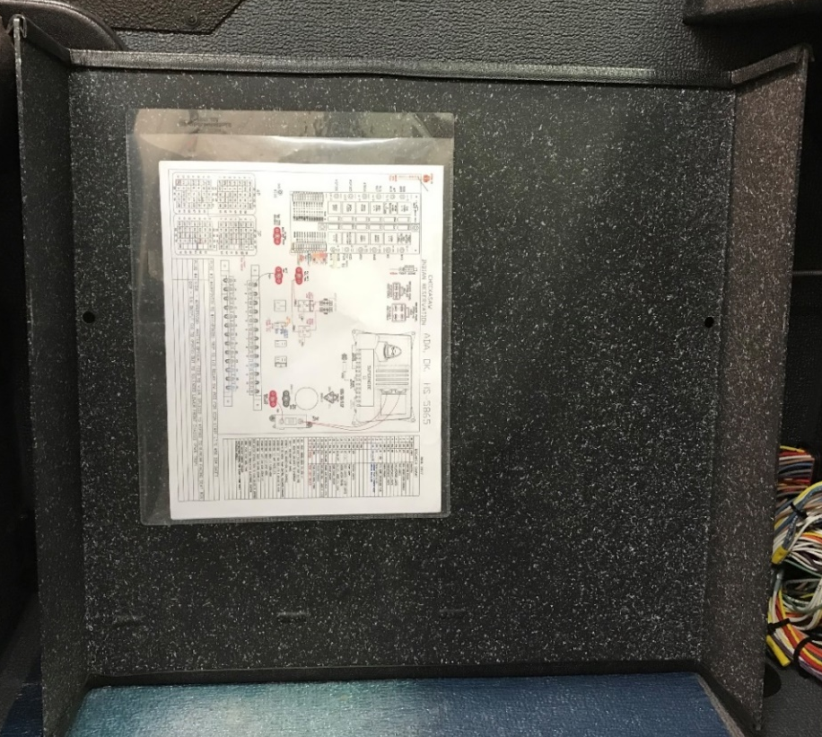
CAB ELECTRICAL DISTRIBUTION PANEL
Printed electrical diagrams are provided on the back side of the removable cover for quick access.

Slide 11
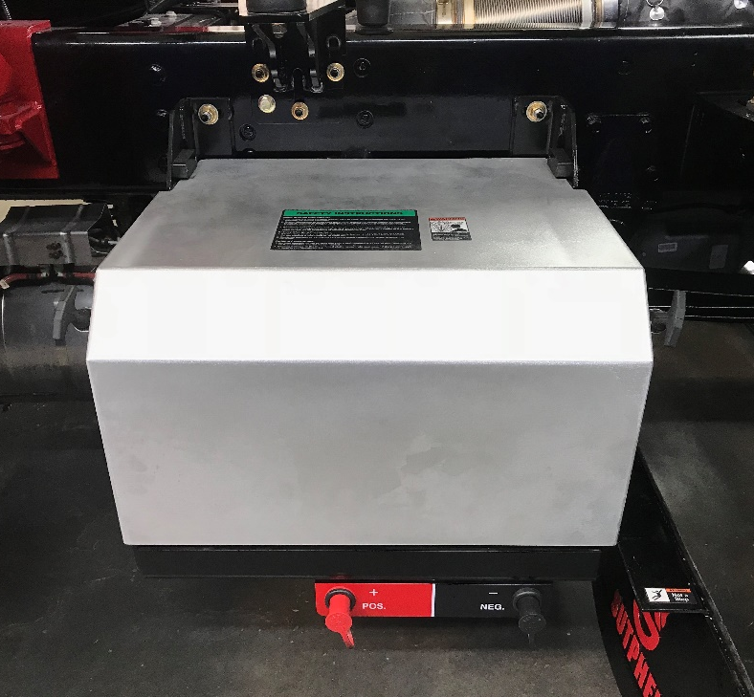
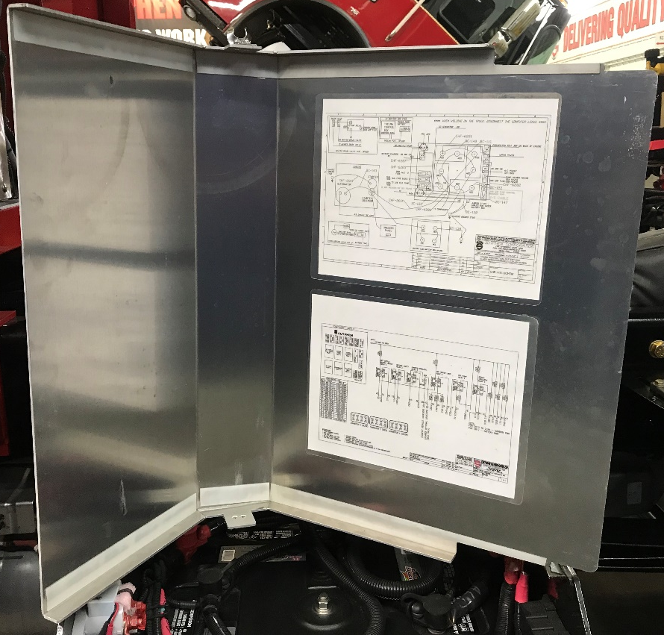
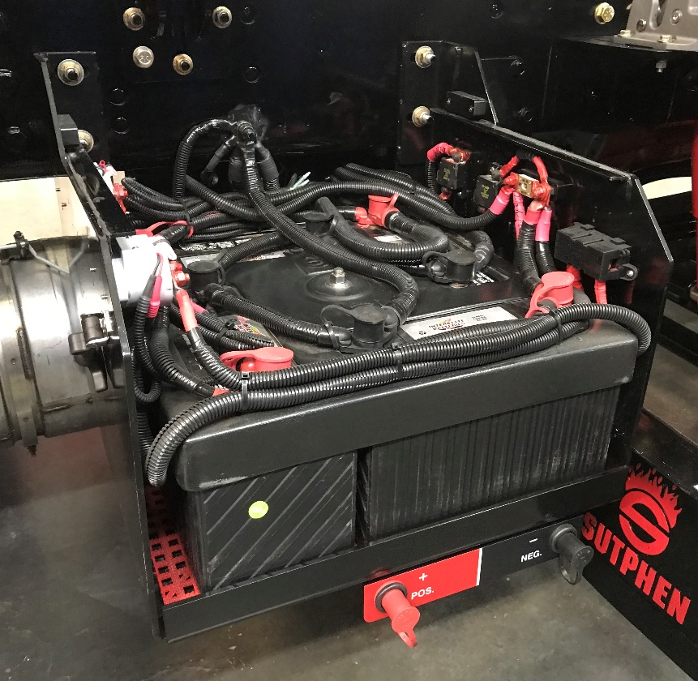
BATTERY BOX
Batteries housed in a 3/16” thick 304 stainless steel cradle with compartment matting installed under batteries
Removable aluminum lid with electrical diagrams secured to underside

Slide 12
Family Owned and Operated Since 1890
PRODUCT
HIGHLIGHTS

Slide 13
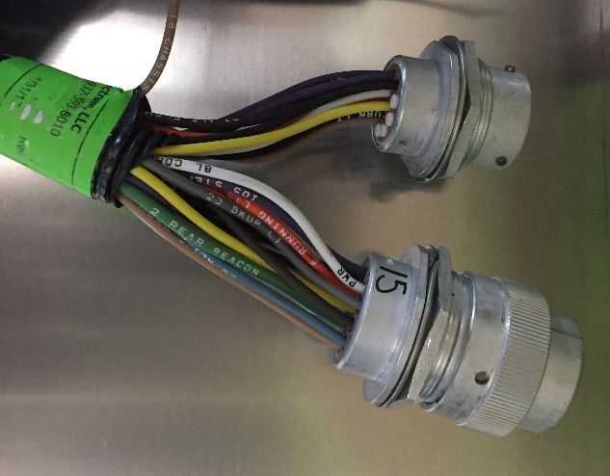
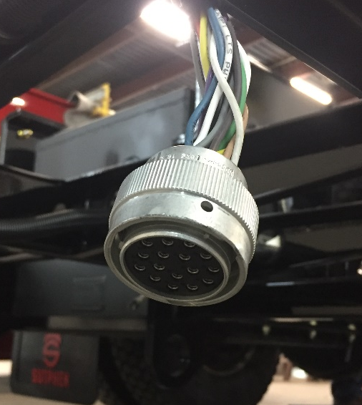
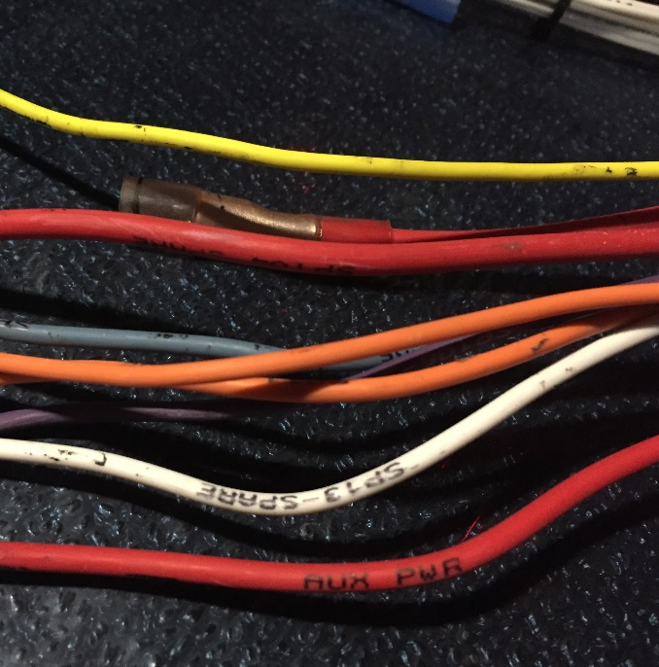
WIRING HARNESS
Standard point-to-point electrical system
Color coded wiring labeled every 3" with function
Heat-resistant loom and terminated with Deutsch connectors

Slide 14
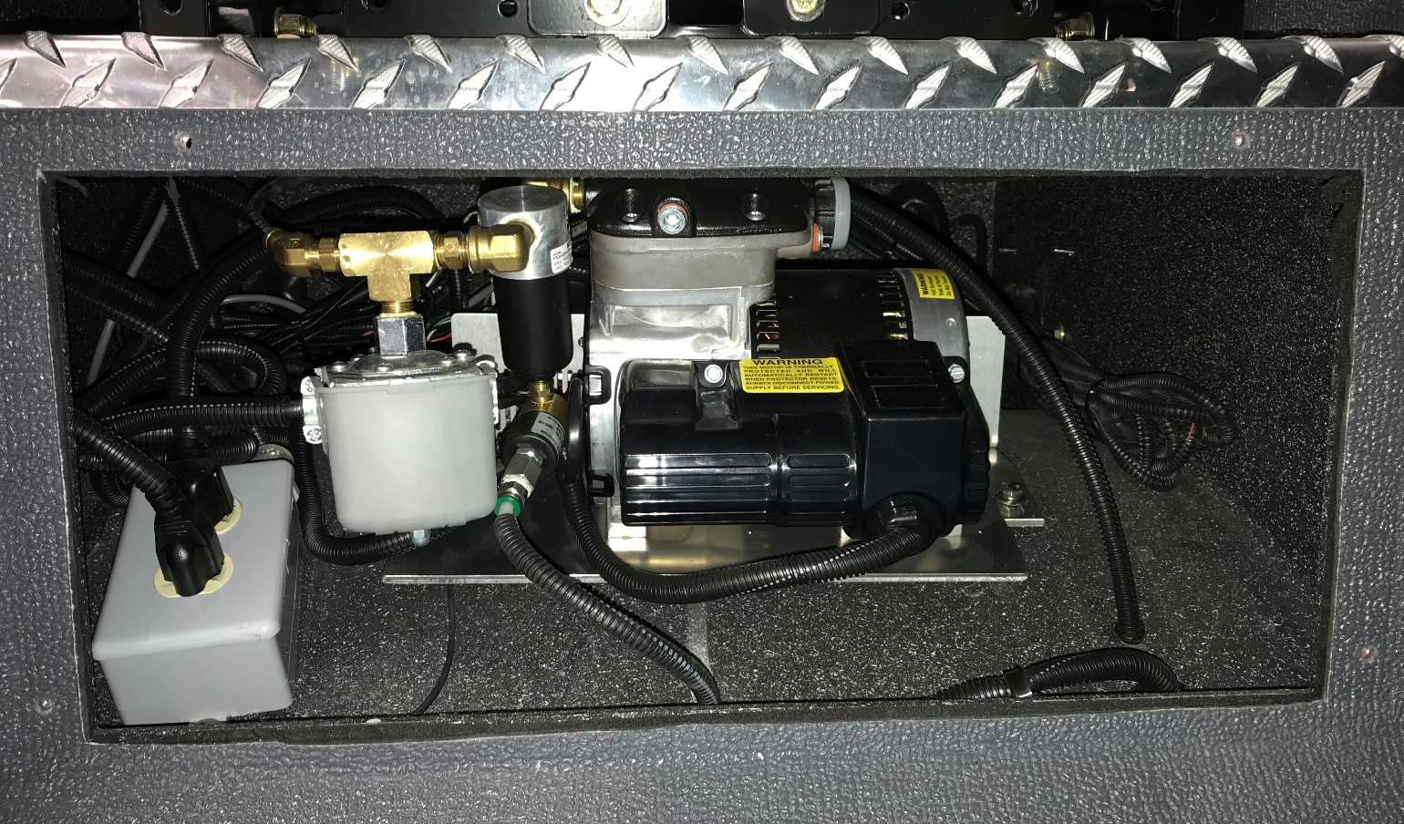
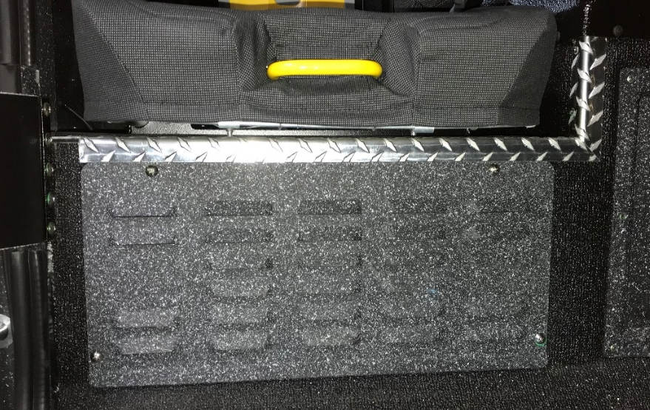
BATTERY CHARGER MOUNTING IN CAB
Battery charger and air compressor (optional) are stored inside the cab in a vented compartment (not exposed).
Units are plugged into a 120V receptacle for easy service.
Air compressor has an automatic drain routed through the wheel well.

Slide 15
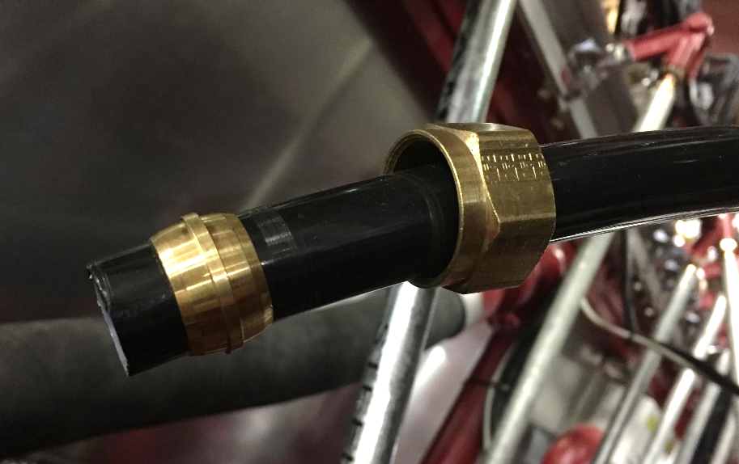
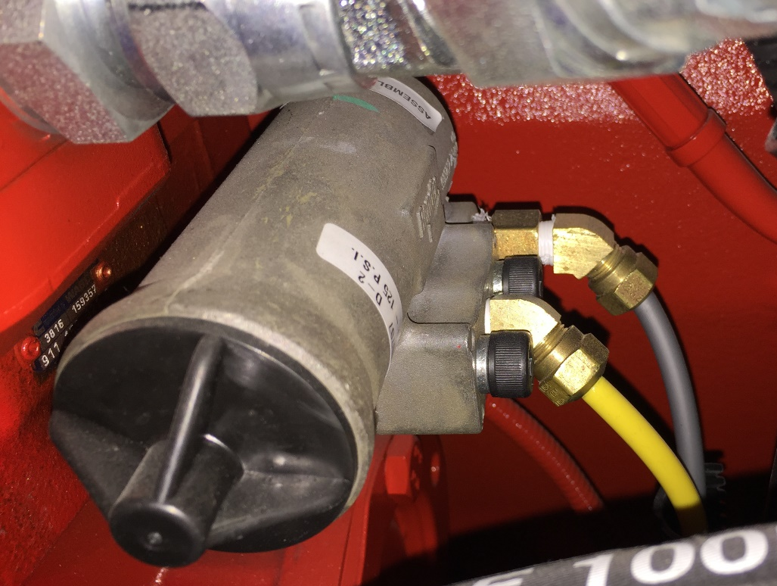
COMPRESSION STYLE AIR FITTINGS
Compression fittings are STANDARD for all air line connections (wherever possible).

Slide 16
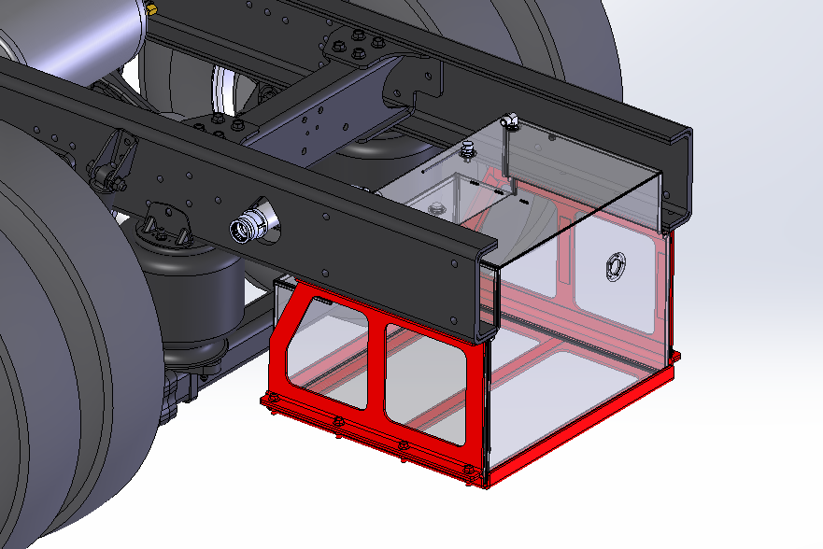
FUEL TANK CRADLE
Fuel tank is supported by a 1/4” thick steel cradle (not with straps).

Slide 17
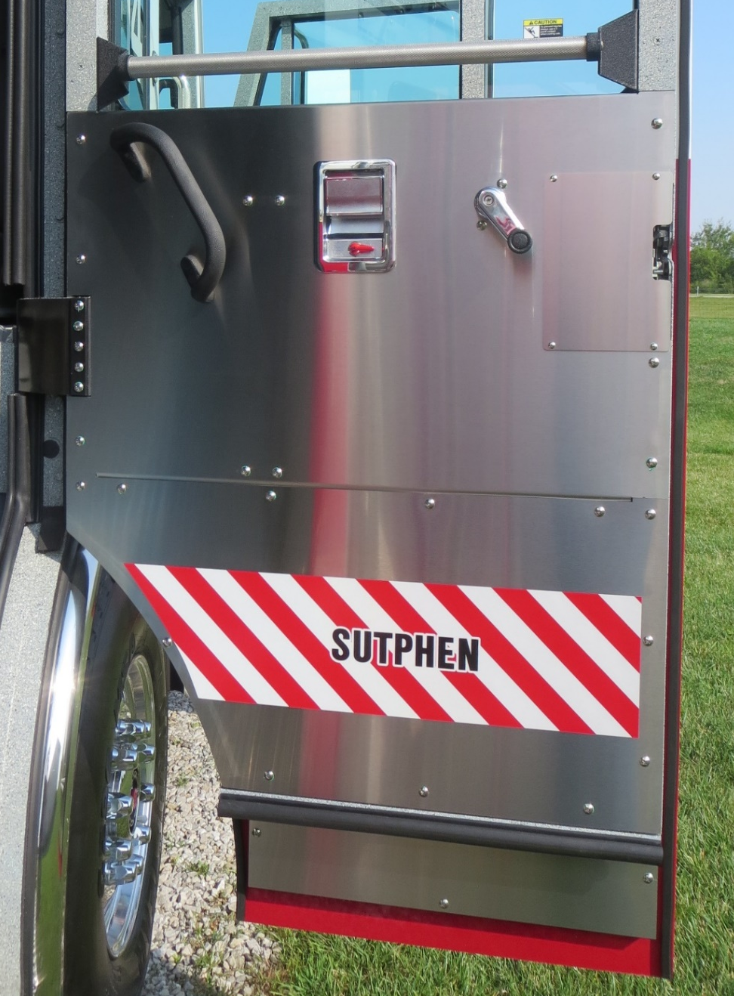
STAINLESS STEEL CAB DOOR PANELS
Full 304 brushed stainless steel cab door panels are STANDARD on all Sutphen custom chassis.
Multi-piece door panels with removable access panel over latch mechanism for easy service without removing the entire door panel.

Slide 18
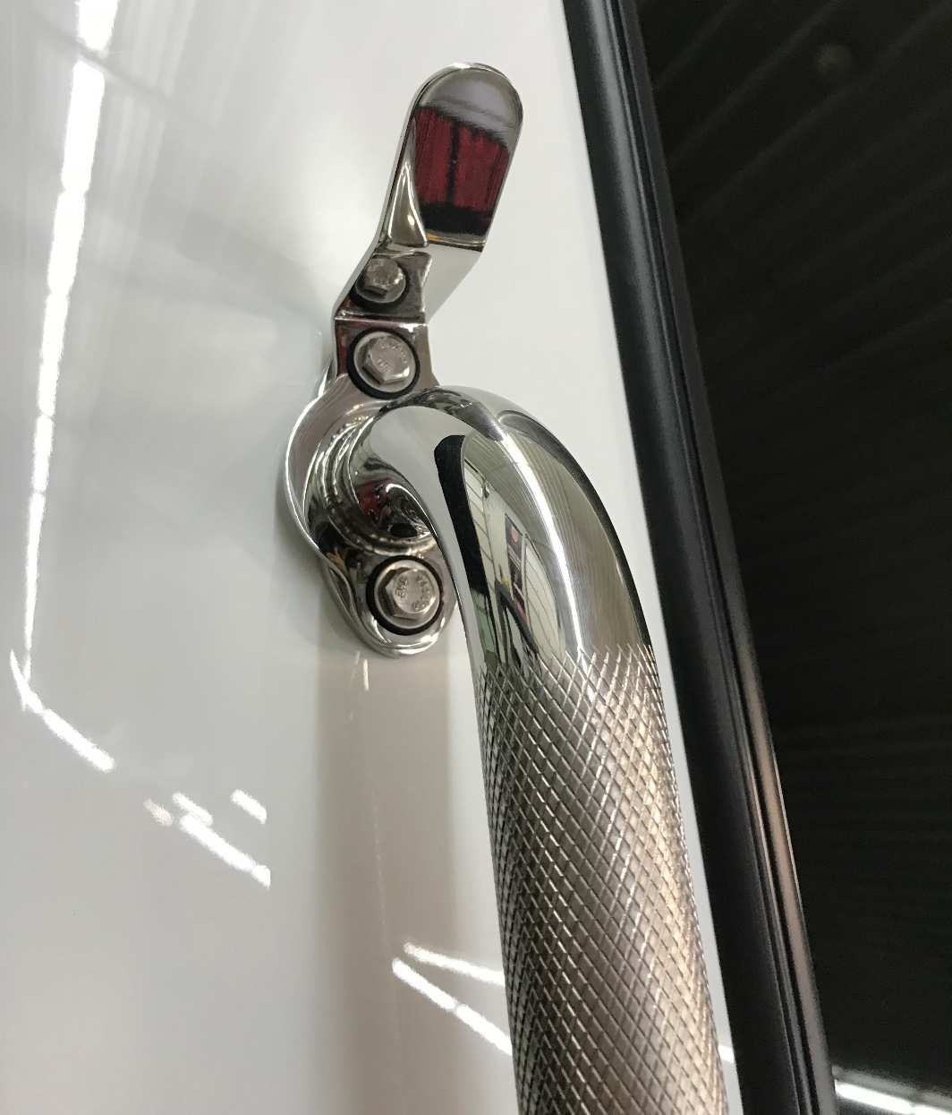
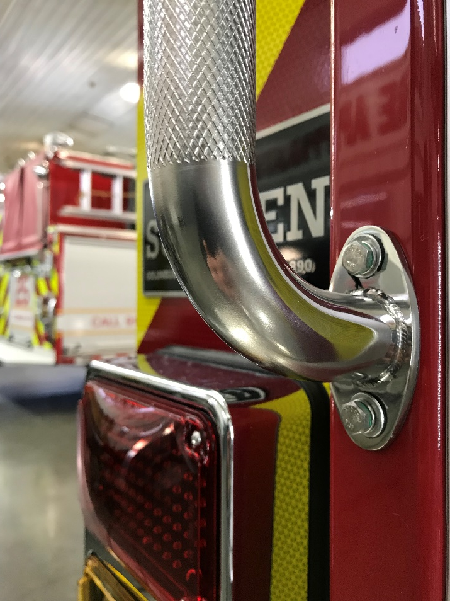
STAINLESS STEEL HANDRAILS
Stainless steel handrails are STANDARD for all exterior locations on all products (coat hook optional).

Slide 19
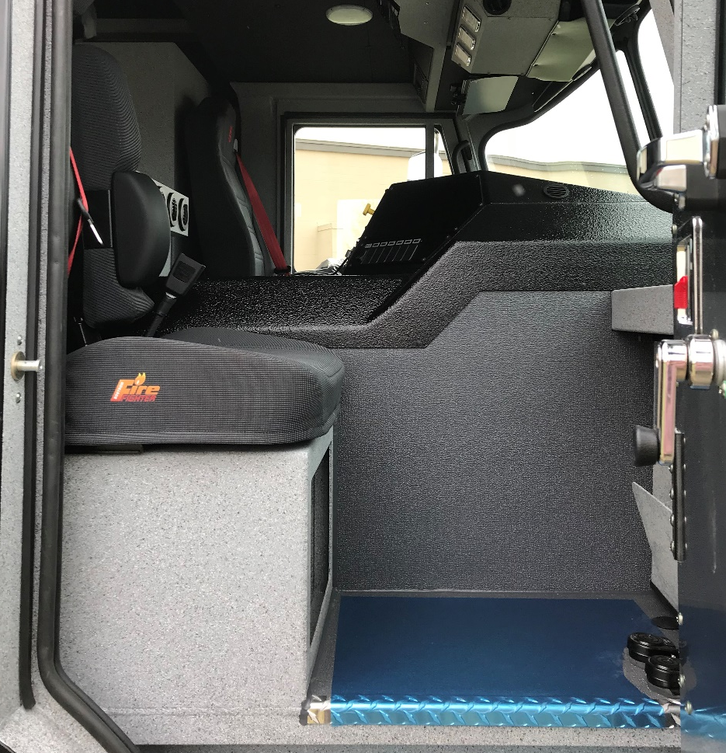
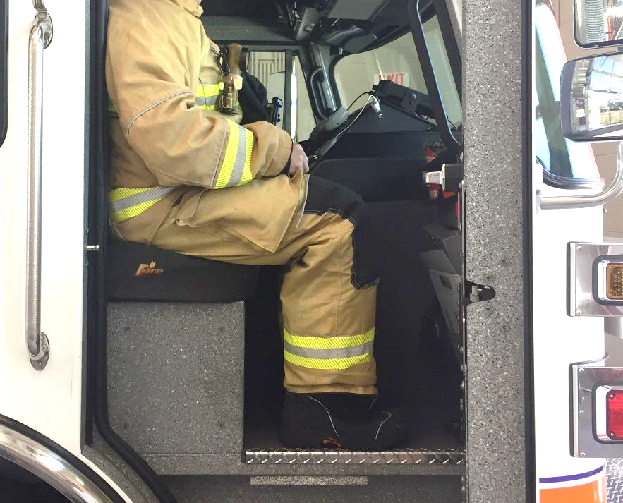
OFFICER’S SPACE
The officer’s seat is located as far rearward as possible to maximize space for the officer and increase driver visibility.

Slide 20
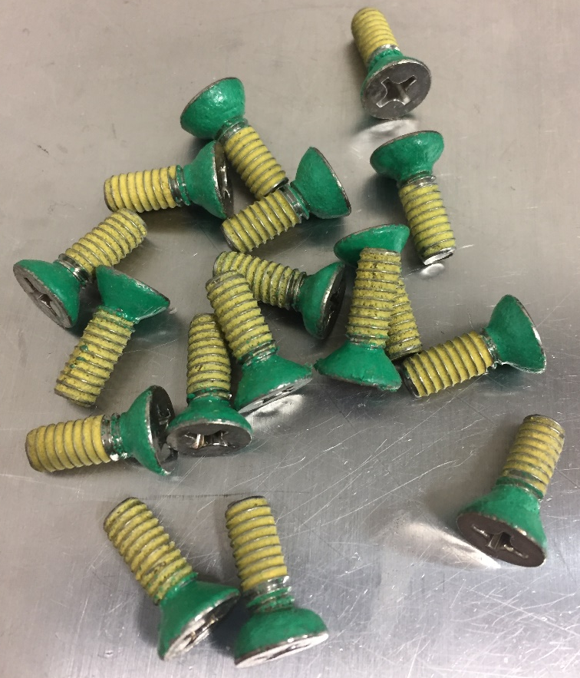
CORROSION PREVENTION
(HARDWARE)
Stainless steel fasteners are pre-coated with Threadlocker and nylon under the heads to minimize corrosion.
This nylon coating acts as a barrier between the fastener head and the metal or painted surface.

Slide 21
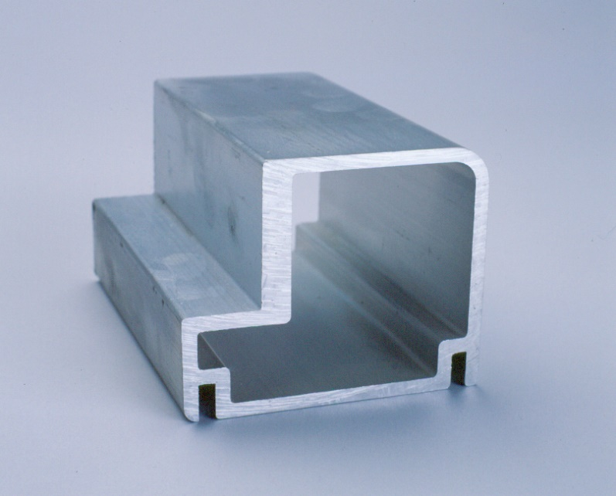
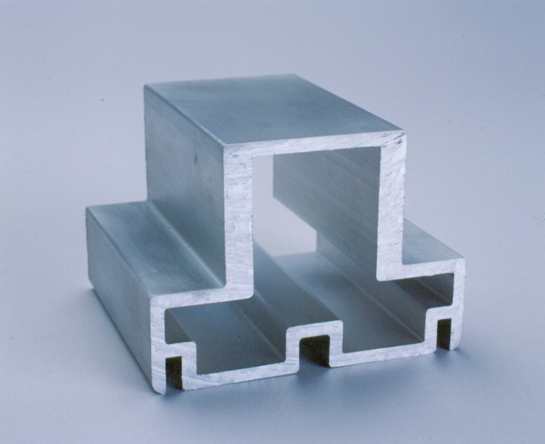
EXTRUDED ALUMINUM PUMPER BODIES
Framework constructed from 6061-T6 custom aluminum extrusions up to 3/8" thick - 3/16" thick 5052-H32 aluminum compartment walls, floors and ceilings
Over 20 standard bodies to chose from or fully customize to your specific needs
BODY CORNER EXTRUSION
UP TO 3/8” THICK WALL
BODY DOOR POST EXTRUSION
UP TO 3/8” THICK WALL

Slide 22
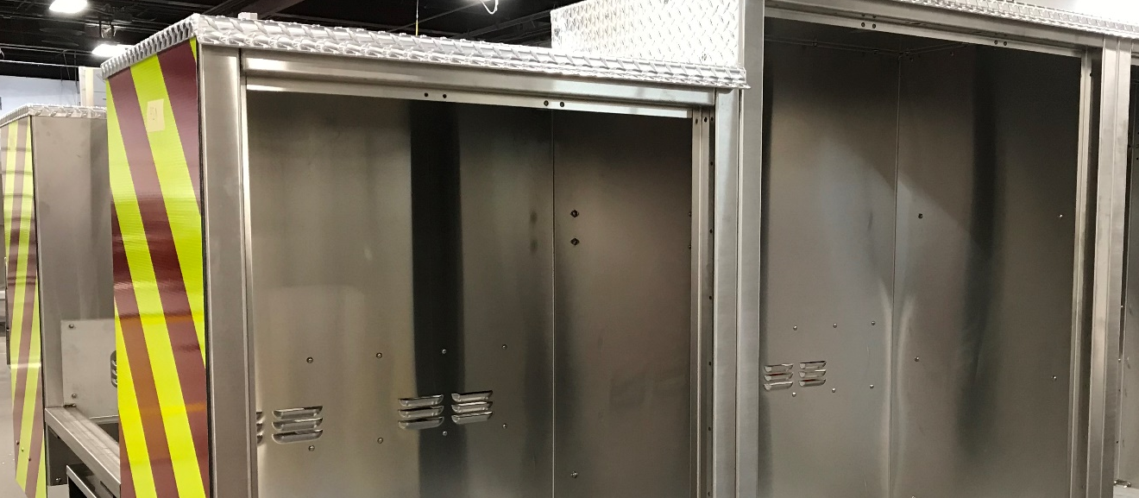
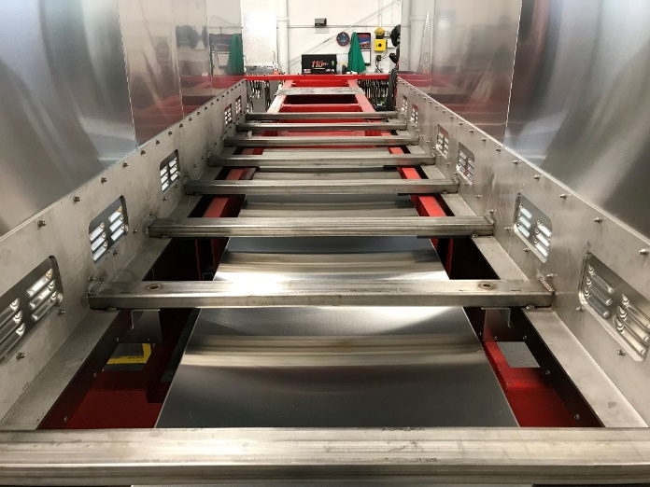
304 STAINLESS STEEL AERIAL BODIES
All aerial apparatus bodies are constructed from 304 14-gauge stainless steel.
Main body support structure is constructed from 304 stainless steel structural components.
Body compartments are bolted together with stainless steel fasteners and secured to the body support structure with stainless steel Huck® fasteners.

Slide 23
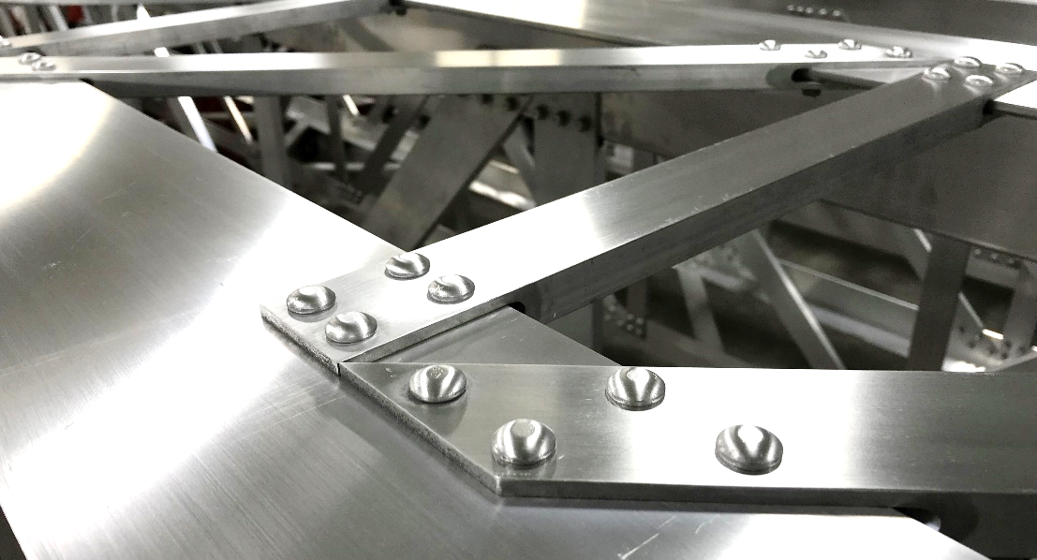
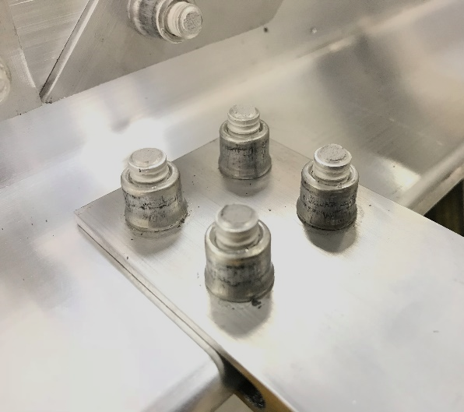
HUCK® LOCKBOLT
FASTENERS (AERIAL)
Used to assemble aerial device instead of welding
Allows for thinner extrusions and overall lighter weight
Can be field replaced for shorter out-of-service time
Huck fasteners do not require torquing and will not work loose (maintenance free)

Slide 24
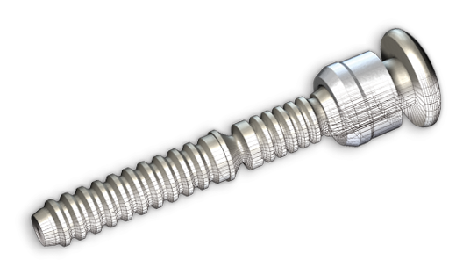
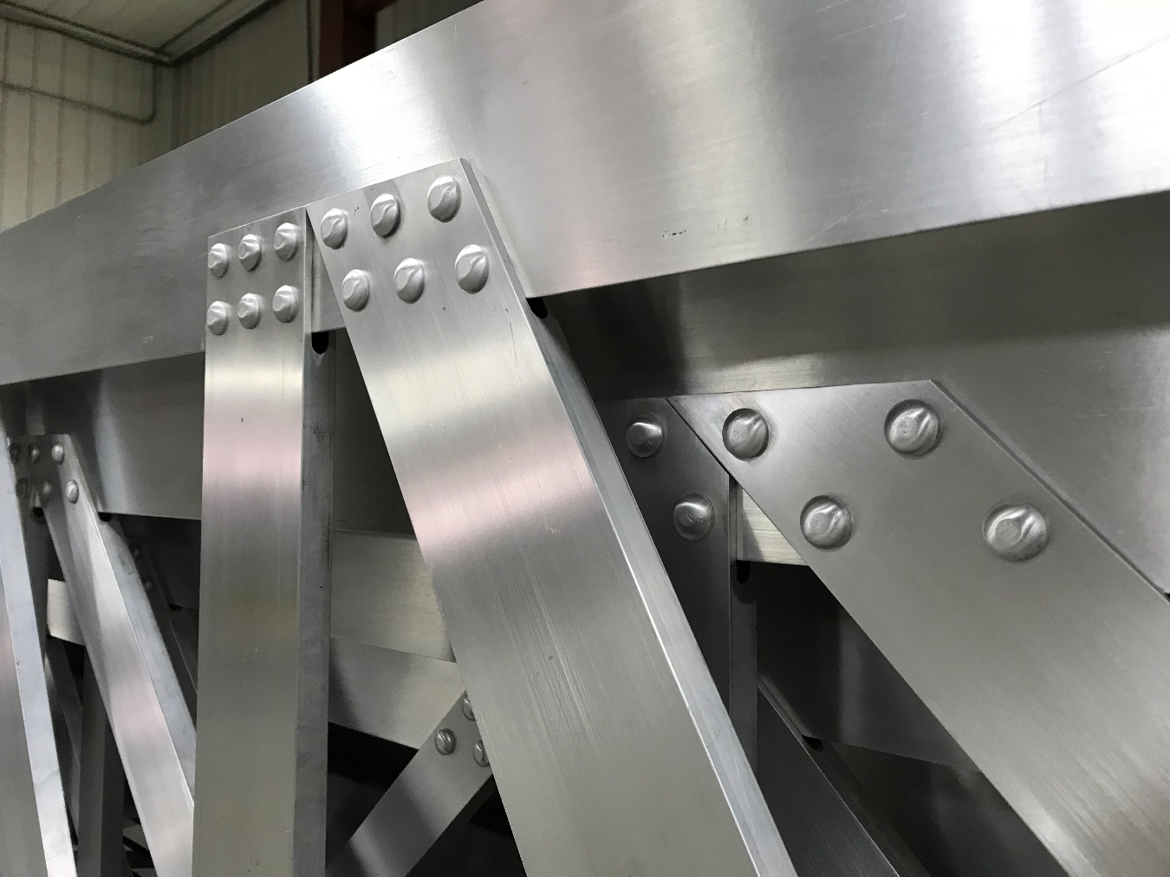
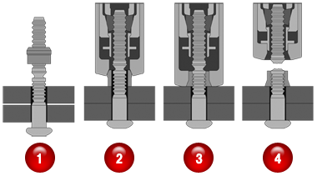
HUCK® LOCKBOLT
FASTENERS (AERIAL)

