Slide 1
Sutphen Corporation
Cooperative Purchasing Programs
10/14/15

Slide 2
COOPERATIVE PURCHASING PROGRAMS
A
Better Way
to
Sell a Fire Truck

Slide 3
COOPERATIVE PURCHASING PROGRAMS
50% – 70% of Sutphen Sales
Full & Open Competition
Sutphen has 9 Pre-Negotiated Contracts
to Simplify Your Sales Process!
Sutphen’s Cooperative Purchasing Contracts . . .
Are YOUR Secret Weapon!

Slide 4
COOPERATIVE PURCHASING
PARTNERS
Florida Sheriff’s Association
General Services Administration (GSA)
HGAC
LaMas
New Jersey
Ohio State Term Schedule
Pennsylvania Costars
National Purchasing Partners (NPP) (Fire Rescue GPO)
Texas BuyBoard

Slide 5
COOPERATIVE PURCHASING
PARTNERS
HGAC
National Purchasing Partners (NPP) (Fire Rescue GPO)
General Services Administration (GSA)

Slide 6
HOW IS A CO-OP ESTABLISHED?
Bid Process
Co-Op Agencies compete the contract
Periodic bid or open bid
Satisfies full and open competitive requirements

Slide 7
HOW IS A CO-OP ESTABLISHED?
Award Process
Single Award Contract
  Full & open competition
  The hard way . . .
Multi-Award Contract
  Meets full and open competition
  Barrier to entry
  The easy way . . .

Slide 8
Sutphen Sales Benefits
Easy & Efficient
Choose the Best Contract for the Fire Department
Pre-negotiated Products, Prices, Contract Language
Full Product Line & Options
Satisfies Full/Open Competitive Requirements

Slide 9
Fire Department Benefits
Easy & Efficient
Satisfies Full/Open Competitive Requirements
Multiple State & Local Contract Options
Full Product Line with Options
SOW Flexibility
Contracts Do Not Preclude Local Clauses

Slide 10
Ohio State Term
Department of
administrative services

Slide 11
Ohio State Term
Dept. of administrative services
State Term Schedule
Contract # 800257
Type: Multiple Award
Terms: 8/17/12 thru 8/31/17
Area: Ohio
Fees: .75%
Catalog: Full Product Line & Published Options

Slide 12
Ohio State Term
Dept. of administrative services
Pricing: Sutphen SQS2 - 15% Discount (Addendum #3)
Purchasing Notes:
Must be a Member
Purchase Order or Contract - reference contract number
Non-Published Options should be on a separate PO

Slide 13
Ohio State Term
Dept. of administrative services
How to Join: http://das.ohio.gov/CooperativePurchasing
▪ Submit a signed resolution
▪ Complete the enrollment form
▪ Submit the appropriate annual fee ($100 - $420)

Slide 14
Ohio State Term
Dept. of administrative services
General Info: http://das.ohio.gov/Divisions/GeneralServices/ProcurementServices/CooperativePurchasing/tabid/304/Default.aspx
FAQ: http://das.ohio.gov/Portals/0/DASDivisions/GeneralServices/Procurment/pdf/CPS%20Brochure3_15.pdf
Sutphen Contract Docs:
http://procure.ohio.gov/proc/viewContractsAwards.asp?contractID=31733

Slide 15
Pennsylvania
Costars

Slide 16
Pennsylvania Costars
Contract # 013-009
Terms: Effective 6/1/10 with annual renewals
Current expiration 6/24/16
Fees: No order fees. Manufacturer pays $1,500 annually.
Area: Pennsylvania
Catalog: Full Product Line, No published options

Slide 17
Pennsylvania Costars
Pricing: Only cost plus contract
Markup not to exceed 10%
Purchasing Notes:
Must be a Member
Contract number on purchase document

Slide 18
Pennsylvania Costars
General Info:
https://www.portal.state.pa.us/portal/server.pt/community/hide-costars/1272
Member Info:
http://www.costars.state.pa.us/Login.aspx
Contract Docs:
http://www.costars.state.pa.us/SearchVendorContract.aspx

Slide 19
Texas association
of school boards
&
buy board program

Slide 20
Texas association of school boards
& buy board
Contract # 491-15
Terms: 9/1/15 thru 8/31/16 (3) one-year options
Fees: $1,500 per Order
Area: National
Catalog: Full Product Line, Published Options
Pricing: Sutphen SQS2 - 15% Discount

Slide 21
Texas association of school boards
& buy board
Purchasing Notes: Must be a Member
Purchase Order is issued from the Buy Board
General Info: https://www.buyboard.com/National.aspx
Member Info: https://www.buyboard.com/BuyBoard/How-to-Join.aspx

Slide 22
Florida sheriffs association

Slide 23
Florida sheriffs association
Current FSA Contractors:
ETR, L.L.C. | Medix Specialty Vehicles
Braun Industries | Osage Industries
Demers Ambulance USA | Pierce Manufacturing
E-ONE | Road Rescue Emergency Vehicles
Excellence Inc. | Rosenbauer
HME, Inc. | Smeal Fire Apparatus
Horton Emergency Vehicles | Sutphen
KME | Toyne, Inc.
KME/ETR (Florida) | Toyne, Inc.
KME/NAFECO (Florida) | Wheeled Coach Industries Inc.
McCoy Miller Emergency Vehicles

Slide 24
Florida sheriffs association
Contract # 15-11-0116
Terms: 2/2/15 thru 3/31/16
Type: Multiple Award
Fees: .75%
Area: National
Catalog: Full Vehicle Product Line, no Published Options

Slide 25
Florida sheriffs association
Pricing: Configured Vehicles, SQS2 Based Net Pricing
Additional options from Base Model are summarized on bid page
Purchasing Notes:
Contract Number on Purchase Document

Slide 26
Florida sheriffs association
General Info:
http://www.flsheriffs.org/about_us/
Bid Award Docs:
http://www.flsheriffs.org/purchasing_programs/cooperative-fleet/fire-rescue-ems/

Slide 27
New jersey
State contract

Slide 28
New jersey state contract
Contract # A86453
Terms: 5/15/14 thru 5/15/19
Fees: N/A
Area: New Jersey
Catalog: Full Product Line & Options
Notes: Piggybacks GSA Contract

Slide 29
New jersey state contract
General Info:
http://www.state.nj.us/treasury/purchase/coop_agency.shtml
FAQ:
http://www.state.nj.us/treasury/purchase/coop_faq.shtml
Contract Docs:
http://www.state.nj.us/treasury/purchase/noa/contracts/g8035_13-r-22923.shtml

Slide 30
Houston-galveston
area council
Hgac buy

Slide 31
Hgac buy
Over 30 years old
Over 7,000 local governments
49 States
Interlocal Cooperative Contract

Slide 32
Hgac buy
Users Include:
  Municipalities, Cities, Counties & State Agencies
  Volunteer Fire Department & Rural Fire Prevention Districts
  Hospitals & Hospital Districts
  Emergency Communication & Medical Districts
  Courts & Judicial Districts
  Schools, School Districts, Colleges, Universities
  Special Districts & Authorities: Airport, Law, Port, Toll, Utility
  Certain Not-for-Profit 510c3 Corporations

Slide 33
Hgac buy
Current HGAC Contractors:
Blanchat Manufacturing | Rosenbauer Minnesota LLC | Smeal
Rosenbauer South Dakota LLC | KME | Super Vac
Crimson | Marion | Sutphen Corporation
Custom Fire | Metro Fire Apparatus Specialists, Inc. | Sunbelt Fire, Inc.
Daco | Nevada Pacific Fire & Safety Inc. | Toyne
Danko | OshKosh | U. S. Tanker
Darley | Pierce | Emergency Vehicles (EVI)
Deep South | Rosenbauer | Weis Fire & Safety Equipment Co.
Emergency One (E-One) | Seagrave
Ferrara | Siddons-Martin

Slide 34
Hgac buy
Contract # 12-15
Terms: 12/1/13 thru 11/30/15 (current)
Terms: 12/1/15 thru 11/30/17 (pending award)
Fees: $2,000 per Order
Area: National
Catalog: Full Product Line & Published Options

Slide 35
Hgac buy
Pricing: Sutphen SQS2 – 15% Discount
Purchasing Notes:
Must be a Member
Any options must be detailed on HGAC Worksheet
Non-Published options not to exceed 25%
Purchase Order (or Contract with cover letter)

Slide 36
Hgac buy
General Info:
https://www.hgacbuy.org
FAQ:
https://www.hgacbuy.org/program/faq/default.aspx
Sutphen Docs:
https://www.hgacbuy.org/products/general/fire-fs12-13.aspx#23

Slide 37
Hgac buy
PROCESS FOR SELLING ON HGAC:
1) Review List of End Users
https://www.hgacbuy.org/program/endusers/default.aspx
2) If not already a member, print ILC Member Form:
https://www.hgacbuy.org/program/interlocal/default.aspx
Customer must be complete and sign. Mail two original copies to HGAC; one executed copy will be returned to customer. May be faxed to: 715-993-4548.

Slide 38
Hgac buy
Determine Published Model
http://hgacbuy.org/products/general/fire-fs12-13.aspx
Sales Representative will configure a quote based on Fire Department’s
needs. Include $2,000 fee. Send Final Configuration to SAE
4) Prepare HGAC Worksheet: Base model, and itemized list
of all Adds & Deletes for Published & Non-Published options.
DDC03 Base Model CL
HGAC Published Options
Sample Worksheet Completed
5) HGAC Worksheet may be faxed to 713-993-4548 for Pricing Verification.
HGAC will send Pricing Verification approval to the Customer and Sutphen.

Slide 39
Hgac buy
Receipt of Purchase Order
If a contract is desired in lieu of a PO; must include a cover letter
on City or Fire Department’s letterhead.
HGAC Purchase Letter
7) Sutphen Contract Admin. will fax Final Documents to HGAC. Includes: - Completed HGAC Worksheet (if not already submitted)
- Purchase Order or Contract / Purchase Letter
- Special Instructions
8) HGAC will send Order Confirmation to Customer and Sutphen.

Slide 40
Louisiana
Lamas

Slide 41
lAmAS
Terms: 7/31/12 thru 7/30/16
Fees: N/A
Area: Louisiana
Catalog: Full Product Line & Options
Notes: Tag-on to GSA Contract

Slide 42
lAmAS
General Info:
http://www.doa.louisiana.gov/osp/about_index.htm
Contract Docs: http://www.doa.louisiana.gov/osp/contracts/lamas/firetrucks/sutphen/sutphenftk.htm

Slide 43
NATIONAL PURCHASING
PARTNERS (NPP) / fire rescue gpo
In Conjunction with
The State of Oregon
Western Fire Chiefs Association
(Fire Advisory Council)
And
International Association of Fire Chiefs

Slide 44
NPP / Fire Rescue GPO
RFP #1420
Terms: 2 Year Contract. May extend up to 3 additional 1-year agreements.
Fees: $2,000 per Order (portion shared with IAFC)
Area: National
Catalog: Full Product Line, Published Base Models, & Published Options

Slide 45
NPP / Fire Rescue GPO
RFP #1420
Pricing: Sutphen SQS2 – 15% Discount
Notes: Must be a Member through Fire Rescue GPO

Slide 46
NPP / Fire Rescue GPO
NPPGov Fire Apparatus Contract Holders:
EJ Metals Inc.
HME Inc.
Pierce Manufacturing Inc.
Sutphen Corp.
Toyne, Inc.

Slide 47
NPP / Fire Rescue GPO
General Info: NPP
https://www.nppgov.com/
General Info: Fire Rescue GPO
https://www.nppgov.com/firerescue-gpo/
Sutphen Page:
https://www.nppgov.com/vendors/sutphen/

Slide 48
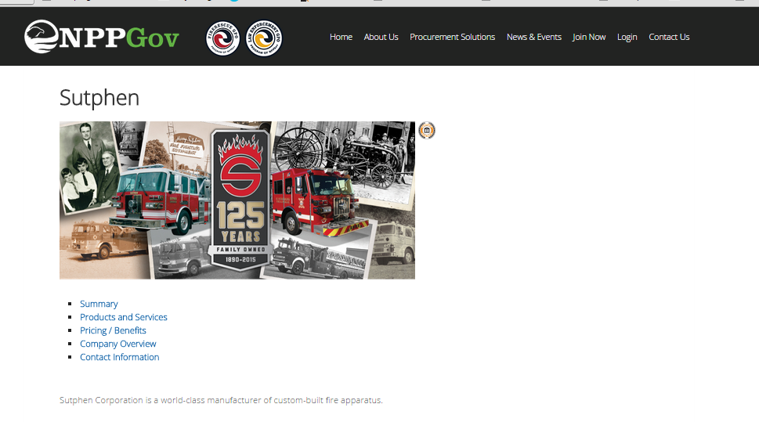
https://www.nppgov.com/vendors/sutphen/

Slide 49
NPP / Fire Rescue GPO
PROCESS FOR SELLING via NPP/FIRE RESCUE GPO:
Join Fire Rescue GPO
https://members.nppgov.com/myNPP/firerescue-gpo/
    Complete Inter-Government Agreement
    Easy, One time only
    Answer six questions on-line
    Keep signed file document copy
    Membership within 2 Business Days
(Member Listing not currently available on line)

Slide 50
NPP / Fire Rescue GPO
2) Full Product Line & Published Options
https://www.nppgov.com/vendors/sutphen/
Member Login required to view pricing
Sales Representative configures quote
Include $2,000 Fee.
Purchase document on letterhead with member number to Sutphen

Slide 51
NPP / Fire Rescue GPO
IAFC Published Article:
“Fire Rescue GPO Adds New Fire Apparatus Contracts”
http://www.iafc.org/Media/articlePR.cfm?ItemNumber=8584&utm_source=Informz&utm_medium=Email&utm_campaign=IAFC+Homepage

Slide 52
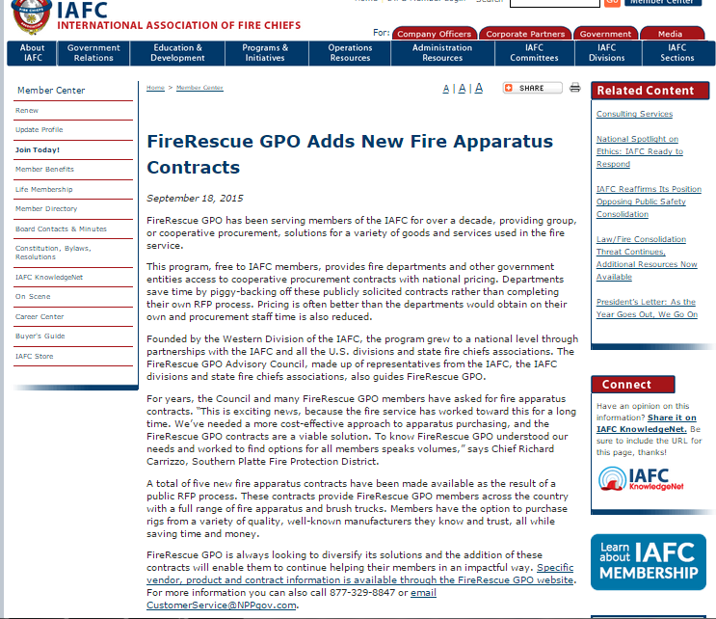

Slide 53
NPP / Fire Rescue GPO
Western Fire Chiefs Association
Published New Contract Announcement for Sutphen
http://us9.campaign-archive1.com/?u=255330792122b18c3e0eb1127&id=31968ddae6&e=ede4819386

Slide 54
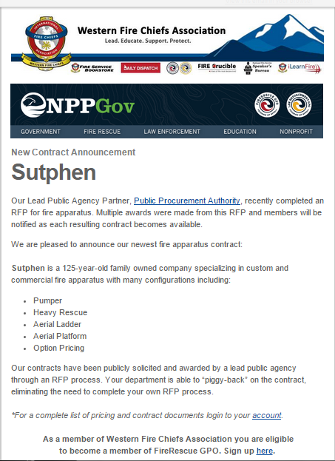
NPP / Fire Rescue GPO

Slide 55
General Services Administration
(GSA)

Slide 56
General Services Administration
Schedule 23V - Fire Apparatus
Contract #GS30F0012Y
Type: Federal Contract, Multiple Award
Terms: Valid 1/5/12 thru 1/4/17 with 3 Five Year Options
Catalog: Full Product Line & Options
Area: National Federal, State/Local Disaster Preparedness

Slide 57
General Services Administration
Pricing: GSA Published List Price, Less 3% (per SQS1)
Fees: Approximately 0.75%
Calculate: List Price x 0.97 / .9925 Current Pricing
Proposed Pricing: SQS2 List x .85 / .9925 Project beginning 11/1/15

Slide 58
General Services Administration
State & Local Governments use GSA under:
    Disaster Preparedness
    Public Health Emergency
    1122 Program (Mobile Command & Control Only)
GSA’s Disaster Preparedness Program allows state and local governments to buy from GSA Schedules to facilitate recovery from or preparation for:
    Terrorism
    Chemical Attack
    Radiological Attack
    Major Weather Event
    Nuclear Attack
    Biological Attack or Biohazard

Slide 59
General Services Administration
Requirements for Order: Must be on company letterhead or PO and include this quote:
“This order is placed under GSA Schedule GS30F0012Y under the authority of the GSA Disaster Purchasing Program. The products or services purchased will be used in preparation or response to disasters or recovery from major disaster declared by the President, or recovery from terrorism or nuclear, biological, chemical, or radiological, or EMP attack.”

Slide 60
General Services Administration
Additional Resources
Schedule 23V: http://www.gsa.gov/portal/content/104238
GSA Advantage: https://www.gsaadvantage.gov
Search Term: GS30F0012Y

Slide 61
Do CO-OPS REALLY WORK?
You Bet They Do!
They are already working for you…
But they can work harder.

Slide 62
Sutphen Corporation
Contact information
Sutphen Corporation
6450 Eiterman Rd.
Dublin, OH 43016
800-726-7030
www.Sutphen.com
Ken Creese Ken.Creese@SutphenCorp.com
Donna Newell Donna.Newell@SutphenCorp.com
Judi Sutphen Judi.Sutphen@SutphenCorp.com

Slide 63
The
Contract Sheriff
Contact information
B2G Partners
W333 S191 Glen Oaks Drive
Delafield, WI 53018
Office: 262-303-4990
Cell: 262-366-6079 (and text)
www.b2g-partners.com
Lise von Zwisler b2gmke@wi.rr.com

